Slide 1
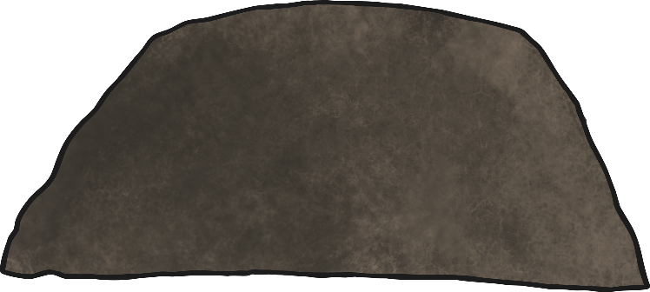
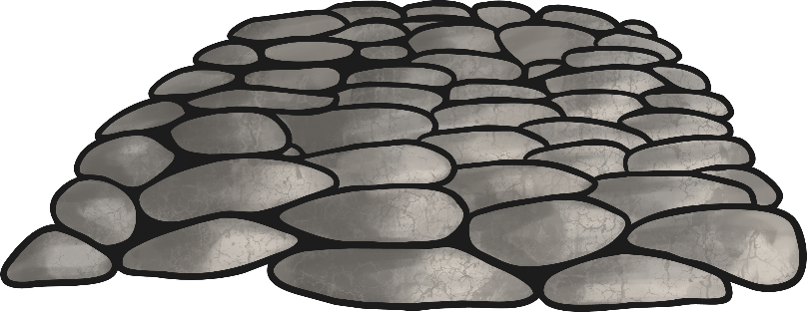
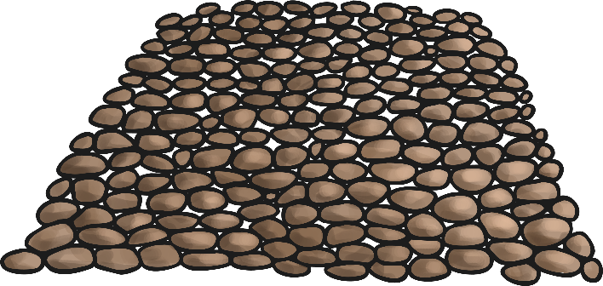
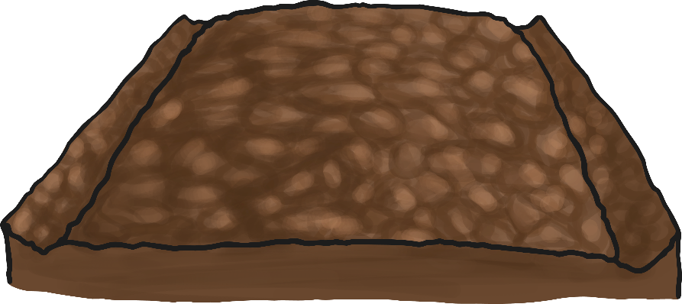
Roman Road Cross Section
Can you name the parts of this Roman road?
large stones
Paving stones cut to fit
gravel
broken stones/pebbles/sand/cement

Slide 2




How did they build the roads?
To build a Roman road we would need to:

