Slide 1
Aim
Interpret negative numbers in context, count forwards and backwards with positive and negative whole numbers, including through zero.

Slide 2

Negative Numbers
Diving
Where should the numbers be placed on the number line?
-4
1
-2
-8
-3
-5
0

Slide 3
Negative Numbers
Diving
Where should the numbers be placed on the number line?
-2
-6
-10
1
3
0

Slide 4
Negative Numbers
Diving
This number line has no labelled intervals.
Where could the numbers be positioned?
-5
-1
-7
0
4
This is one possible answer.

Slide 5
Negative Numbers
Diving
Here is a number line without intervals.
Estimate where on the number line each number should
go and then write it in the correct position.
-2
5
-5
-9
-10
-5
0
10
Pick one of the numbers and explain
how you decided where to position it.
For example, I picked -5. I knew where to position it
because it is halfway between 0 and -10.

Slide 6

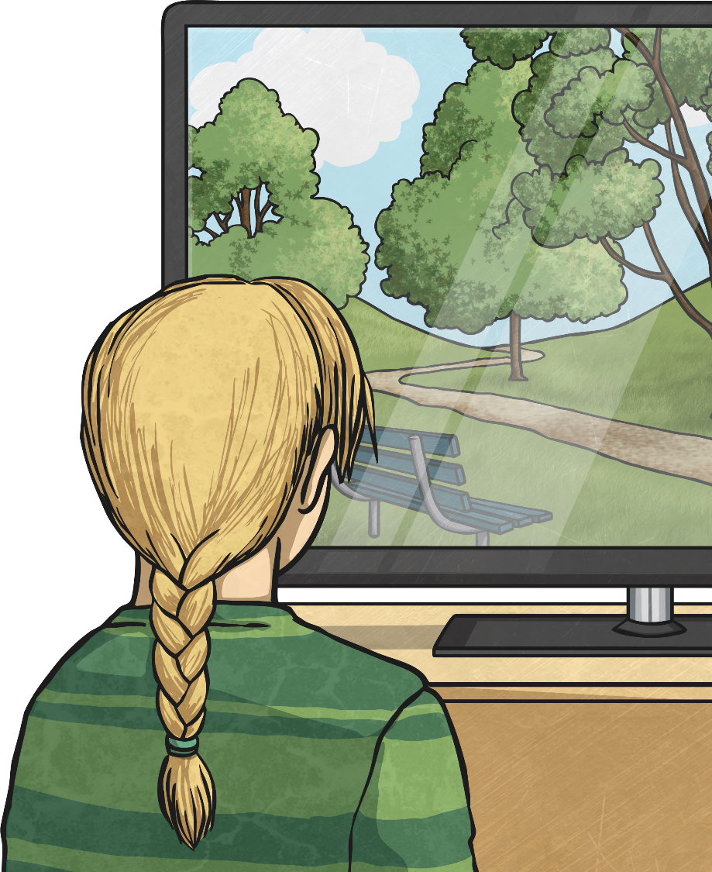
Negative Numbers
Deeper
Beccie is watching the weather forecast.
In Antarctica, it is -12°C and in Sweden,
it is -3°C.
Beccie says it is warmer in Antarctica
because 12 is greater than 3.
Why is Beccie incorrect?
Beccie is incorrect because, with negative numbers, as you move in steps further
away from zero, the digits increase
but, in fact, the number is getting
smaller. -12 is further away from
zero than -3 and is therefore colder
in terms of temperature.

Slide 7
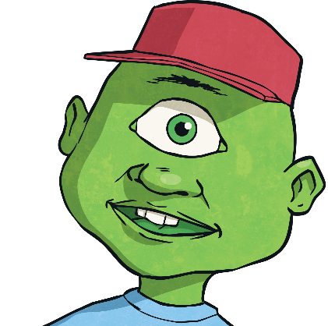
Negative Numbers
Deeper
This alien recorded the temperature on their home planet
at the same time every day for a week.
Day | Monday | Tuesday | Wednesday | Thursday | Friday | Saturday | Sunday
Temperature | -13°C | -4°C | 2°C | -10°C | -5°C | 1°C | -19°C
Are these statements true or false? Prove it!
1
2
3
1
2
3
Monday was 6°C
colder than Sunday.
Wednesday was
the warmest day.
Friday was
warmer than Tuesday.
False
True
False
The difference between
-13 and -19 is 6 but it was 6°C warmer.
2°C is the warmest temperature.
-5 is less than -4
and therefore Friday was 1°C colder than Tuesday.

Slide 8

Negative Numbers
Deepest
Here is a number line. Each arrow is the position of a number.
C is a negative number between -4 and -10.
B is 5 less than C.
A
B
C
What could the values of B and C be? Find all possibilities.
A is 12 less than B. What could A be? Find all possibilities.
If C = -5, B = -10.
If C = -6, B = -11.
If C = -7, B = -12.
If C = -8, B = -13.
If C = -9, B = -14.
Where B= -10, A = -22.
Where B= -11, A = -23.
Where B= -12, A = -24.
Where B= -13, A = -25.
Where B= -14, A = -26.

Slide 9
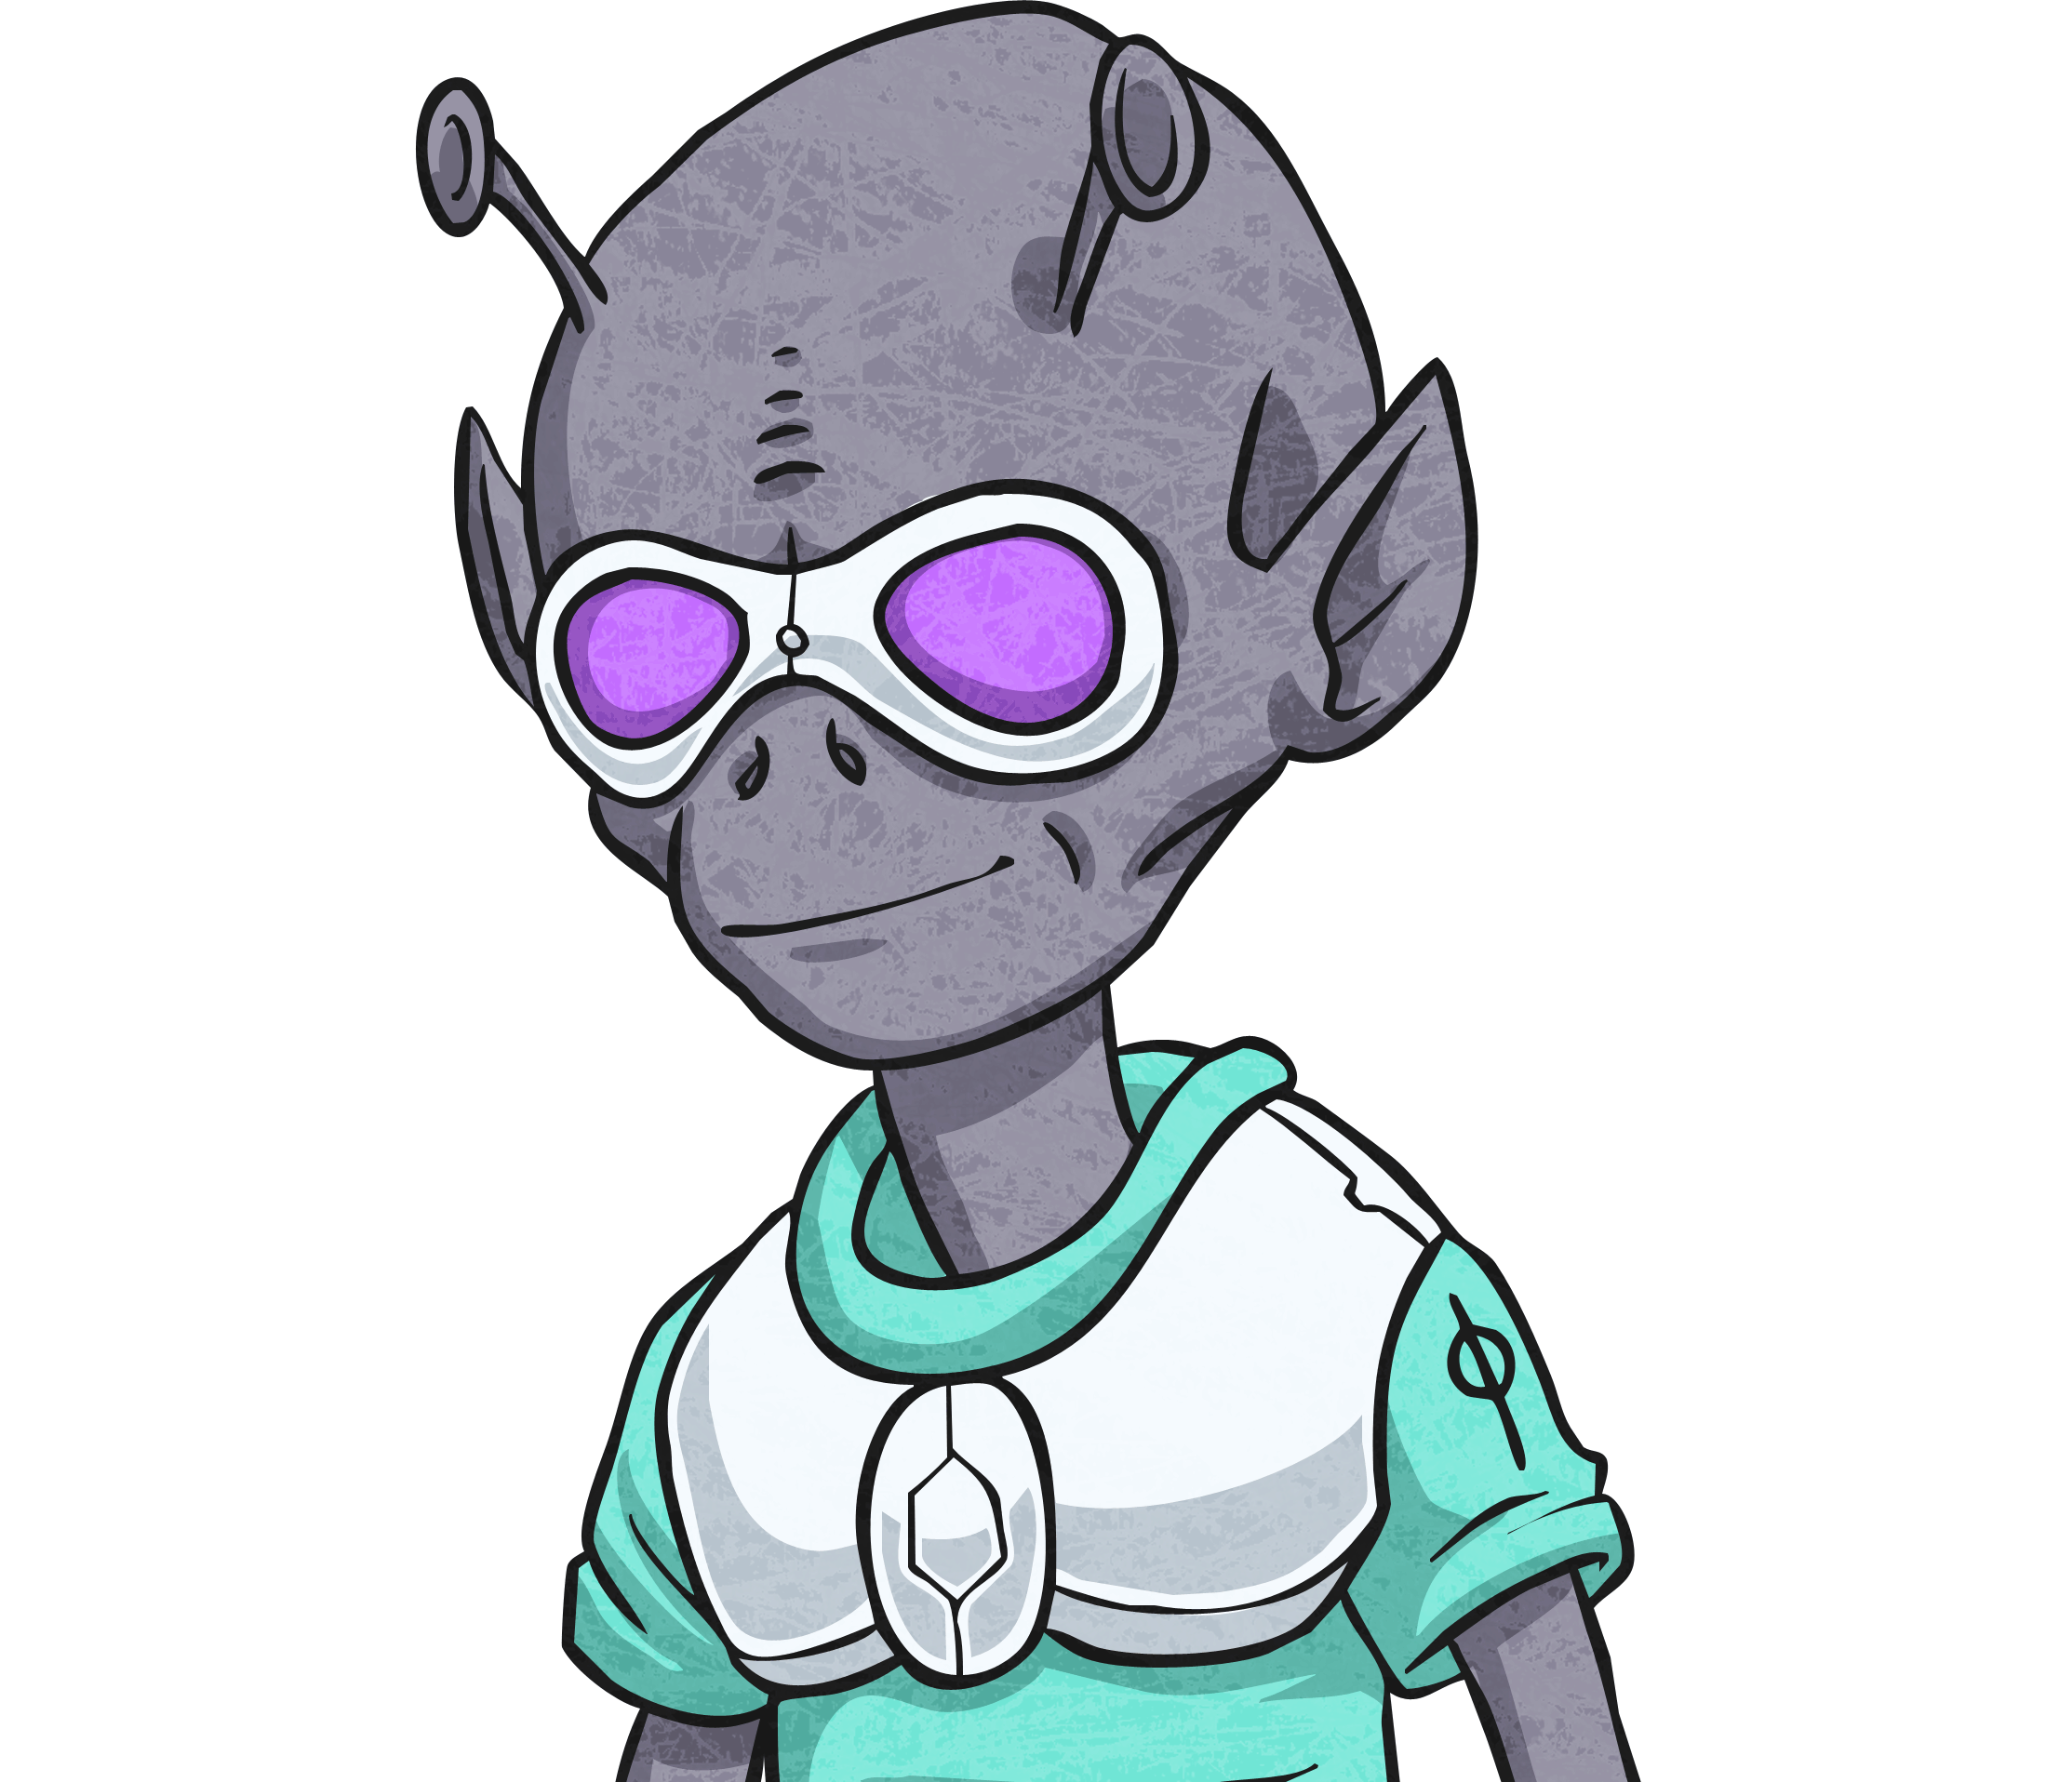

Negative Numbers
Deepest
Each alien has started from the number on their T-shirt and worked their way up the maze to the finish line.
Can you find each alien’s correct route? You can move horizontally, vertically or diagonally.
Finish
-27 | -28 | -22 | -21 | -28 | -31 | -31 | -29
-24 | -19 | -19 | -21 | -23 | -12 | -28 | -25
-16 | -20 | -17 | -13 | -17 | -23 | -22 | -8
-13 | -16 | -12 | -15 | -4 | -16 | -4 | -16
-15 | -10 | -17 | -8 | -13 | 0 | -13 | -10
-2 | -7 | -7 | 8 | -11 | -9 | 4 | -8
-4 | -3 | -9 | -5 | -7 | 8 | -6 | -6
-1 | 15 | -6 | -3 | 12 | -15 | -4 | 7
Start
Look for numbers counting backwards
in steps of 4.
-28
-22
-24
-19
-16
-20
12
-13
-16
-12
-4
-10
-8
0
-7
4
Look for numbers counting backwards in steps of 3.
-4
8
-1
12
-1

Slide 10
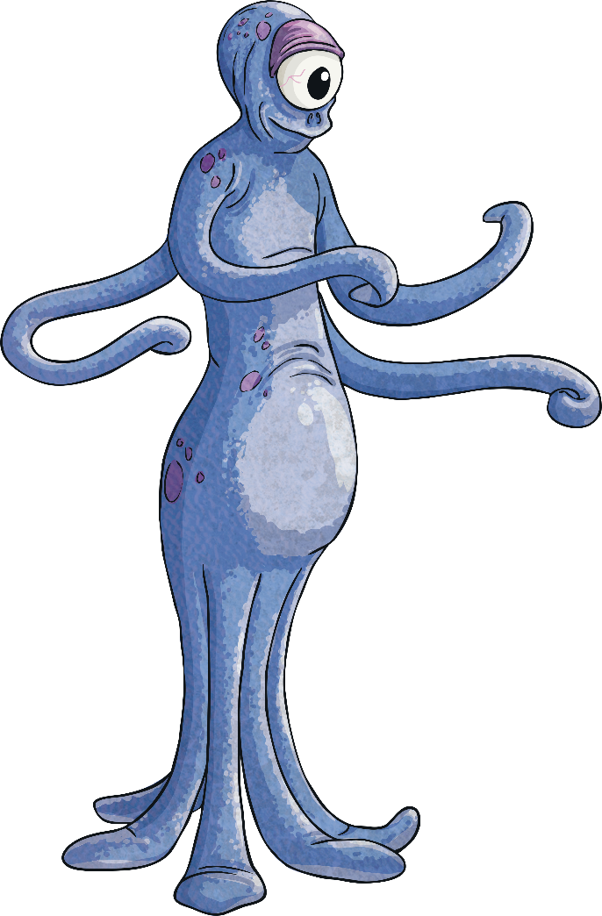
Negative Numbers
Deepest
This sneaky little alien has hidden another route but he won’t reveal the
counting instruction.
Can you find another route from one of the starting numbers to a finish number, counting backwards in the same step each time and reveal the counting instruction?
Finish
-27 | -28 | -22 | -21 | -28 | -31 | -31 | -29
-24 | -19 | -19 | -21 | -23 | -12 | -28 | -25
-16 | -20 | -17 | -13 | -17 | -23 | -22 | -8
-13 | -16 | -12 | -15 | -4 | -16 | -4 | -16
-15 | -10 | -17 | -8 | -13 | 0 | -13 | -10
-2 | -7 | -7 | 8 | -11 | -9 | 4 | -8
-4 | -3 | -9 | -5 | -7 | 8 | -6 | -6
-1 | 15 | -6 | -3 | 12 | -15 | -4 | 7
Start
I counted backwards in steps of 2.
-28
-22
-21
-24
-19
-19
-16
-20
-17
-13
-16
-12
-15
-4
-10
-8
-13
0
-3
-7
-11
-9
4
-4
-5
-7
8
-1
-3
12

Slide 11


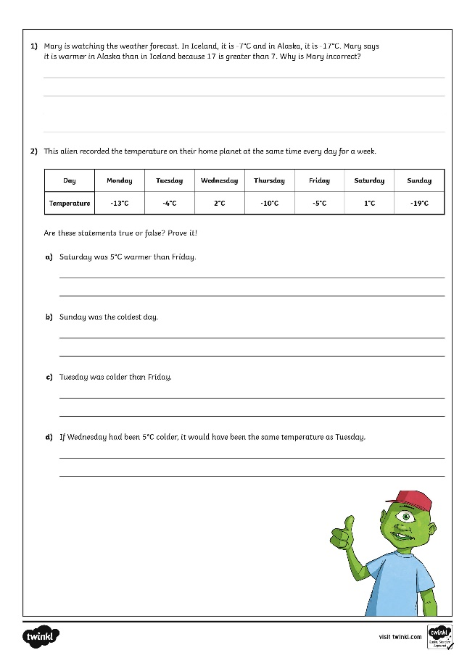
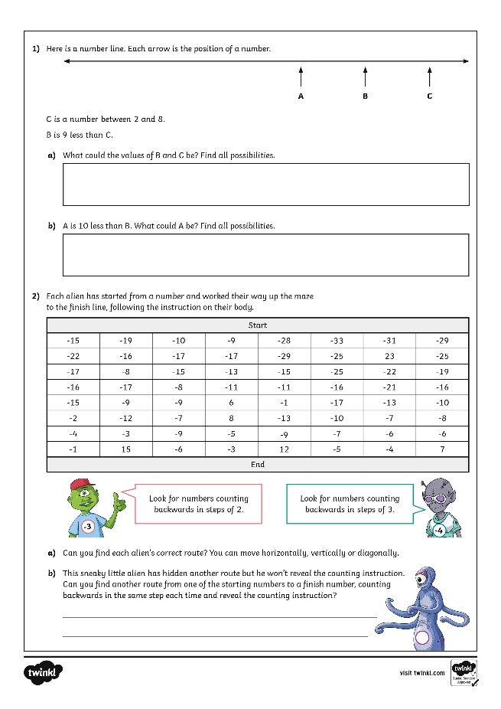
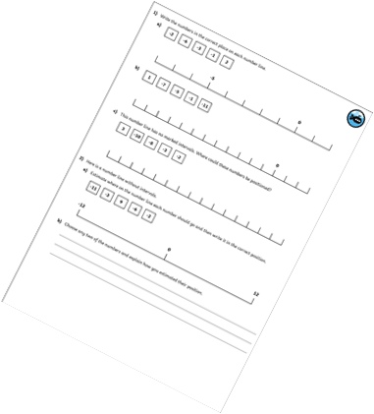
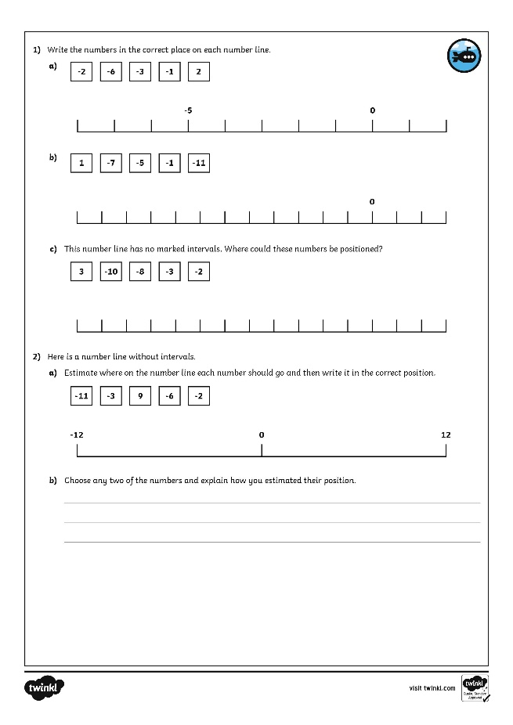
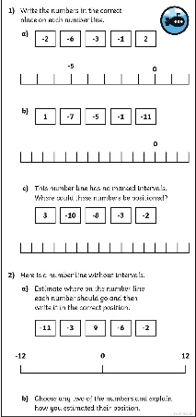
Negative Numbers
Dive in by completing your own activity!

