Slide 1



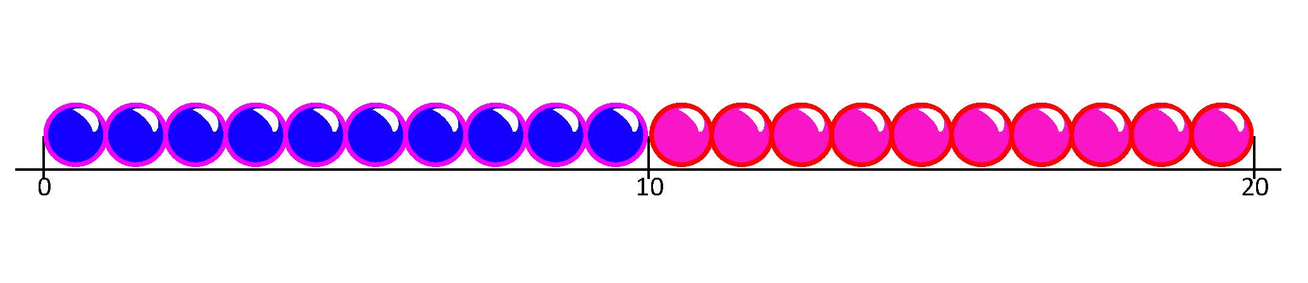
Multiply using arrays and beaded lines.
What can you see?
How many rows?
How many in each row?
How many altogether?
What number sentence could we write?
What can you see now?
How many 3s are in 15? What number sentence can we write?
3 lots of 5, or 3 times 5.
How many lots of 5 are in 15?
5 lots of 3, or 5 times 3.
How many lots of 3 are in 15?
3 × 5 and 5 × 3
have the same answer!
5 × 3 = 15
3 × 5 = 15
15

Slide 2
Multiply using arrays and beaded lines.
2 rows of 8.
What multiplication can we write?
What multiplication can we write now?
We still have 16 counters!
Let’s check 2 hops of 8,
then 4 hops of 4
on the number line…
2 × 8 = 16
4 × 4 = 16
16
16

Slide 3
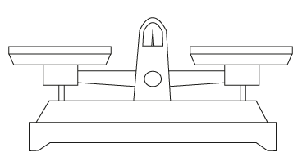
Multiply using arrays and beaded lines.
The equals sign (=) is like a balance!
The number sentences on each side have the same answer.
2 × 8 = 4 × 4
2 × 8
4 × 4

Slide 4
Multiply using arrays and beaded lines.
What missing number would make this balance?
6 × 5 = 10 × 3
6 × 5 = 10 × ?
6 × 5
10 × ?

