Slide 1
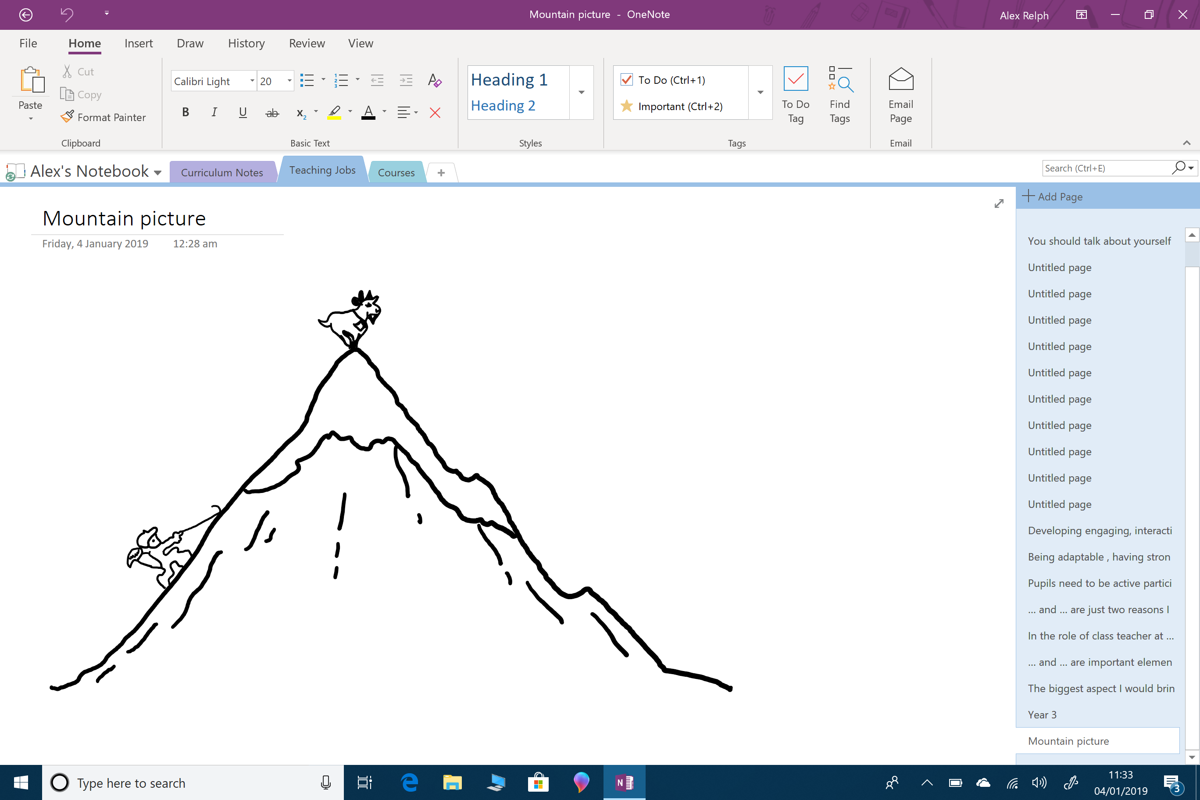
Problem_______________________________________________________________________________________ ______________________________________________________________________________________________________________________________________________________________________________________________________________________________________________________________________________________________________________________________________________________________________________________________________________________________________________________________________________________
Build Up___________________________ ________________________________________________________________________________________________________________________________________
Resolution_________________________ ________________________________________________________________________________________________________________________________________
Intro________________________ ________________________________________________________________________________________________________________
Conclusion___________________ ________________________________________________________________________________________________________________

Slide 2
Problem
The conflict or climax in the story (most interesting part of the story),
What goes wrong?
How do the characters react?
How do the characters feel?
Build Up
Find out more about the characters,
Add details about the setting,
Clues that lead up to the problem (high point) in the story
Resolution
How do the characters solve the problem?,
Do the character go back to same place they started or do they end up somewhere new?
Intro
Interesting story opener,
Introduce main character,
Where is the story set?
Conclusion
How does the story end?
How have your characters changed?
What have they learnt?
Happily ever after or cliff hanger?

Slide 3
Objective : To plan an outline for my story using a story mountain. Who is the main character in my story? What are they like? What is the story about? What am I going to include that will challenge myself? | Objective : To plan an outline for my story using a story mountain. Who is the main character in my story? What are they like? What is the story about? What am I going to include that will challenge myself?
My Story Mountain
My Story Mountain

Slide 4
Problem
Build Up
Resolution
Intro
Conclusion

Slide 5
Problem_______________________________________________________________________________________ ______________________________________________________________________________________________________________________________________________________________________________________________________________________________________________________________________________________________________________________________________________________________________________________________________________________________________________________________________________________
Intro________________________ ________________________________________________________________________________________________________________________________________________________________________________________________________________________________________________________________________________________________________________________________________________
Conclusion___________________ ________________________________________________________________________________________________________________________________________________________________________________________________________________________________________________________________________________________________________________________________________________

