Slide 2
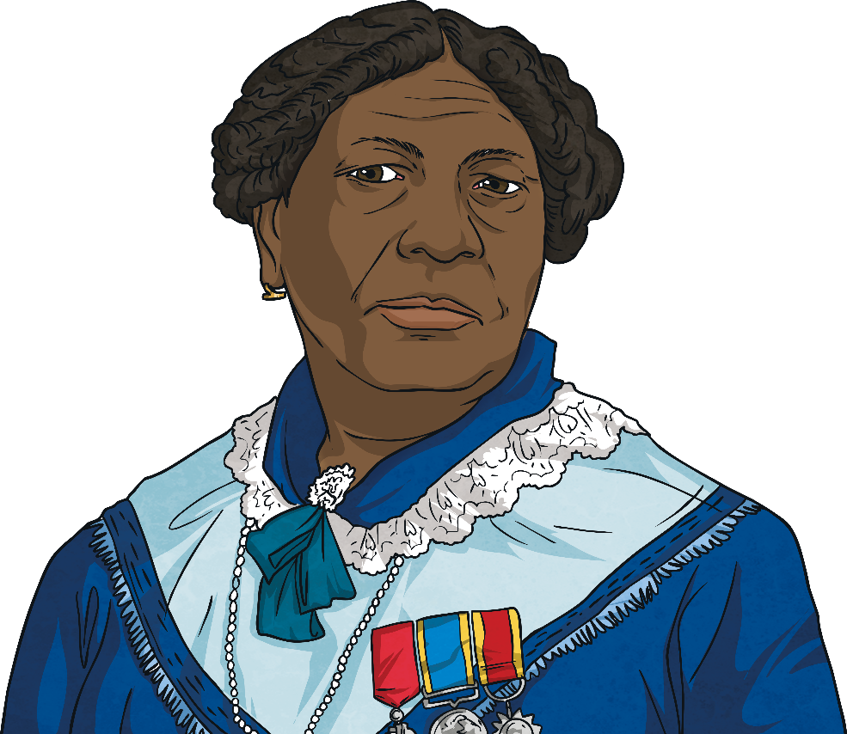
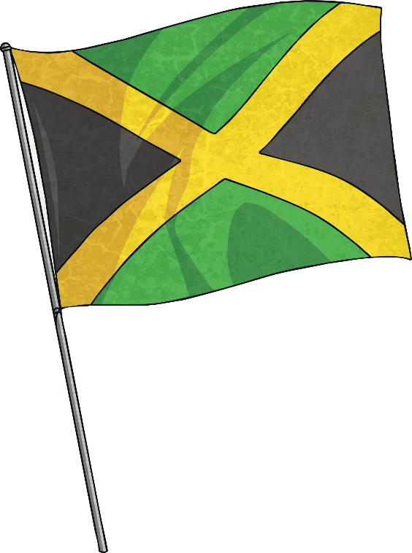
Who Was Mary Seacole?
Mary Seacole was a British-Jamaican woman who overcame racial prejudice to help others.
She is most famous for travelling to the Crimea in 1855 to help care for British soldiers wounded in the war. The soldiers even called her “Mother Seacole.”

Slide 3
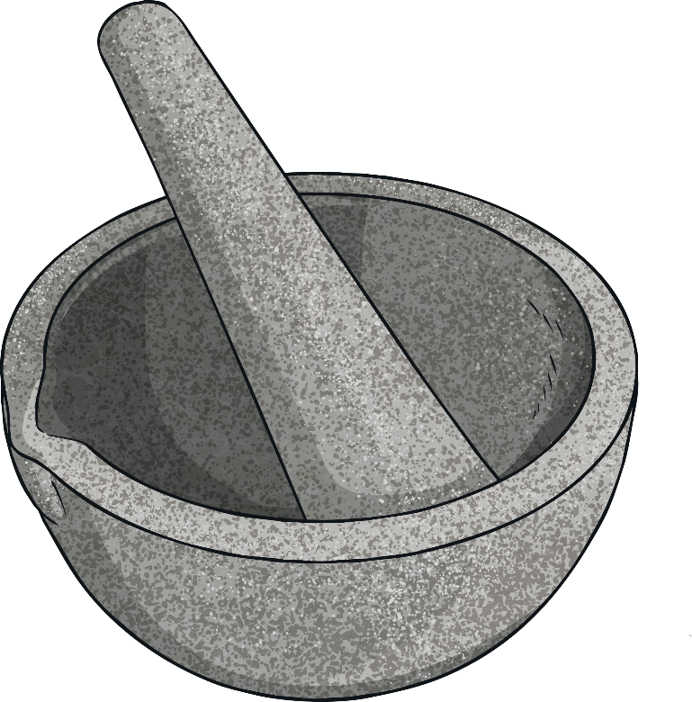
The Life of Mary Seacole
Mary Grant was born in 1805 in Kingston, Jamaica.
Her father was a Scottish soldier and her mother was a Jamaican “doctress.” A doctress was a healer who used African and Caribbean herbal remedies.
Mary learned nursing skills from her mother, who ran a boarding house for injured soldiers.

Slide 4

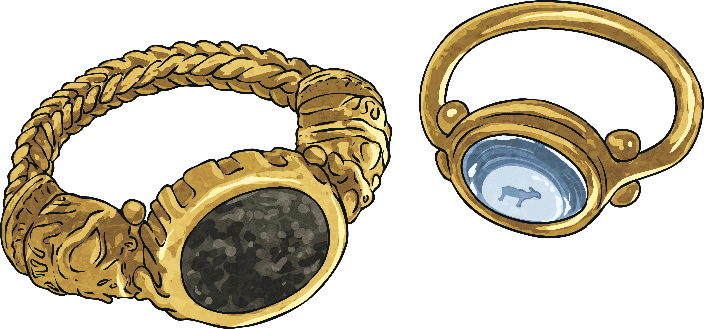
The Life of Mary Seacole
In those days, there was a lot of racial prejudice. This meant that people were treated differently and were not allowed to do certain things because of the colour of their skin.
Mary was well-educated and well-travelled.
On November 10, 1836, Mary married Edwin Horatio Hamilton Seacole, Godson of Lord Admiral Nelson, in Kingston. He sadly died eight years later.

Slide 5
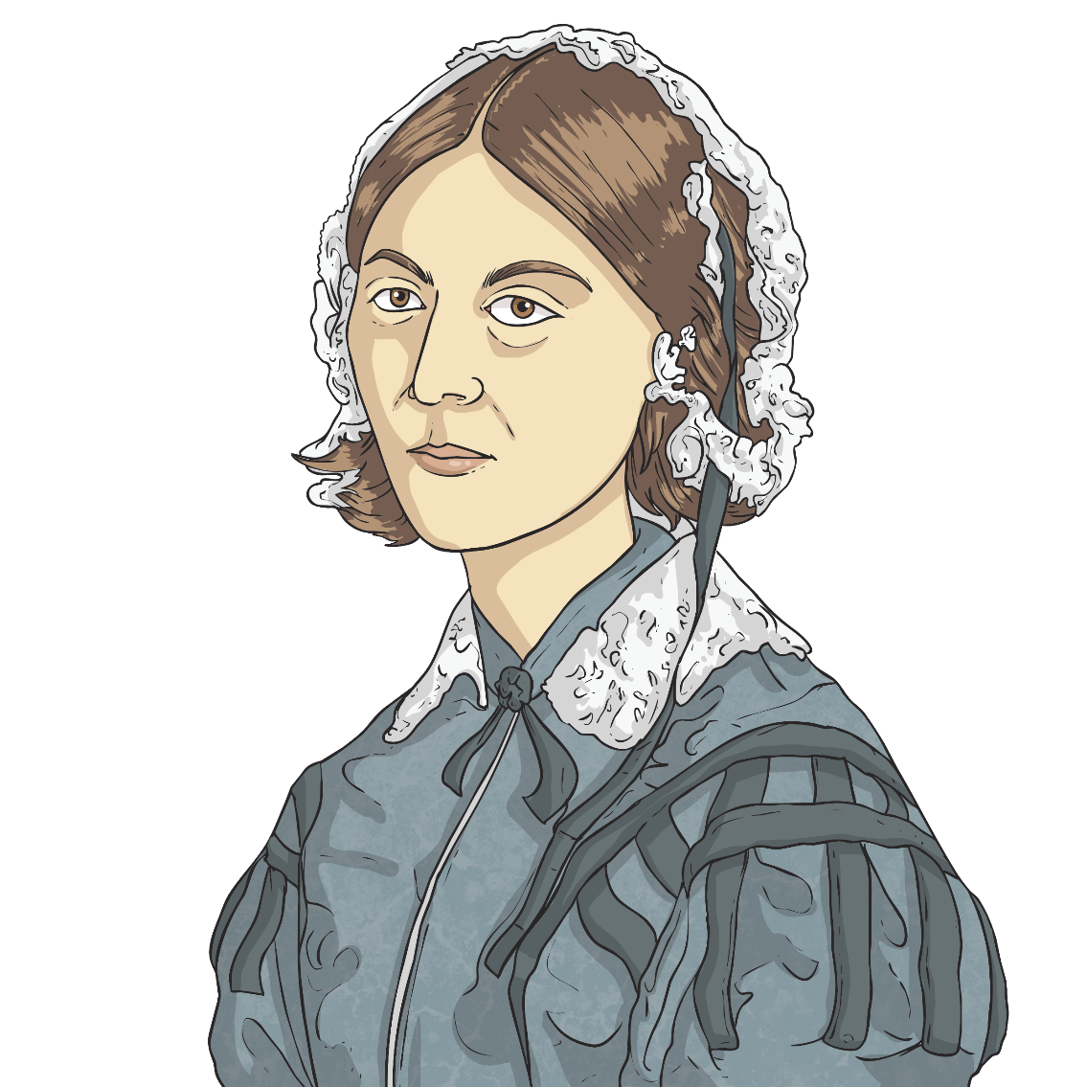
The Crimean War
In 1853, the Crimean War began. Mary wanted to help the soldiers.
She travelled to London to visit the War Office. She wanted to help with the work Florence Nightingale had started.
Although Mary had very good references, her offer of help was turned down. This was because she was black.

Slide 6
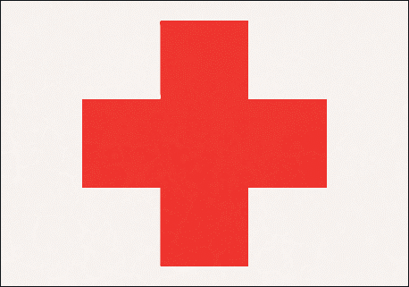
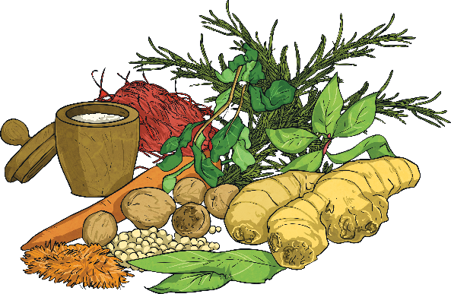
The Crimean War
  Mary decided she would pay for herself to get to the Crimea. She set up her own hospital just two miles from the fighting.
She called her hospital the “British Hotel.”
Mary cared for and treated the injured soldiers with her herbal remedies.
She even travelled to where the fighting was and treated them while under fire.

Slide 7
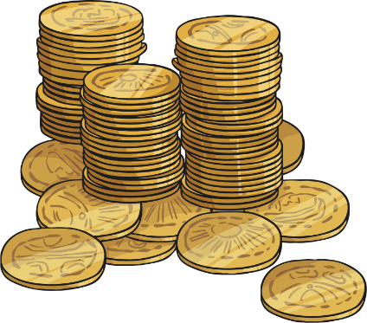
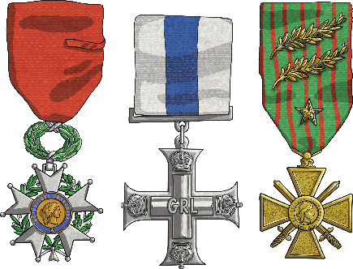
After the War
After the war Mary returned to Britain. She had no home and was in bad health.
The British people heard of Mary’s good work. They wanted to help her. They held a fundraiser to raise money.
She was awarded medals.
In 1857, a book was published about her life. “The Wonder Adventures of Mrs. Seacole in Many Lands” was an autobiography. It was the first by a black woman in Britain.

Slide 8

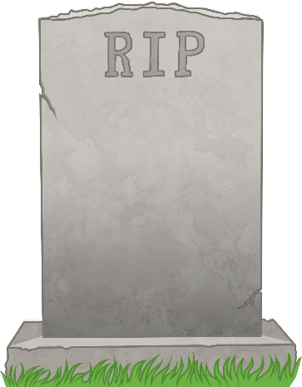
After the War
Mary Seacole died on May 14, 1881, at the age of 76 in her home in London.
After her death, Mary and her work where sadly forgotten. But about 100 years later, a group of Jamaican nurses wanted to know more about her and started to make her famous again.

Slide 9


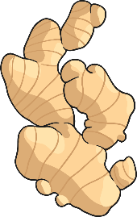
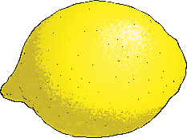

Herbal Remedies
Mary Seacole mixed plants together to make herbal medicine to help the wounded soldiers, as other medicines were not easily available.
These are some of the ingredients she used in her medicines:
Lemongrass, boiled to help a fever.
Aloe vera, mixed to help heal cuts and wounds.
Ginger, ground to help diarrhea.
Lemons, mixed to help coughs.
Okra, chopped to heal boils.
She would grind ingredients with a pestle and mortar, mix them in a mixing bowl, or place them in a pan over a fire.
In some countries remedies like this are still used today.

