Slide 1
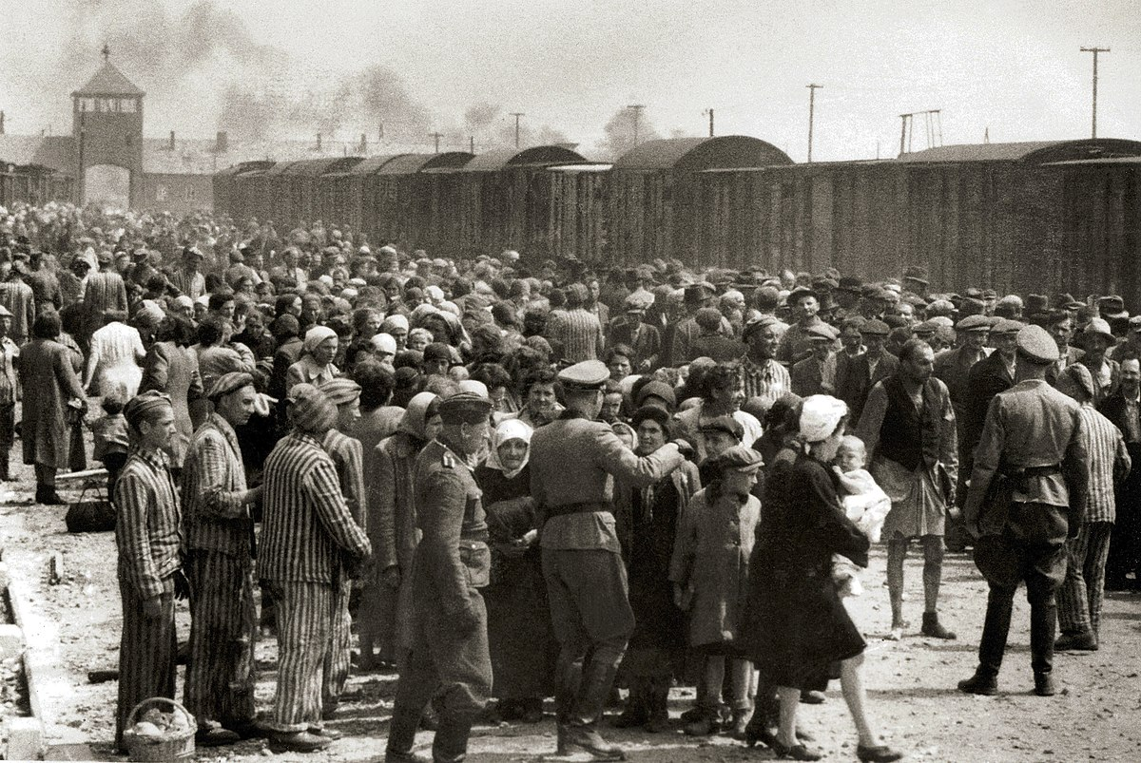
The Holocaust
By Gabi and Tami

Slide 2
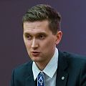
Arnos Rosin
He was a Jew .
He was from Slovakia. He was detained at a death cam in Ausheviz,Poland
Rosin escaped from Ausheviz on the 27th of may

Slide 3
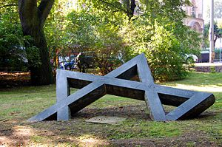

Slide 4
Joseph Goebbles
He was a member of the Nazi party.
His friend was Adolf Hitler.
He was in chare of propaganda.
He was aimed to provote and Justify.

