Slide 1
Holocaust
By Lucy and Scarlett

Slide 2
The killings
The Nazi party also known as National Socialist German Workers Party[NSDAP], killed 6 MILLION Jews as well as disabled people and gypsies. Even though the Nazi party were politicians they arrested politicians and gay people also called homosexuals. The only reason Hitler arrested politicians was because he wanted everything his way.

Slide 3
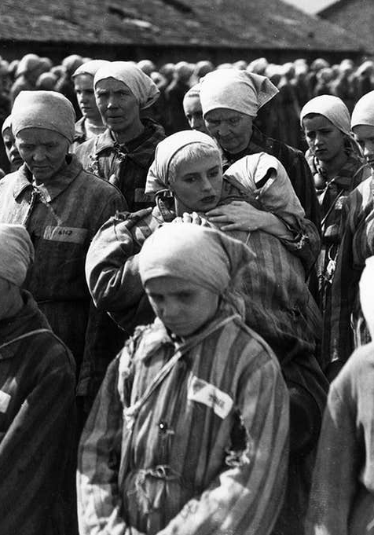
What happened?
75 years ago there was a tradgic thing that happened called the Holocaust. In the Holocaust, Jewish peoples lives were at risk because the Nazi party believed that all of their problems were caused by the Jews.

Slide 4
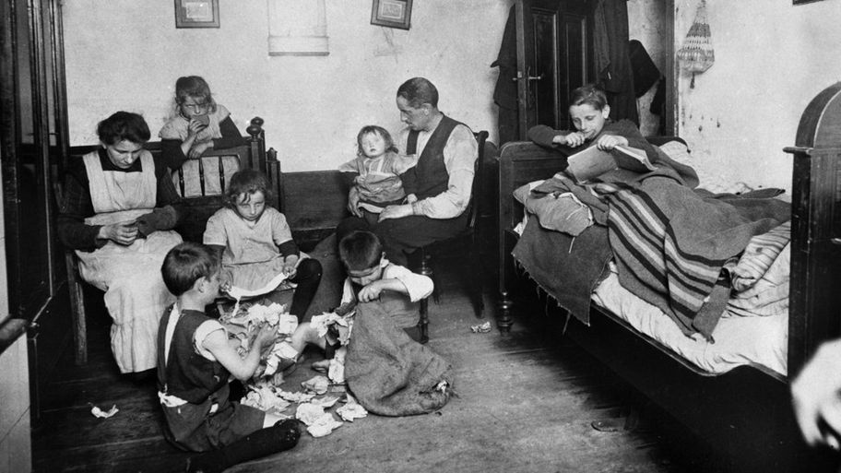
The hiding
During the Holocaust Jews were forced to go into hiding. The Jews couldn’t take suitcases otherwise they would be questioned, so they had to wear as many layers of clothes as possible.

Slide 5
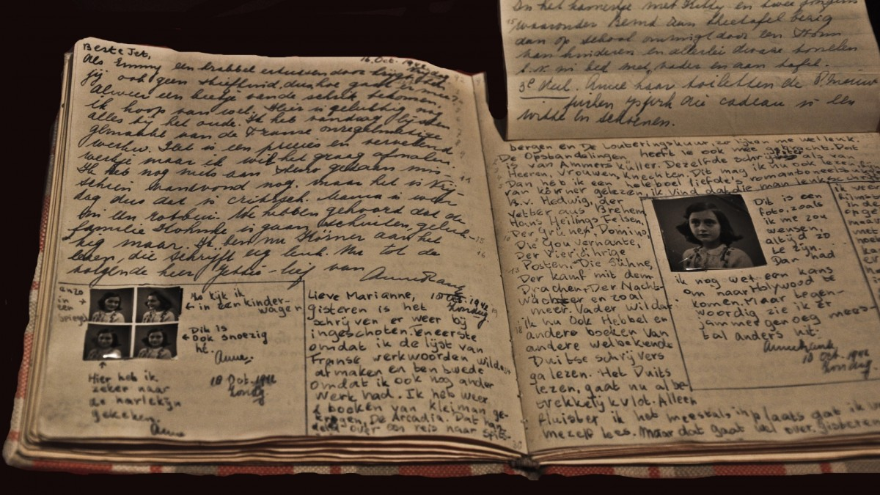
Anne Frank
Anne Frank was a thirteen year old who had to hide during the Holocaust. Luckily, she had a 4 room hiding place behind a bookcase. Unfortunately, she was caught and taken to a concentration camp. Only her dad survived(Otto)and he published her very devastating but interesting diary.

Slide 6
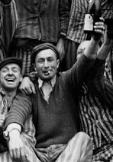
How it affects us today
The Holocaust was a dreadful time but when it was over everyone was happy again as shown in this picture. Although it was sad we still need to remember the people and what happened. This taught us that we shouldn’t have wars and even though we have enemies we should avoid them instead of arguing.

Slide 7
Where they went
Some Jews went into horrible places to hide. Some went into cess pits(poo pits). Some went into houses that were not luxury houses but they were good enough for them. The only reason they went in places such as cess pits was because they didn’t want to be killed.

