Slide 1
Holocaust
Arthur And Joe

Slide 2
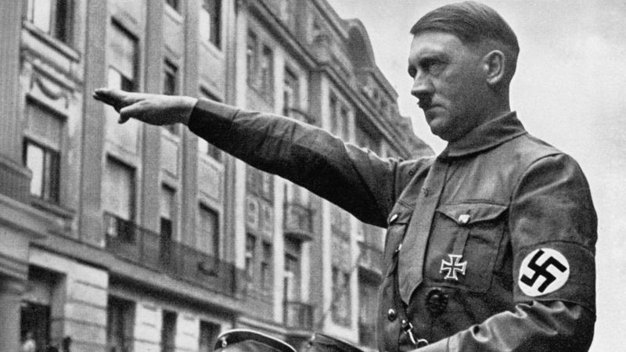
The killings of the Jews were organised by Germany's Nazi party, led by Adolf Hitler.
Jews were the main target of the Nazis, and the greatest number of victims were Jewish. Nearly seven out of every 10 Jews in Europe were murdered because of their identity.Jews were bullied at school by Teachers and school pupils.

Slide 3
Jews were not allowed on public transport or public grounds. Robberies were performed on Jewish shops and Hitler believed that Jews caused them to lose the world war 1 and all German’s problems . The Nazi party where called that for short , there real name is the national socialist German workers.

Slide 4
During the holocaust 17 million people died in consentration camps and 6 million were Jews .
Auschwitz was originally a Polish army barracks but it was invaded by Nazis in September 1939 and turned into a prison.
It's widely known as the most famous of all the concentration camps because it was the biggest and became the site of huge gas chambers which were used to kill people.
People from all over Europe were crammed into wagons that didn't have windows, toilets, seats or food, and taken there.
Historians believe just over one million people were murdered.

Slide 5
An important date was 9 November 1938, when there was a night of terrible violence against Jewish people.
It became known as Kristallnacht - the 'night of broken glass' - due to all of the smashed glass that covered the streets from shops that were raided

Slide 6
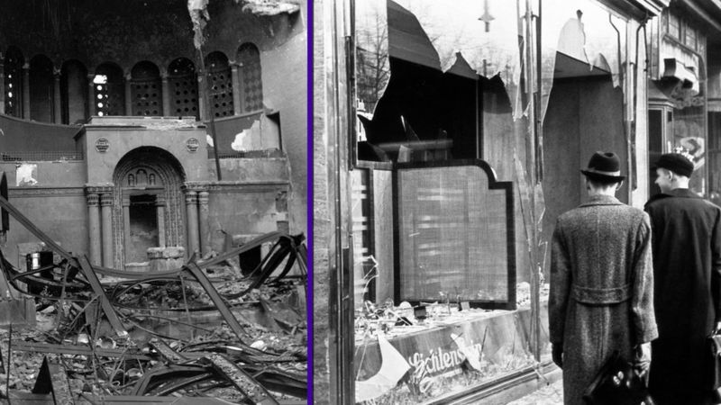
Many groups of people were involved in carrying out the Holocaust. There were two Nazi groups in particular which organised the killing of Nazi enemies.

