Slide 1
Holocaust

Slide 2
Concentration camps
Concentration camps are where the people slept in the night there was over 100 people in the rooms and over 100,000 people in the building it was overcrowded.

Slide 3
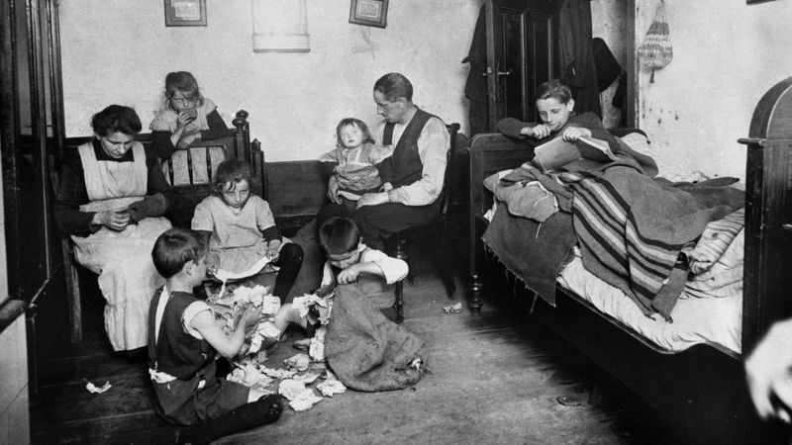

Slide 4
We found out
During the holocaust Jews were told and made to say Jews were bad and hold up signs about it.

Slide 5
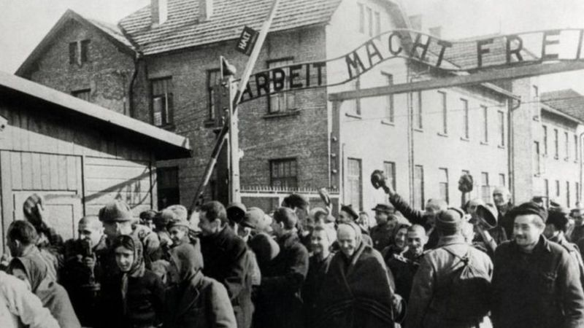

Slide 6
And we also found out
In the war over 6 million Jews were killed in concentration camp if they gave up. And others who survived they would be slaves for them.

Slide 7
Goebbles was a friend of hitler he was in charge of making all the bad propaganda about the jews to get them arrested to go to concentration camps.

Slide 8
hitler
Hitler was a man who at the time was the leader of the naziz party he also won the election so that meant he ruled germany

