Slide 1
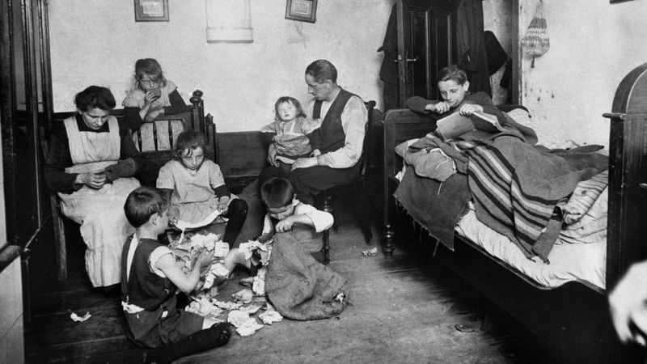
What was the Holocaust?
Presentation by Sabine

Slide 2
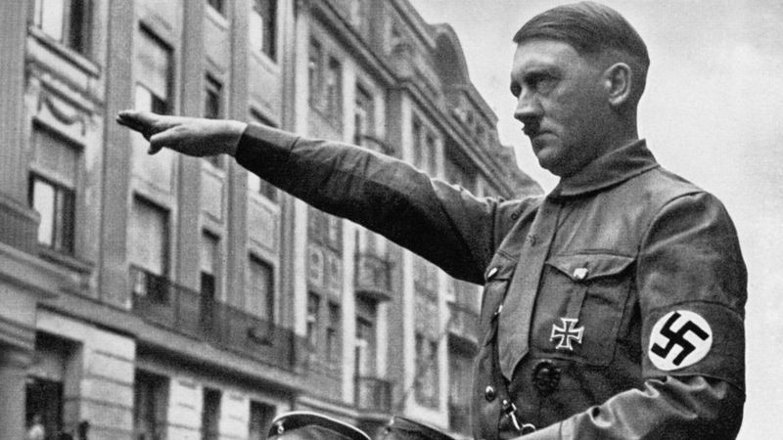
About the Holocaust…
The Holocaust was a period of history at the time of World War Two when millions of Jews were murdered because of who they were.The killings were organised by Germany`s Nazi party led by their leader `Adolf Hitler`.

Slide 3
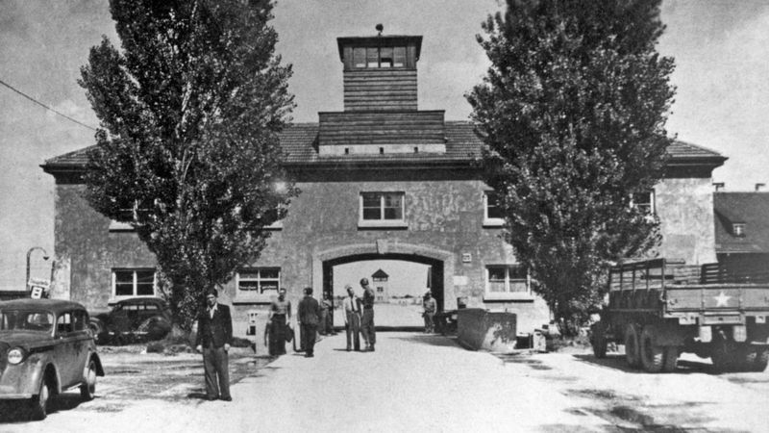
Who the Nazis killed…
The Nazis main target were Jews.But some were Roma(Gypsies)and disabled people.There were lots of other large groups of nationality,race and religion.
concentration camp
In Germany ->

Slide 4
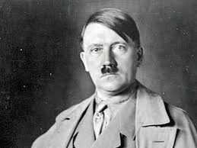
What`Nazi` meant…
The word `Nazi`was a shortened name for: The National Socialist German Workers… So the `Nazis` are just German workers but are national and social.
Photo of Adolf Hitler ->

Slide 5
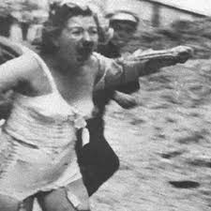
What happened to the Jews during the Holocaust?
The Jews were made to wear a six pointed star on their clothes so the people that were not Jews would not be kind to them.Then,to make it even harder the Germans sent all of the Jews to a concentration camp to make it hard for them to survive,also they gave barely enough food to the Jews that it was scary. Some Jews went into hiding into attics and annexes like Anne Frank.You might of heard about her or read her diary, if you have you know she and her family were Jews. Anne went into hiding, into an annexe, but her family got found and sent to a camp. Anne, her sister, and her mother all died, but Otto Frank lived.

Slide 6
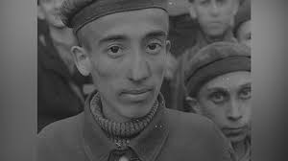
How long was the Holocaust?
The Holocaust was a shocking 12 years, imagine if you were at a concentration camp! Do you think you would have survived or not? They gave you enough food for a small bird! I do not think I would be able to survive.
It started in 1933 and finished in 1945.I could not be able to survive 12 years with barely any food!

