Slide 1
The holocaust
By Samuel and Beau

Slide 2
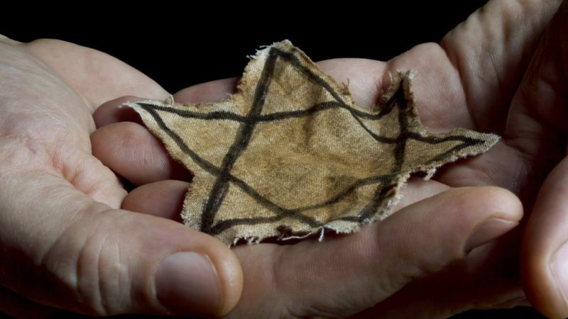
Germany invades
In the holocaust Germany bombed and burnt down synagogues and Hitler invaded France and marched his troops in sun light.
Jews had to wear the star of David to say to the Germans they are Jews and send them to go to concentration camp and in 1920 Hitler lied to the
German army that Jews were why they didn’t win WW1.

Slide 3
Arnost rosen
Arnost was a jew in concentration camp and escaped in 27th may 1944
Fun fact hitler killed 6,000,000 jews!
Hitler also set Jews in to death camp to die in gas chambers

Slide 4
Joseph gobbels

