Slide 1
Holocaust
By Erin and Sarah

Slide 2
What is the Holocaust?
The Holocaust was a period in history at the time of WW2 (World war 2,1939-1945),When millions of Jews were murdered because of who they were.
The killings were organised by Germany’s Nazi Party ,led by Adolf Hitler.
Jews were the main target of the Nazis,and the greatest number of victoms were Jewish. Nearly seven out of every ten Jews in Europe were murdered.

Slide 3
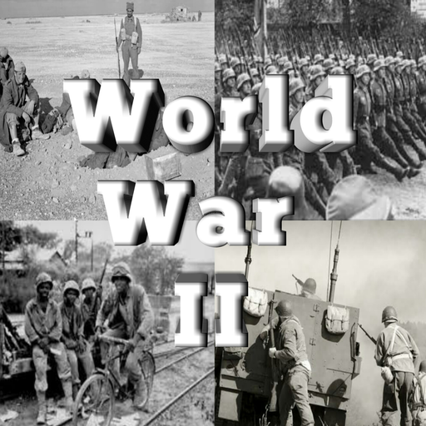
What happened during Holocaust?
During November 1938,what
was following the night of
brutal attacks
on Jewish homes across Germany
known as Kristllnacht
(The Night of Broken Glass),
Witch made the British
refugee organisations persuade the British government to permit, Jewish children under seventeen to go temporarily to Great Britian.

Slide 4
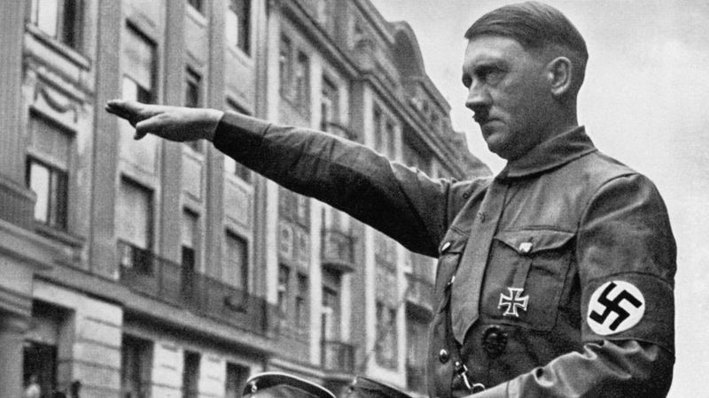
WW2 Holocaust Picture

Slide 5
What happend to Jews during Holocaust?
During WW2 ,many Jews were to sent to different concentration camps were they were forced to work as slaves.
If they were to ill or disabled then they would be percecuted.
Some people who were not good enough at being slaves would be sent to death camps and would be killed in gas chaimbers.

Slide 6
What happened to Jews during Holocaust?
The Holocaust describes the killing of over six million Jews and some innocent people during WW2.
These killings were organised by the German Nazi Party and were directed by the party leader Adolf Hitler.
The Jews were kept in an open room with six beds ,where millions of Jews were kept. The rooms were in very poor conditions and spread illnesses. Lots of people died of hunger.

Slide 7
What happened to Jewish children during Holocaust?
The stories of child survivors of the Holocaust could be used to help improve the lifes of refugees in the UK.
About 10,000 mainly Jewish children escaped from the Nazis in the 1930s.
A study at Aberystwyth university will look at how those children’s experiences went on to affect them in there adult hood.

Slide 8
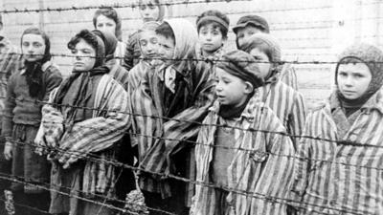
WW2 Holocaust picture

Slide 9
Thanks for watching

