Slide 1
The Holocaust
By Amelie ,Grace and Phoebe

Slide 2
Anne Frank
Anne Frank was a 13 year old girl she was Jewish , on her birthday she got a blank diary. behind a bookshelf.
So she wrote in her blank diary to keep track of her life
Her and her family were made to go into hiding in her Dads office in a secret room ep track for 2 years while her and her family were hiding from the Germens.
It was very hard for them to live as they could not use the loo during the day because people were down stairs and they didn’t want to be discovered because they would be capered .

Slide 3
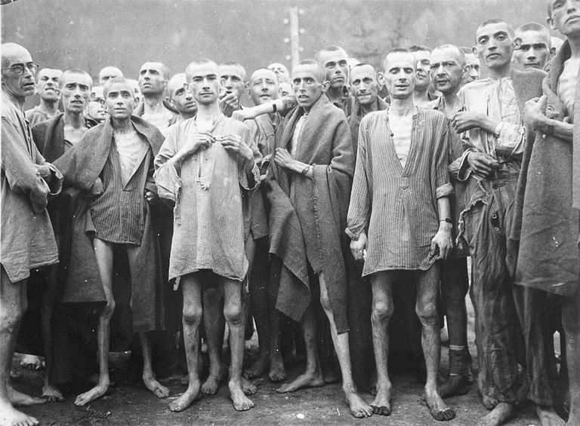
Death camps all jews and disabled people were put in death camps.

