Slide 1
The Holocaust
By Beaumont

Slide 2
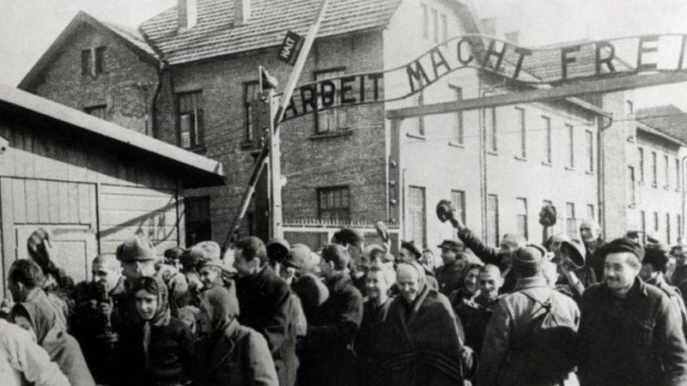
Hitler Horror
In 1920 Hitler blamed jews for all they’re problems. He made jails for them called concentration camps. Some went to death camps where: They got killed in gas chambers. Over 6,000,000 jews died. Though over 10,000,000 people died.

