Slide 1
THE HOLOCAUST
By Eddie

Slide 2
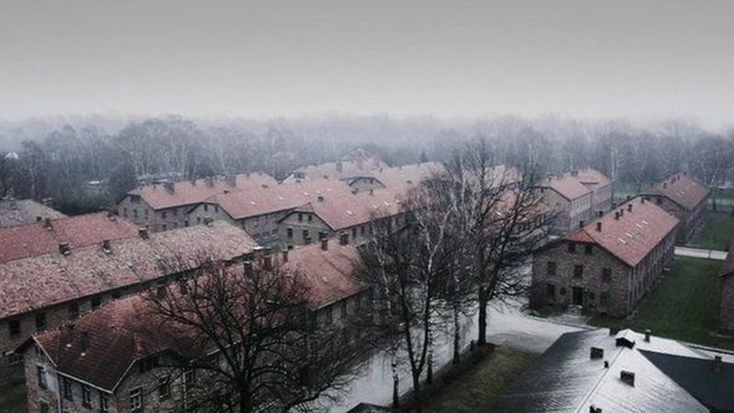
The Holocaust was the tragic killing of over six million Jews by the Nazi party, who ruled Germany at the time.
The Nazis believed the Jews were the cause of the countrys problems.
The picture above is the prison camp Auschwitz . It used to be a Polish Army barracks . Over a million people were killed here during the Holocaust.

Slide 3
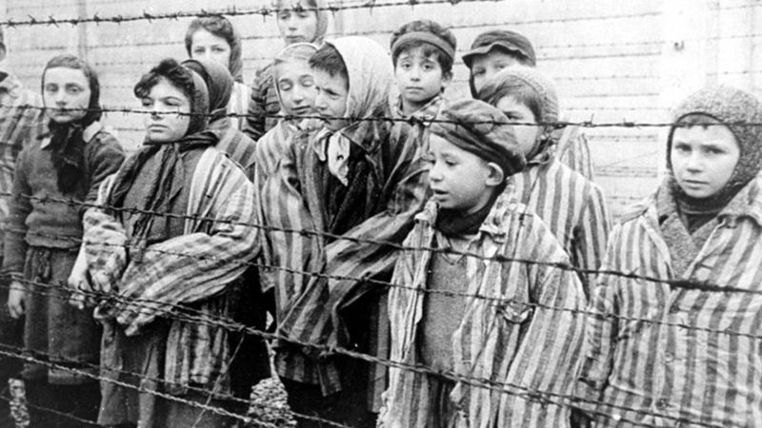
Other groups targeted by the Nazis were Homosexuals , Disabled people and Roma . In Germany people who weren’t targeted were known as Aryans.
Jews and other groups were often killed in gas chambers or sent to concentration camps, were most of them died.

Slide 4
The Nazis used radio , newspapers and leaflets to promote hatred of the Jews . They made Jews hold signs saying don’t buy from jewish shops

Slide 5
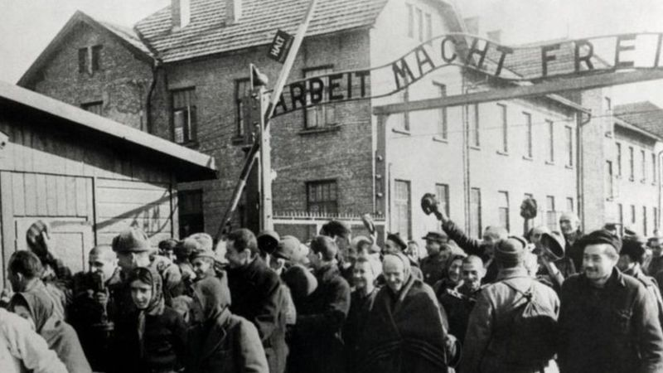
How the Nazis treated the Jews should not be forgotten so we can learn from history . We must learn from our mistakes to make sure this doesn’t happen again.

