Slide 1
THE HOLOCAUST
Presented by hollie and lillie

Slide 2
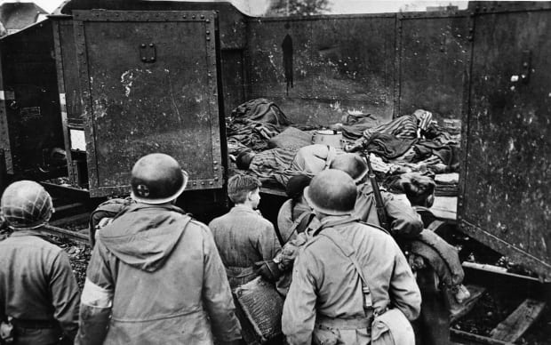
How it all started
In November 1938,following the night of brutal attacks on Jewish homes across Germany known as kristallnatcht,British refugee organisations persuaded the British government to permit Jewish children under the age of seventeen to come temporarily to Britain. It all started because Hitler [the German leeder] had a strong hate for Jews.He persuaded the people of Germany that Jews were the cause of all their problems.

Slide 3
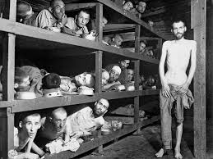
Conserntration camps
Conserntration camps were where Jews were kept and made to do hard, forced slavery.Jews were kept in poor conditions,so not all survived and there were upto twelve people sleeping on each bunk.It wasn’t just Jews who were kept in consentration camps, it was also disabled people and homosexuals.

Slide 4
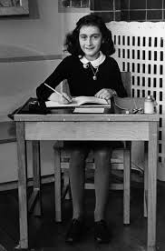
ANNE FRANK’S
STORY
Anne Frank was a young girl who lived during the second world war and this is her story. On Anne Frank’s thirteenth birthday she got a diary but not just any old diary a special diary where she wrote all her thoughts and feelings.A thew weeks after Anne’s birthday she went in to hiding.The Germans found Anne and her family and took them to a conserntration camp but only her dad survided unfortunately.

Slide 5
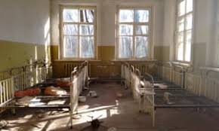
OVERALL
SUMMARY
In 1938 the Holocaust started and ended at the end of the war. The person who started it all is Hitler, because he kept invading more land after he said he wouldn’t. Jews, disabled people and Homosexuals were kept in concerntration camps and forced to do hard slavery.

