Slide 1
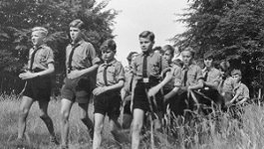
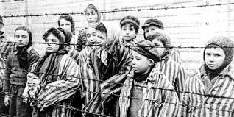
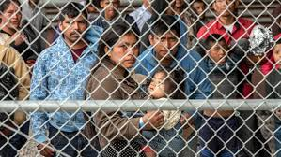
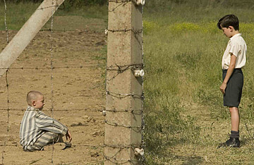
The Holocaust
By Joanna and Ruby

Slide 2
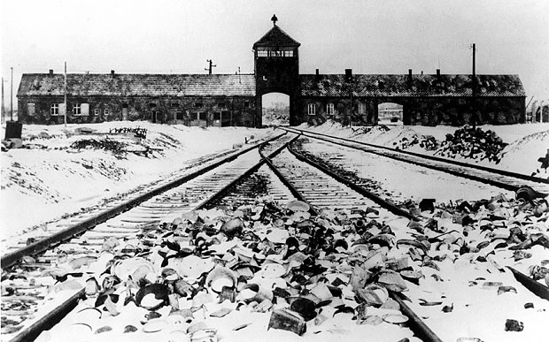

Slide 3
The Holocaust was a process that started with discrimination against Jewish people, and ended with millions of people being killed because of who they were .
Nearly seven out of every 10 Jews in Europe were murdered because of their identity .
In 1934, a law called Malicious Gossip Law was introduced which made it a crime to tell an anti-Nazi joke .
In the Holocaust over 6 million Jews died before and during WW2 due to the German Nazi party.
The Nazis also killed other groups of people, including Roma and disabled people.

Slide 4
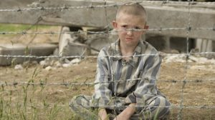

Slide 5
They also arrested and took away the rights of other groups, like gay people and political opponants .
The death camp is in Auschwitz, Poland .
Anne Frank was a girl who hid in an attic and wrote diary enterys. They were soon caught and sent to a concentration camp only her Dad survived and published her diary.
Adolf Hitler the leader of the Nazi Party wanted to kill all the Jews in the country and Poland .
The Holocaust was when Adolf Hitler killed Jews that didn’t fit in and had other religions ,disabilities ,hair colours and eye colours etc.

Slide 6
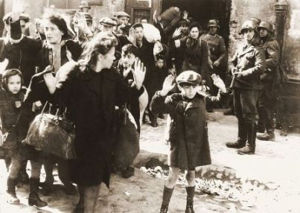

Slide 7
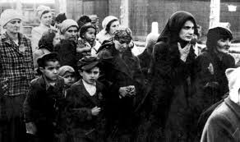
The Holocuast was when the Jews were killed and murdered and sent to concentration camps .
Only some Jews survived because some died of diseases , tiredness or hunger.

Slide 8
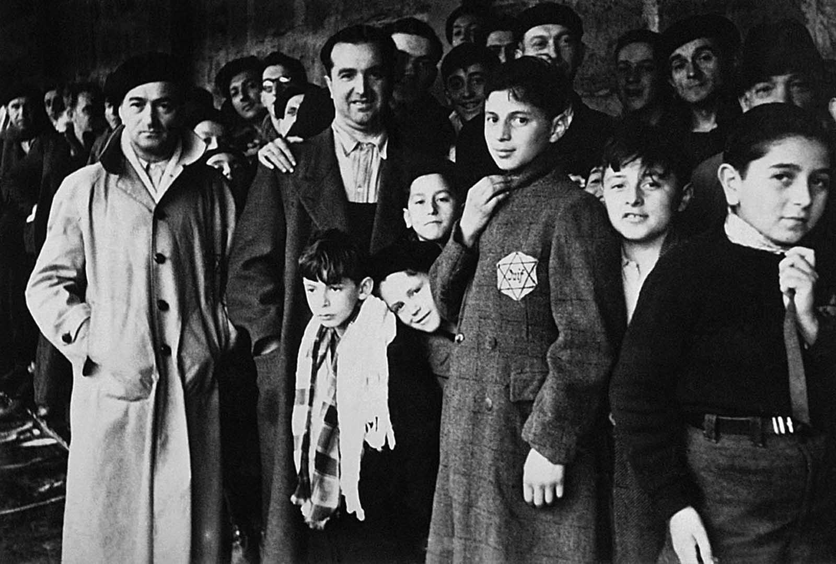
By Joanna and Ruby!

