Slide 1
The
Holocaust
By Oscar A
And Elliot
☺☺☺

Slide 2
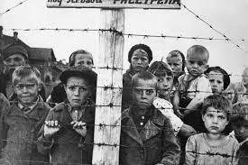
The Holocaust was a very sad ☹ time in ww2. During this period Hitler decided to put Jews, disabled people and homosexuals into concentration camps to do manual labour . If they were not strong enough they would be killed!
Hitler believed Jews were responsible for all the problems in Germany.

Slide 3
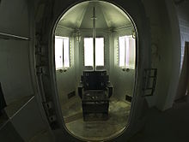
The Nazis started to kill Jews by shooting them but it upset their soldiers so they started gassing them instead.
They looked like this.
←

Slide 4
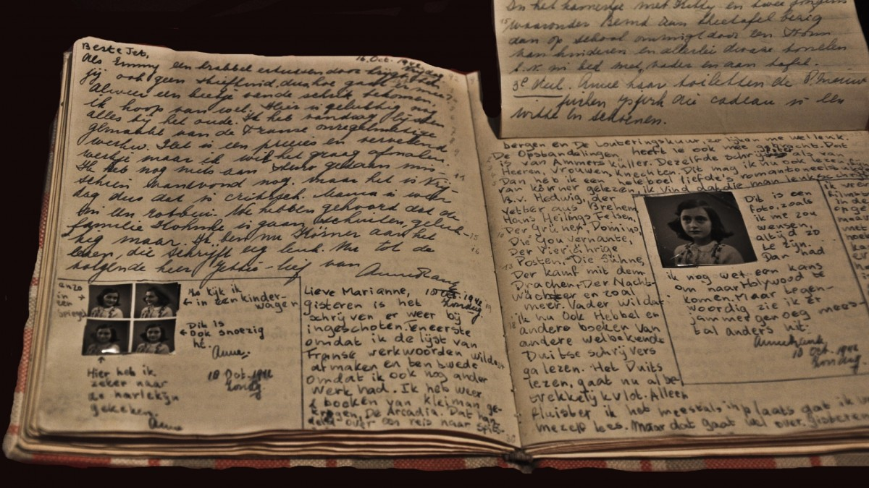
Some Jews hid from the Nazis in secret attics or basements.
ANNE FRANK’S DIARY
Anne Frank was a Jew living in Holland when the Nazis invaded. She and her family hid in a secret warehouse above her fathers office. She wrote a diary about her experiences that became very famous and many books were made about it.

Slide 5
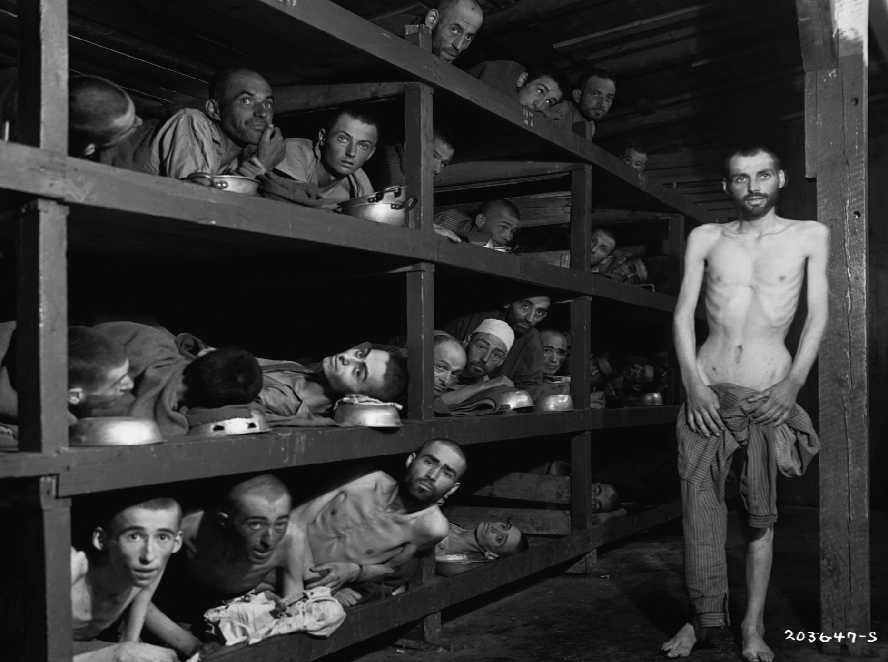
The conditions in the camps were terrible . The Nazis fed them just enough for them to stay alive . So a meal might be a watery vegetable peel soup with scraps of bread and no meat of any kind. They slept in cramped bunkbeds with 100 people in one room. Many were worked to death and collapsed on the muddy ground.

Slide 6
THE END

