Slide 1
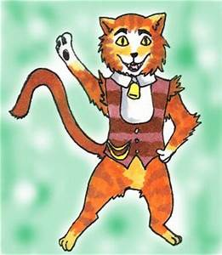
Copied his poem in her power point:!Gabriyel!
Skimbleshanks the railway cat
Poet:TS Elliot

Slide 2
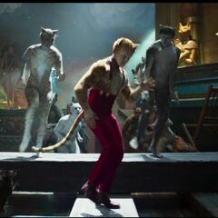
There's a whisper down the line at 11.39 When the Night Mail's ready to depart, Saying "Skimble where is Skimble has he gone to hunt the thimble?
We must find him or the train can't start." All the guards and all the porters and the stationmaster's daughters They are searching high and low, Saying "Skimble where is Skimble for unless he's very nimble Then the Night Mail just can't go. "At 11.42 then the signal's nearly due And the passengers are frantic to a man
Then Skimble will appear and he'll saunter to the rear: He's been busy in the luggage van! He gives one flash of his glass-green eyes And the signal goes "All Clear!" And we're off at last for the northern part of the northern hemisphere

Slide 3
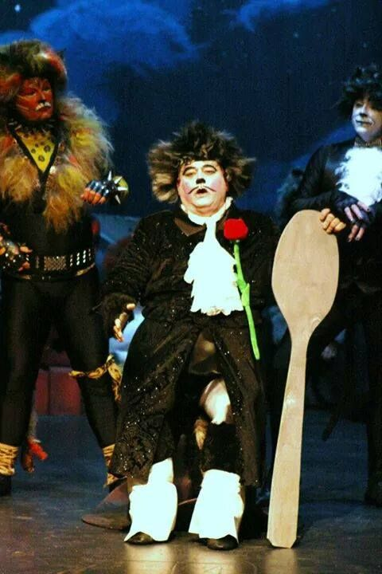
You may say that by and large it is Skimble who's in charge Of the Sleeping Car Express. From the driver and the guards to the bagmen playing cards He will supervise them all, more or less. Down the corridor he paces and examines all the faces Of the travellers in the First and the Third; He establishes control by a regular patrol And he'd know at once if anything occurred. He will watch you without winking and he sees what you are thinking
And it's certain that he doesn't approve Of hilarity and riot, so the folk are very quiet When Skimble is about and on the move. You can play no pranks with Skimbleshanks! He's a Cat that cannot be ignored;
So nothing goes wrong on the Northern Mail When Skimbleshanks is aboard.

Slide 4
1. The train, full of commuters­ was ready at 11.39
2. Nobody knew where Skimbleshanks, the cat of the railway , had gone.
3.Everybody, including the daughters of Stationmaster- searched hard for him.
4.The passengers {that were in the train} grew frantic.
.
8. Everybody – including Passangers, drivers, guards and bagmen - respect Skimbleshanks.
9.Skimbleshanks, keeping control as he goes, patrols the corridors
.
7.The train was travelling to the north through the night – on the way to Scotland
6.The driver watched for the signal (just to be safe) then started the journey
5.Skimbleshanks gave a flash of his eyes, Emerald-green and bright, to set the train going

Slide 5
7.Le train se déplaçait vers le nord toute la nuit - jusqu’au chemin de l’Ecosse
1. Le train, plein de navetteurs était prêt à 11h39
4.Les passagers « qui étaient dans le train » sont devenus frénétiques.
9.Skimbleshanks, en gardant le contrôle au fur et à mesure, patrouille les couloirs
2. Personne ne savait où Skimbleshanks, le chat du chemin de fer , était allé.
6.Le conducteur a regardé pour le signal (juste pour être sûr) puis a commencé le voyage
3.Tout le monde, y compris les filles de Station master- a cherché dur pour lui.
5.Skimbleshanks a donné un flash de ses yeux, vert émeraude et lumineux, pour mettre le train en route
8. Tout le monde, y compris les Passangers, les chauffeurs, les gardiens et les bagmen, respecte Skimbleshanks.
r

Slide 6
Hope you enjoyed my short and sweet power point!!!
?HAVE YOU SEEN CATS THE MUSICAL OR CATS THE FILM?

