Slide 1

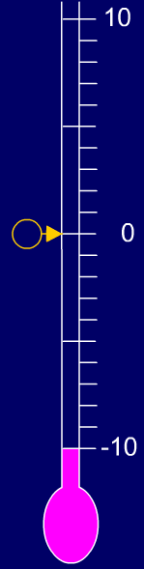


Use negative numbers in context of temperature; calculate rises and falls in temperature.
At what temperature might we see ice beginning to form outside?
Why?
As water freezes at 0 degrees Celsius, the temperature will be less than this, e.g. minus 1, minus 2, etc.
Which of the temperatures shown on this thermometer is the coldest?
Notes:
Ask children up to label some temperatures on the thermometer.

Slide 2
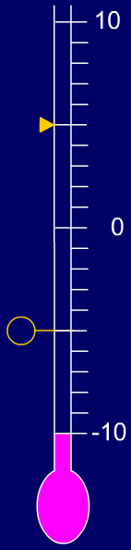

Use negative numbers in context of temperature; calculate rises and falls in temperature.
During one day it was 5 °C.
At night the temperature fell to minus 5 °C. How many degrees has the temperature fallen?
5˚C
How many degrees had it fallen when it got to zero?
And then?
-5˚C
The temperature drops 5°C between 5 and 0°C,
then drops another 5° to reach -5°C.
It’s fallen 10˚C in total.

Slide 3
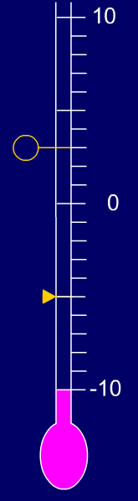
Use negative numbers in context of temperature; calculate rises and falls in temperature.
The next day the temperature rose, but it was colder than the previous day.
How much has the temperature gone up by?
3˚C
-5˚C
The temperature rises 5°C between -5 and 0°C,
then rises another 3° to reach 3°C.
It’s risen 8˚C in total.

Slide 4
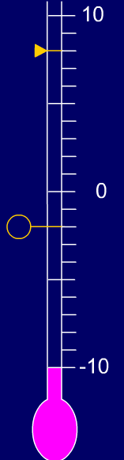
Use negative numbers in context of temperature; calculate rises and falls in temperature.
8˚C
The temperature was 8˚C.
Overnight the temperature dropped to -2˚C.
How much has the temperature fallen?
-2˚C
The temperature drops 8°C between 8 and 0°C,
then drops another 2° to reach -2°C.
It’s fallen 10˚C in total.
Notes:
Children can now go on to do differentiated GROUP ACTIVITIES. You can find Hamilton’s group activities in this unit’s TEACHING AND GROUP ACTIVITIES download.
WT: Label temperatures on a thermometer, then use this image to calculate falls in temperature.
ARE/GD: Draw vertical number lines to help calculate rises and falls in temperature.

