Slide 2
Aim
Use common factors to simplify fractions; use common multiples to express fractions in the same denomination.

Slide 3

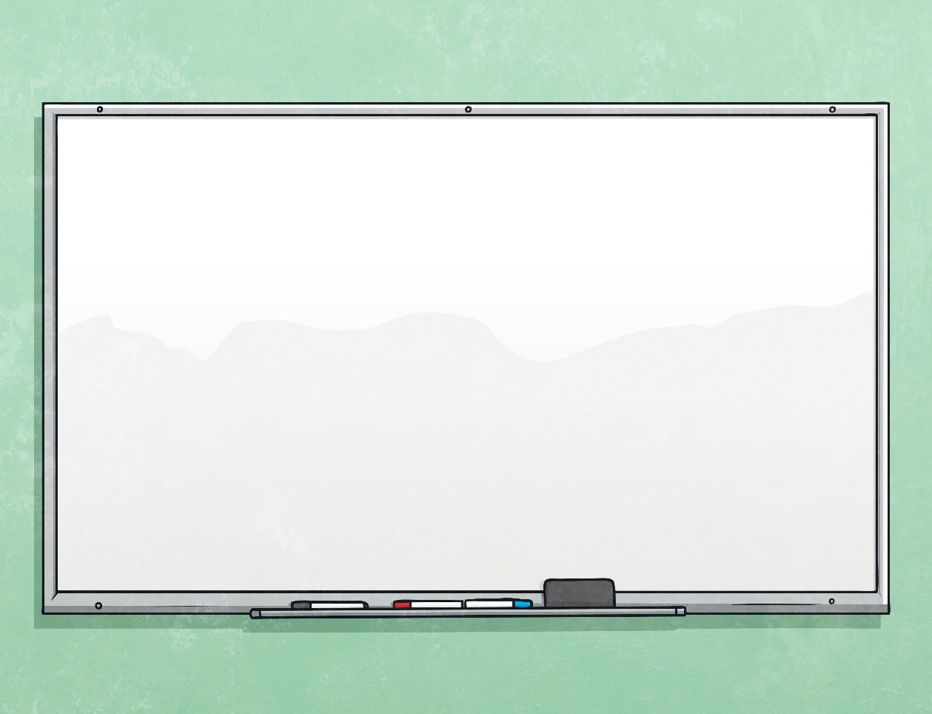

Fractions on a Number Line
Diving
Which letter shows the correct position of $\frac{\text{4}}{\text{6}}$ on the number line?
0
1
2
A
B
C
D
E
F
C

Slide 4

Fractions on a Number Line
Diving
Which letter shows the correct position of $\frac{\text{3}}{\text{18}}$ on the number line?
0
1
2
A
B
C
D
E
F
A

Slide 5
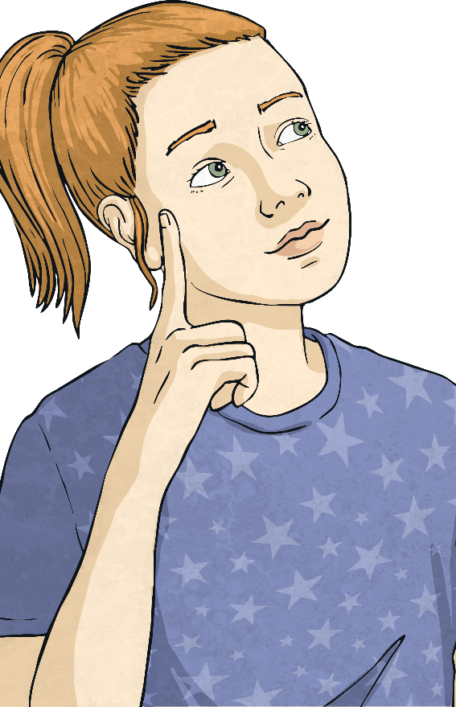
Fractions on a Number Line
Diving
Which letter shows the correct position of 1 $\frac{\text{15}}{\text{18}}$ on the number line?
0
1
2
A
B
C
D
E
F
F

Slide 6
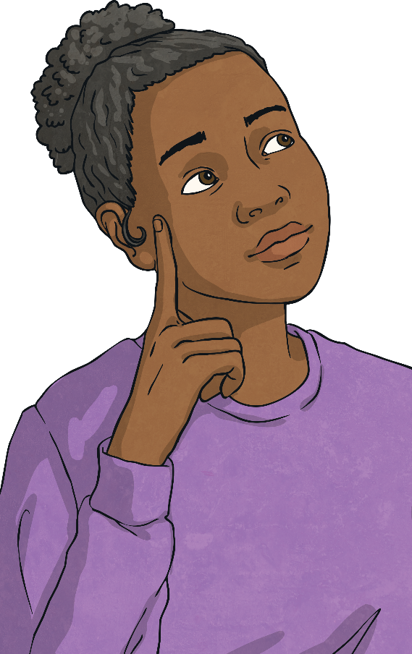
Fractions on a Number Line
Diving
Which letter shows the correct position of 1 $\frac{\text{6}}{\text{18}}$ on the number line?
0
1
2
A
B
C
D
E
F
D

Slide 7


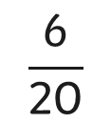

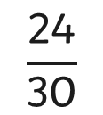
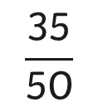

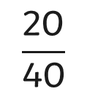

Fractions on a Number Line
Deeper
Which fraction is the odd one out?
Explain your reasoning using the number line.
$$\frac{\text{8}}{\text{10}}$$
0
$$\frac{\text{3}}{\text{10}}$$
$$\frac{\text{5}}{\text{10}}$$
$$\frac{\text{7}}{\text{10}}$$
1
$$\frac{\text{6}}{\text{20}}$$
$$\frac{\text{20}}{\text{40}}$$
$$\frac{\text{35}}{\text{50}}$$
$$\frac{\text{24}}{\text{30}}$$
Three of the fractions simplify to an odd number of tenths, the odd one out simplifies to an even number of tenths.

Slide 8
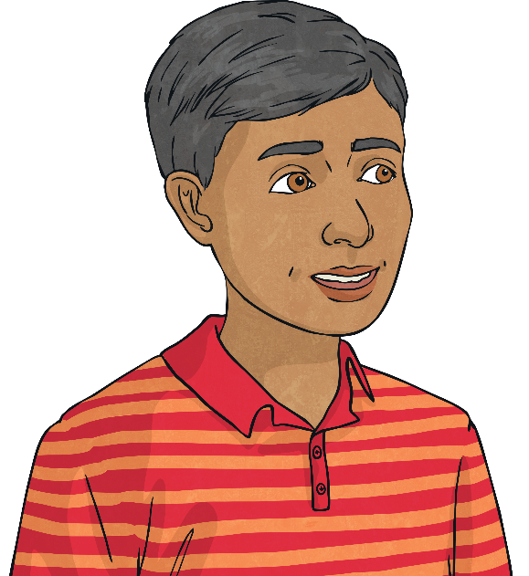
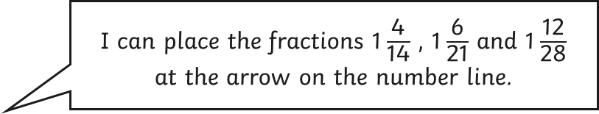
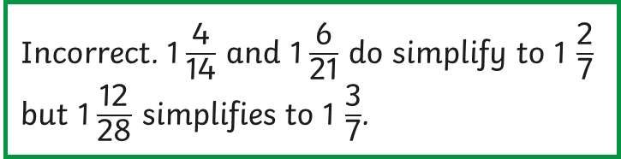
Fractions on a Number Line
Deeper
Is Rami correct? Explain your reasoning using the number line.
0
1
I can place the fractions 1 $\frac{\text{4}}{\text{14}}$ , 1 $\frac{\text{6}}{\text{21}}$ and 1 $\frac{\text{12}}{\text{28}}$
at the arrow on the number line.
Incorrect. 1 $\frac{\text{4}}{\text{14}}$ and 1 $\frac{\text{6}}{\text{21}}$ do simplify to 1 $\frac{\text{2}}{\text{7}}$
but 1 $\frac{\text{12}}{\text{28}}$ simplifies to 1 $\frac{\text{3}}{\text{7}}$.

Slide 9

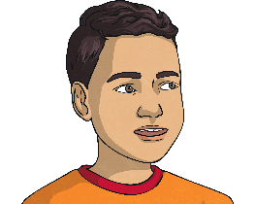

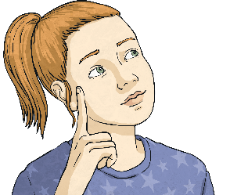
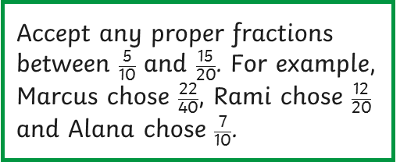


Fractions on a Number Line
Deepest
Marcus, Alana and Rami have each chosen a fraction to put on this number line.
What combination of fractions could the children have placed? How many answers can you find?
$$\frac{\text{5}}{\text{10}}$$
$$\frac{\text{15}}{\text{20}}$$
Accept any proper fractions between $\frac{\text{5}}{\text{10}}$ and $\frac{\text{15}}{\text{20}}$. For example, Marcus chose $\frac{\text{22}}{\text{40}}$, Rami chose $\frac{\text{12}}{\text{20}}$ and Alana chose $\frac{\text{7}}{\text{10}}$.
0
1
We have all chosen fractions with different denominators. My fraction is the smallest.
All our fractions are greater than ½ but smaller than ¾.
My fraction is the furthest along the number line.
Marcus
Rami
Alana

Slide 10


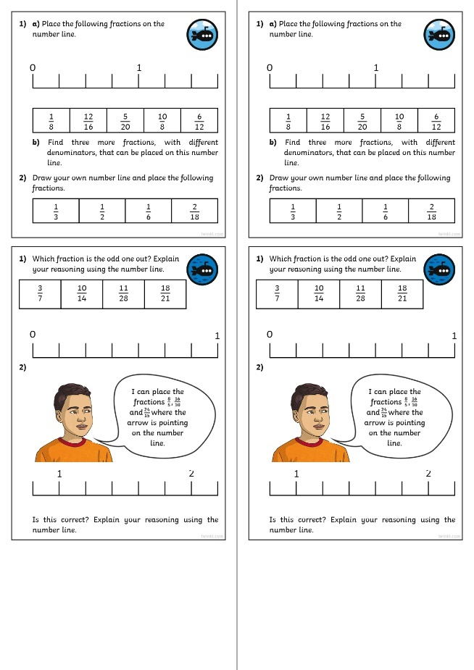
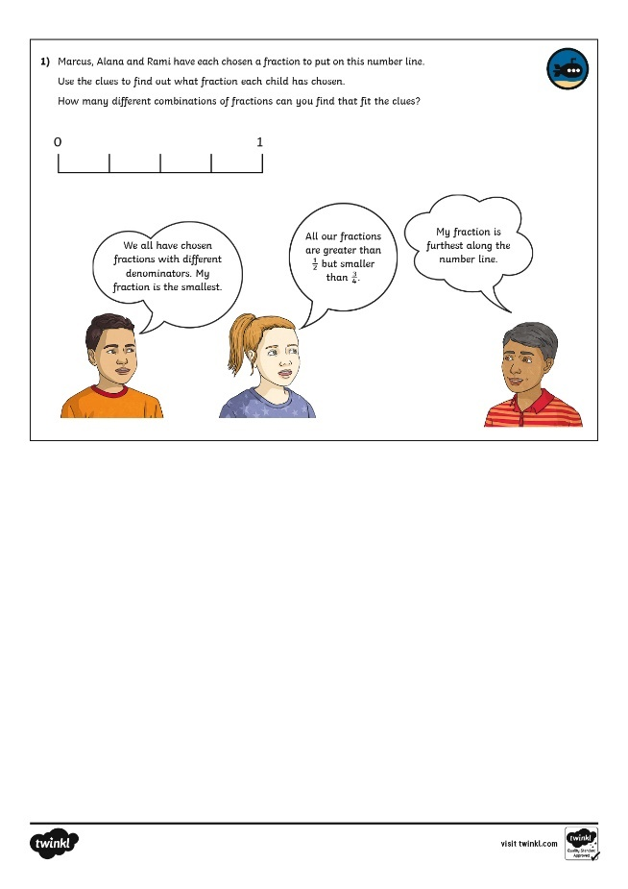
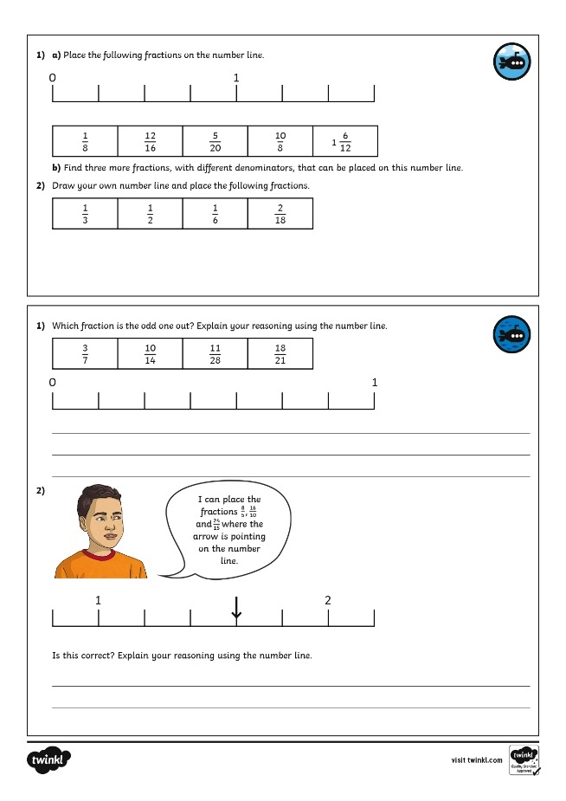

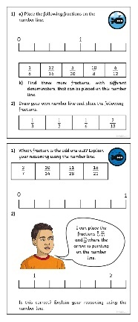
Fractions on a Number Line
Dive in by completing your own activity!

