Slide 1
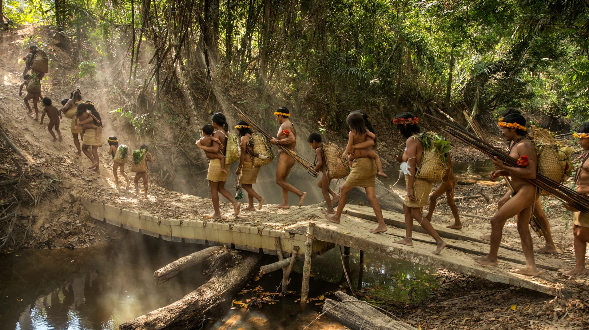
Awá Tribe
By Lucy Owen

Slide 2
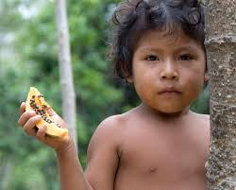
Food
They hunt for turtle and fish.
They catch them with arrows and then they cook them on a fire.
They normally had fish for lunch.
They also grow crops to eat like bananas, beans and corn.

Slide 3
Endangered
Loggers, farmers, cattle ranchers, disease and road building is what is making the Awá endangered.
Diseases have killed thousands of people in the tribe and also people from the Awá Tribe have been killed by the loggers and farmers.

Slide 4
Campaign
In April 2012, Survival launched a global campaign to save the Awá.
Two years later, in April 2014, Survival, the Awá and their supporters celebrated as the campaign scored an unprecedented victory when the Brazilian government sent in troops to expel the illegal loggers from Awa land.

Slide 5
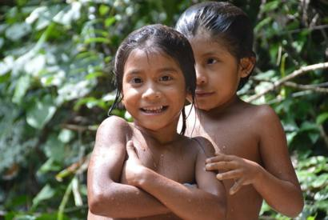
Socialising
They don’t go to school but they are happy because they have each other. There are 350 members and 100 of them have no contact with the outside world.

Slide 6
Language
The Awá Tribe speaks their own language .
Their language is Guajá.
Even though they are a Brazilian tribe they do not speak Portuguese.

