Slide 1


My Mini Shard
Howie Baker
Group 2 - Age 8

Slide 2


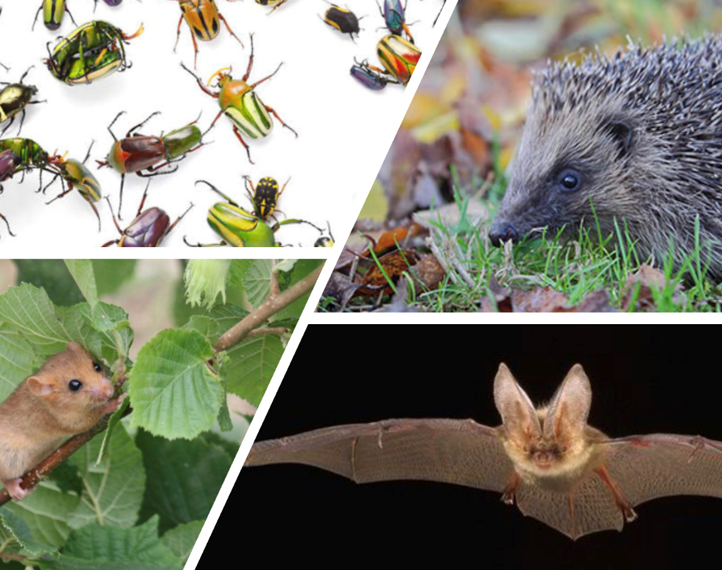
I have made a scale model of the famous London landmark The Shard. Completed by Mace in 2012.
My Shard lives in my garden standing 1.7 metres tall. I have made changes to the design for small animals and creatures to sleep and live.
This build is made of recycled materials like wood making it really sustainable.
Using plans for an A4 paper model I found on the internet. With dads help, I scaled the dimensions by a factor of 10 using multiplication onto the wood marking out the lines for cutting. Once the panels were cut I fixed the structure together with a power drill and screws. Painting it in leftover animal friendly paint.
Having learned about the small visitors to my garden. My Mini Shard includes somewhere to live for door mice, bats, hedgehogs, lots of bug shelters and I added a pond, which mum was less than pleased with.

Slide 3
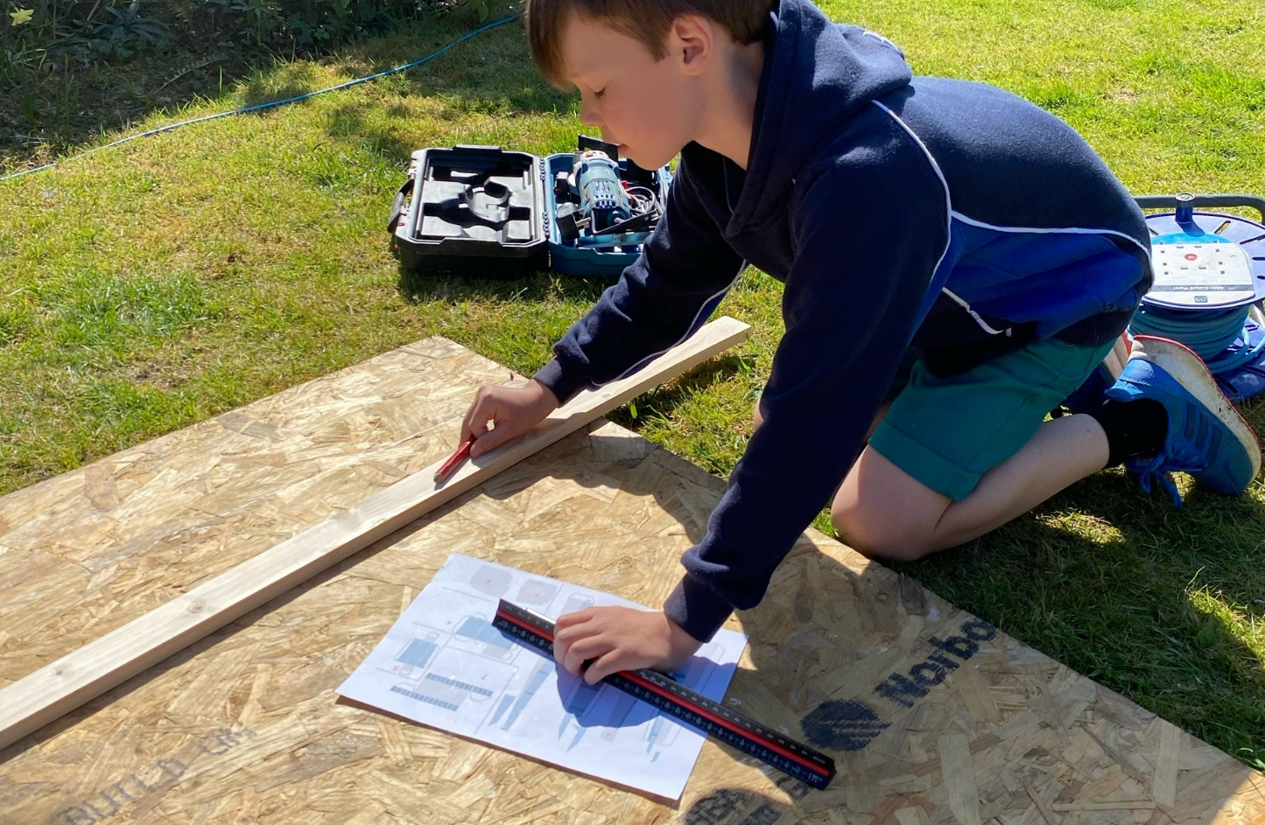
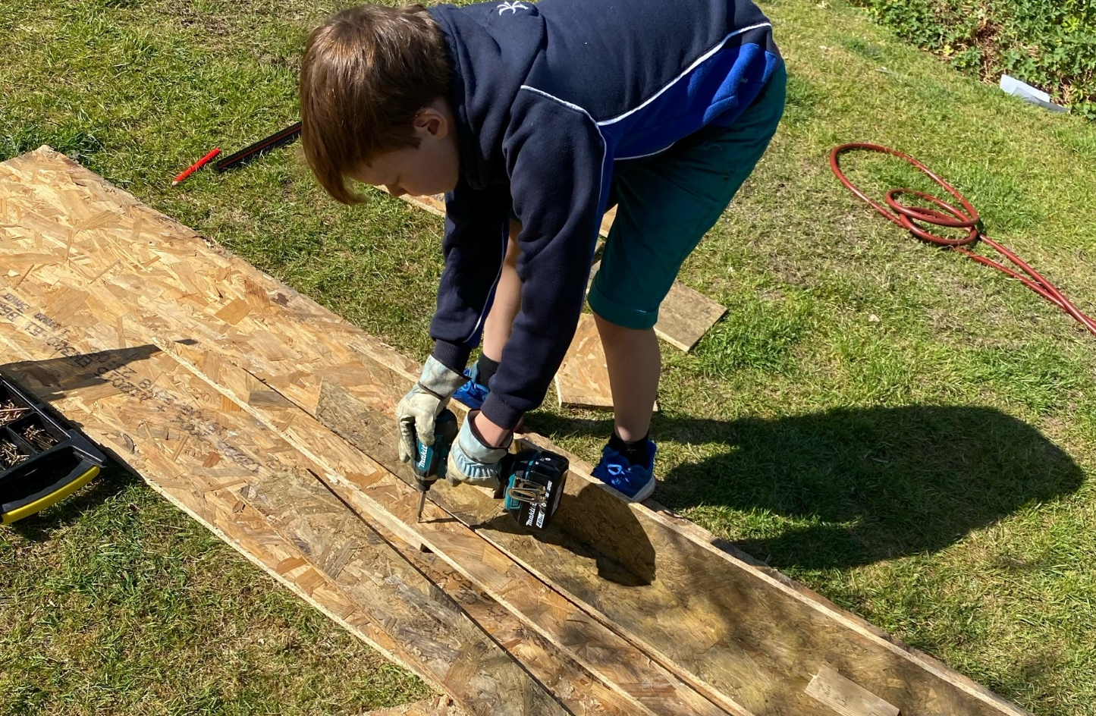
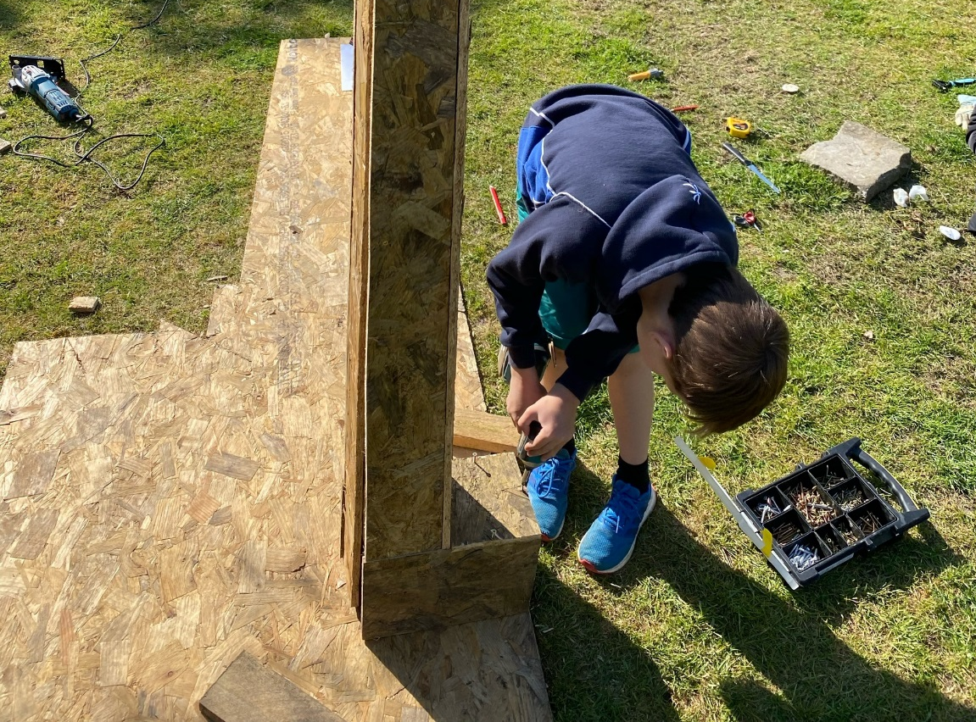
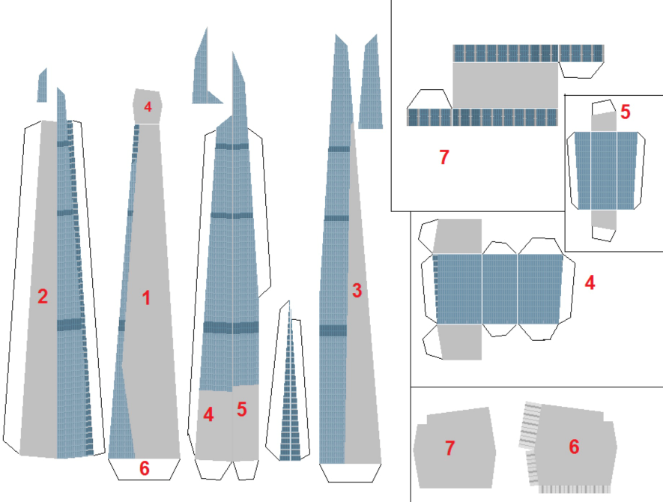
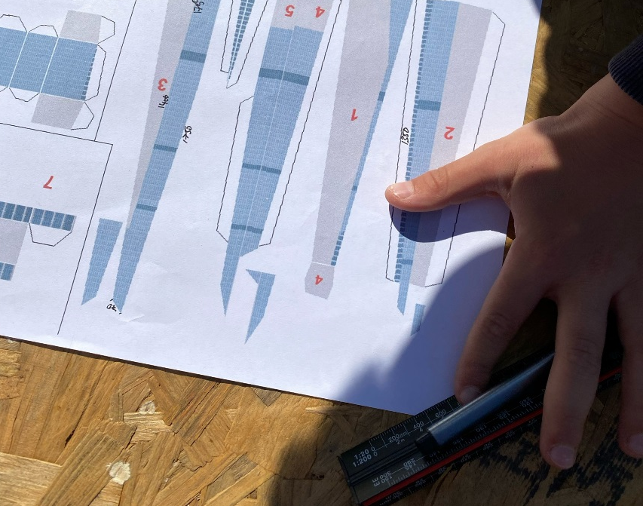

Slide 4
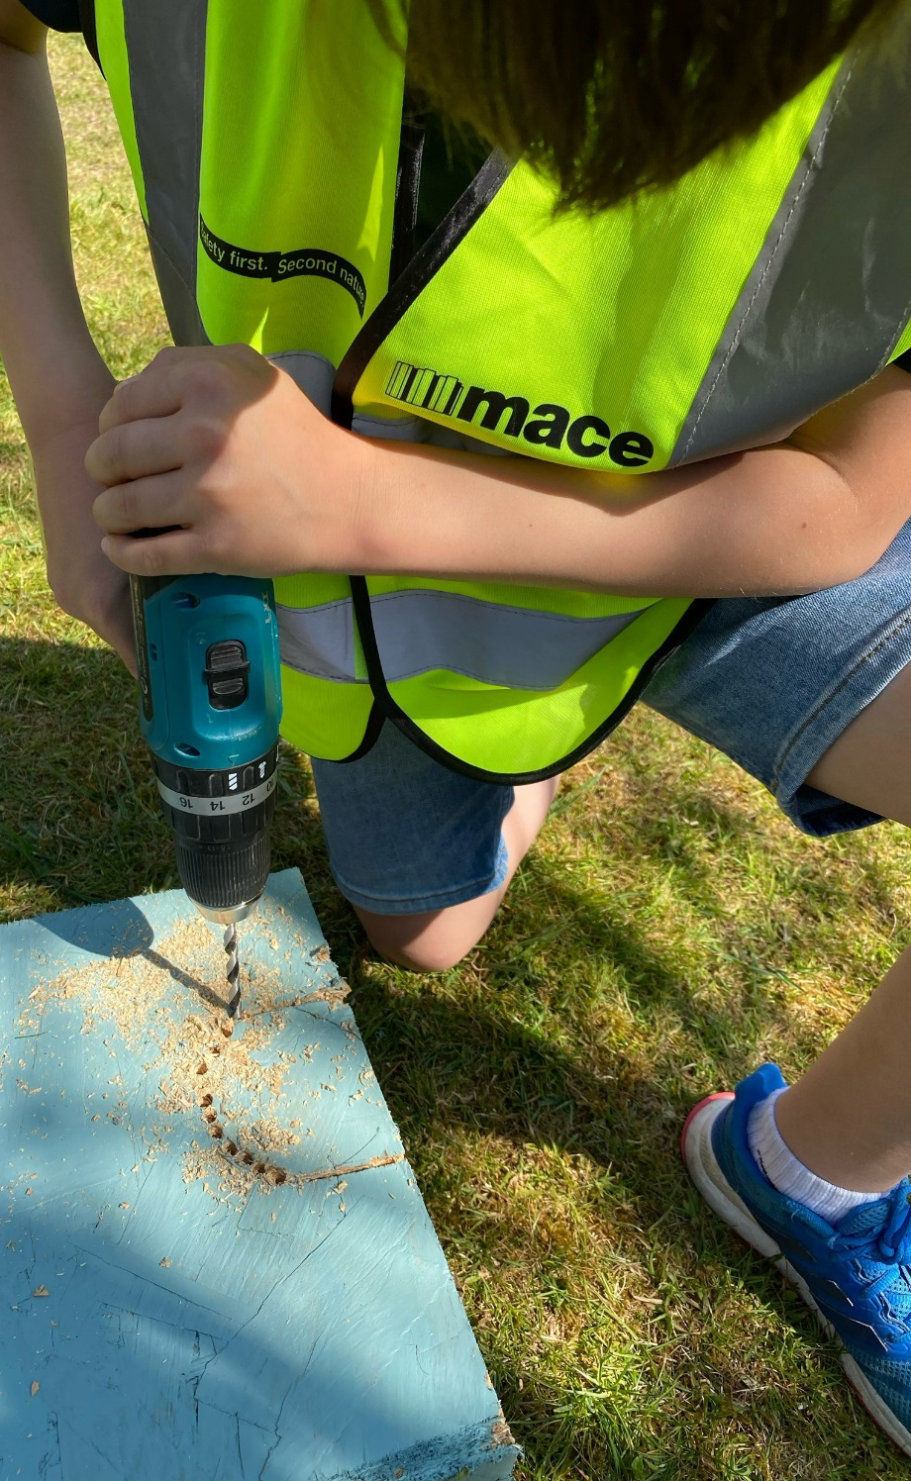
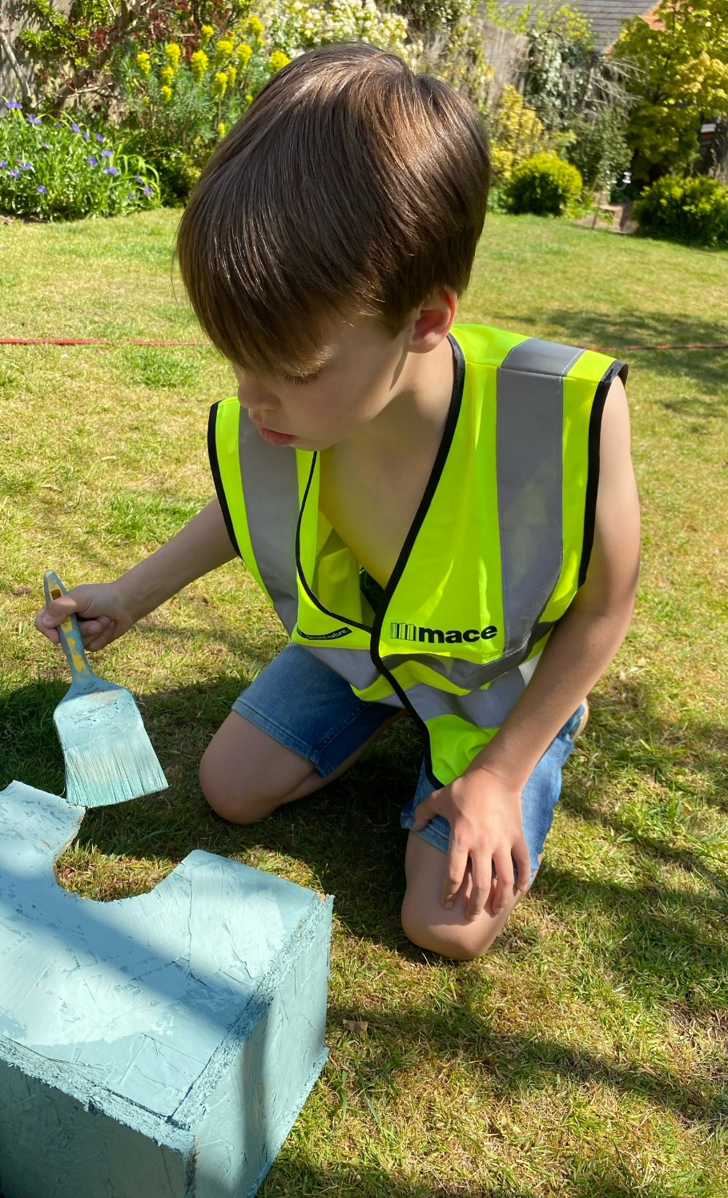
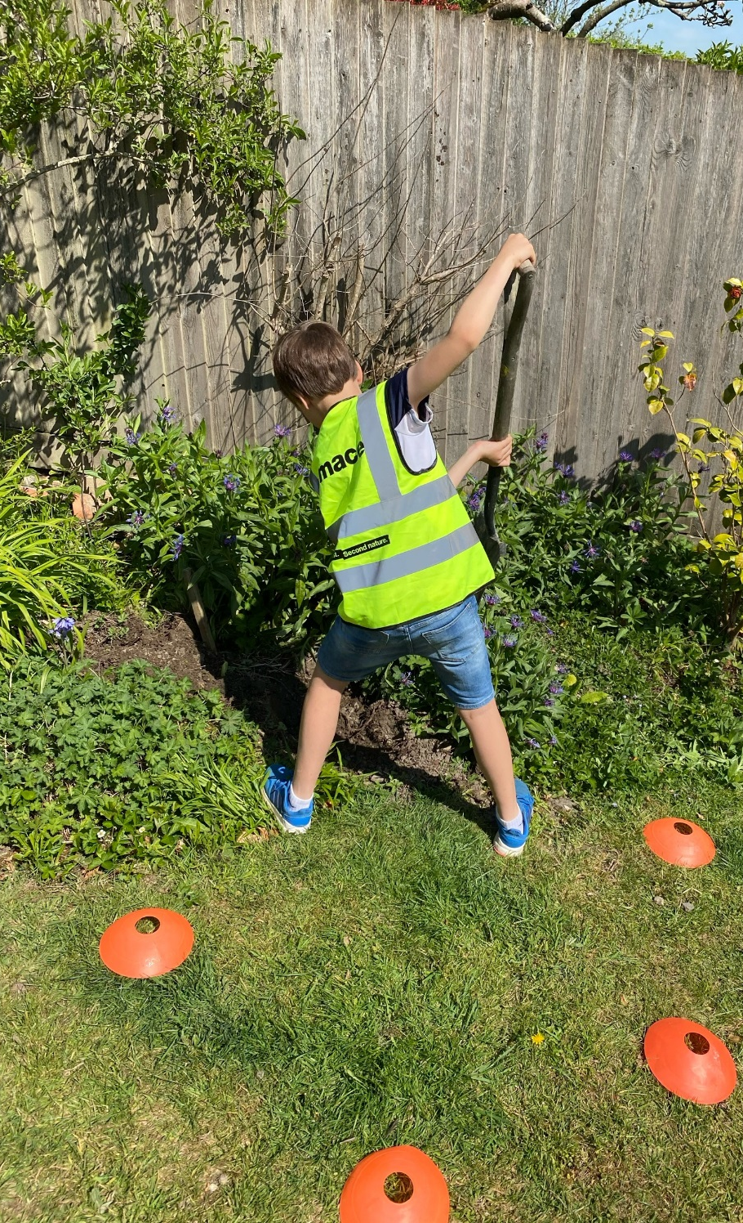

Slide 5
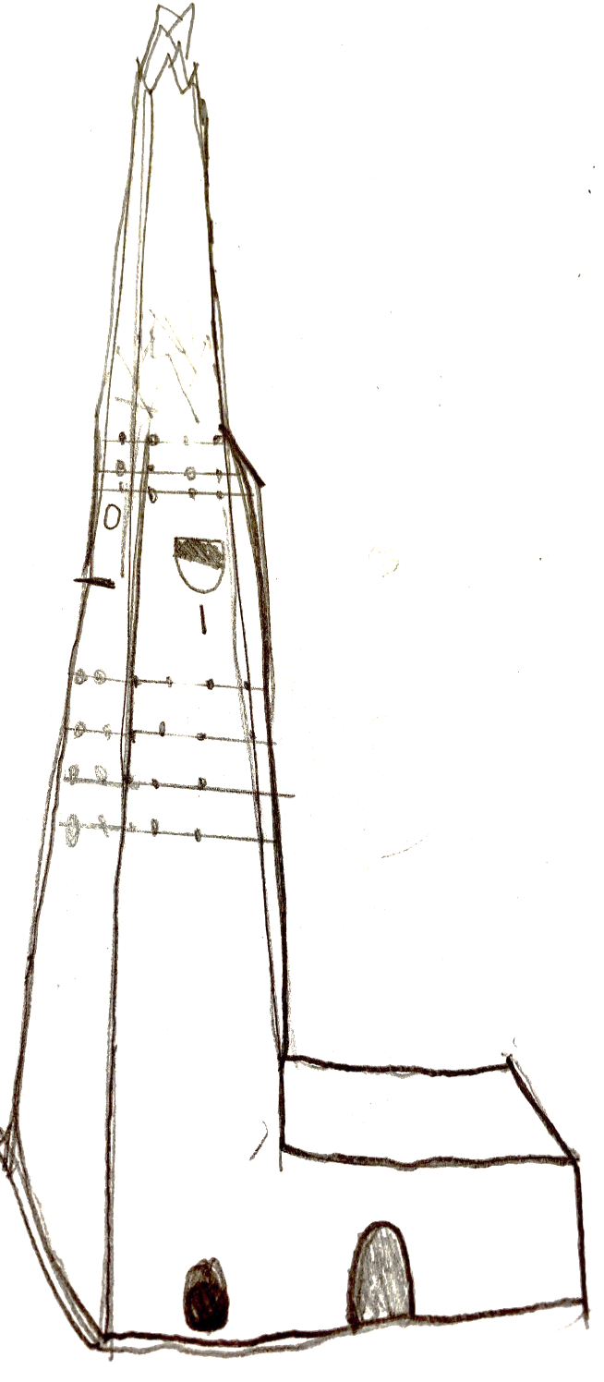
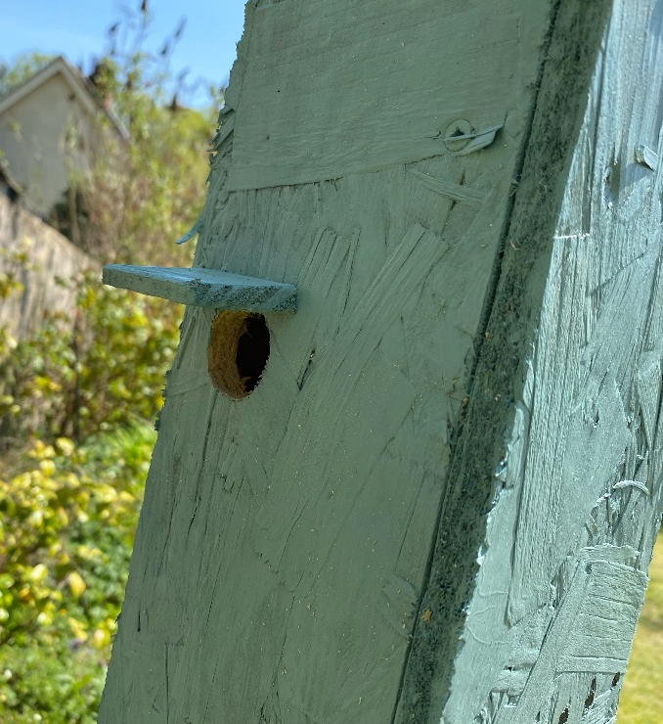
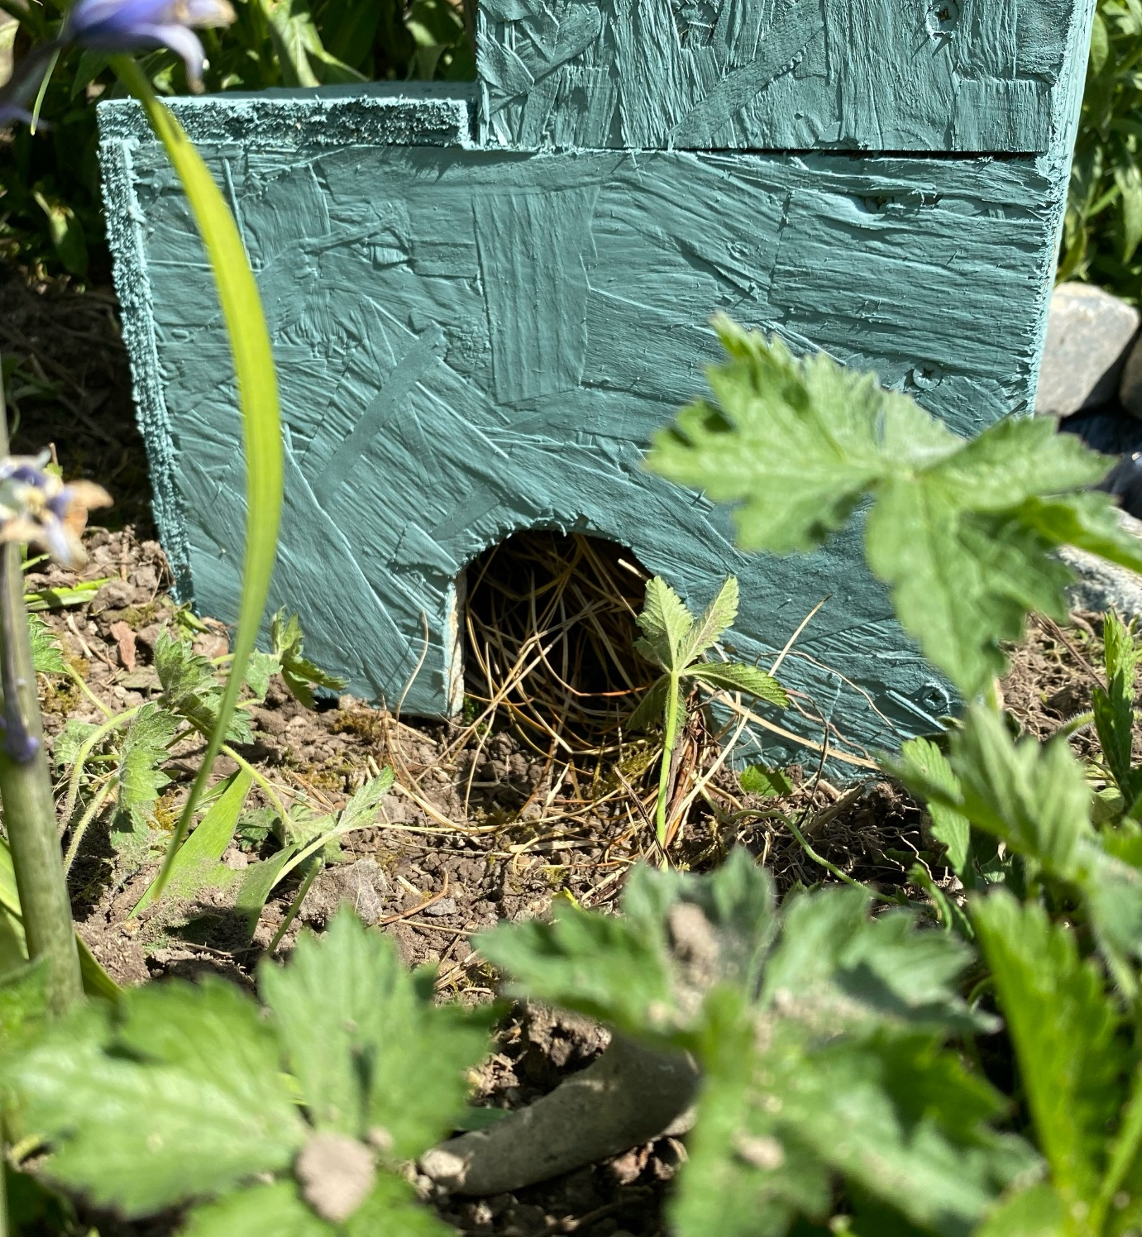
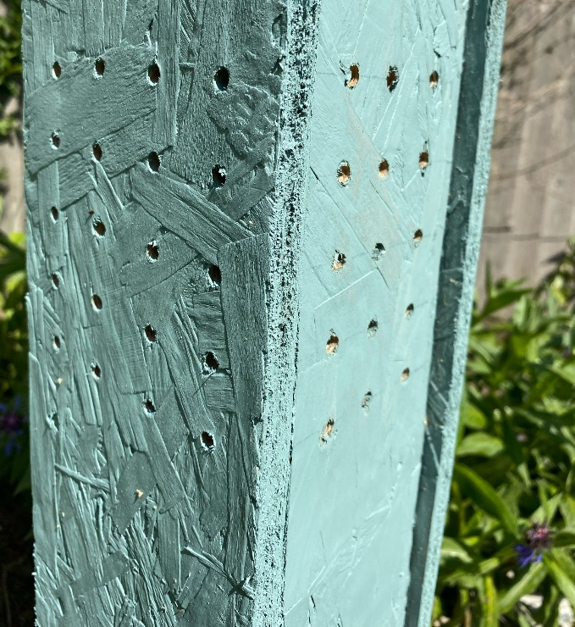

Slide 6


