Slide 1
PSHE and Citizenship
Relationships | Be Yourself
PSHE and Citizenship | Year 5 | Relationships | Be Yourself | Let It Out! | Lesson 2

Slide 2
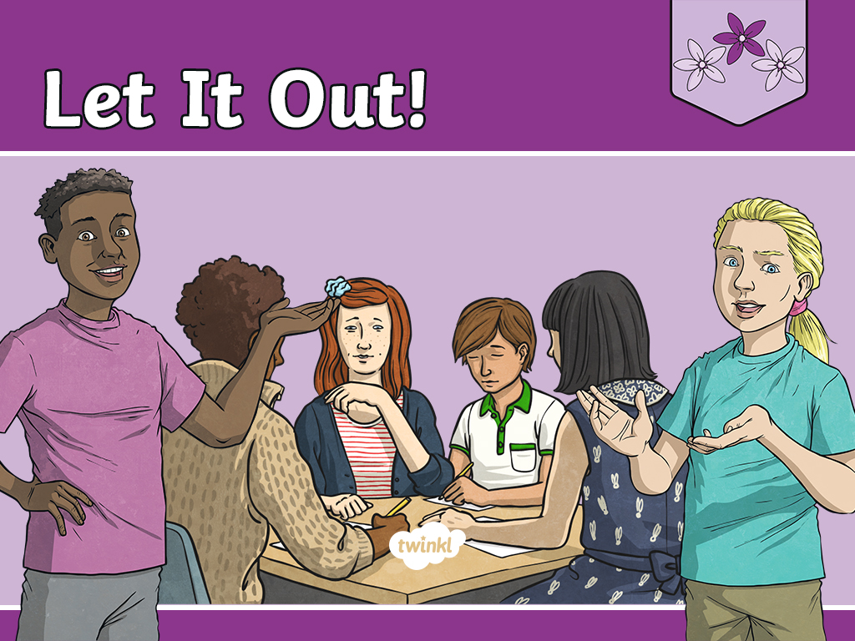

Slide 3
Aim
I can explain why I should share my own thoughts and feelings and I know how to do this.
Success Criteria
I can identify the thoughts and feelings I am happiest to share.
I can identify when I am comfortable sharing my true thoughts
and feelings.
I can discuss the positive impact of sharing my true thoughts and feelings.
I can describe how I would communicate my thoughts and feelings in different situations.
I can reflect on how I can support others in sharing their thoughts and feelings with me.
This resource is fully in line with the Learning Outcomes and Core Themes outlined in the PSHE Association’s Programme of Study.

Slide 4
The Big Questions

Slide 5

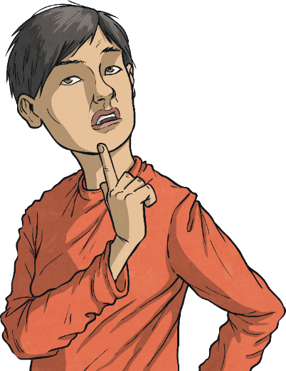

Why is it important to share our thoughts and feelings with those around us?
How can we communicate our thoughts and feelings to others?

Slide 6
Reconnecting

Slide 7

Expressing Our Thoughts
Which situations do you find it easier to share your thoughts and feelings in?
Are some feelings easier to express than other feelings?
When we are with people we feel happy with, we may feel more confident to share our true thoughts and feelings.
We also might find comfortable and positive thoughts and feelings easier to share than uncomfortable thoughts and feelings.
Sometimes, we may express positive thoughts and feelings because we want to fit in with the group of people we are with. We may feel unable to express our true thoughts or feelings for fear of not being accepted.
However we are feeling or whatever thoughts we may have, it is important we share them with people. This can help us to manage our emotions and encourage our minds to stay healthy.

Slide 8
Exploring

Slide 9


Sharing
Discuss each of the following scenarios with a partner. Identify the positive impact the sharing of true thoughts and feelings would have on the situation.
Tom does not want to jump into the swimming pool as he feels frightened. All of his friends are jumping in, so Tom feels like he needs to do it too. He thinks that if he doesn’t do it that his friends might make fun of him.

Slide 10
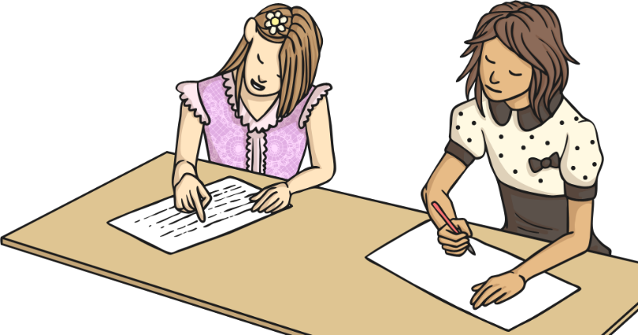
Sharing
Ajara is saying that the teacher has been unfair because she has made her and some of her classmates stay in to finish their work. She is saying that they should all go outside, even though they have not finished their work yet. Her friend Helen is feeling worried as she thinks that she should do as her teacher asked and finish her work first.

Slide 11
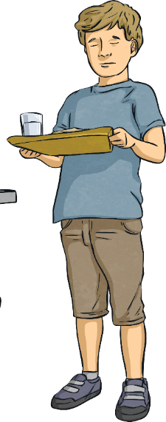
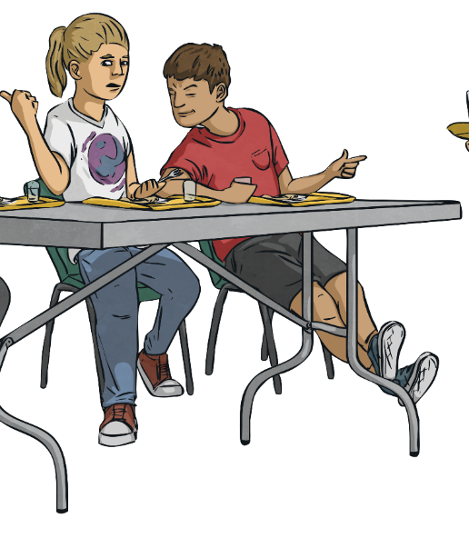
Sharing
Toru has been asked if he wants to go up for seconds of school dinners. He is feeling really hungry but his friends are telling him to come outside to play. He thinks that if he doesn’t go outside with them, he will spend playtime alone.

Slide 12
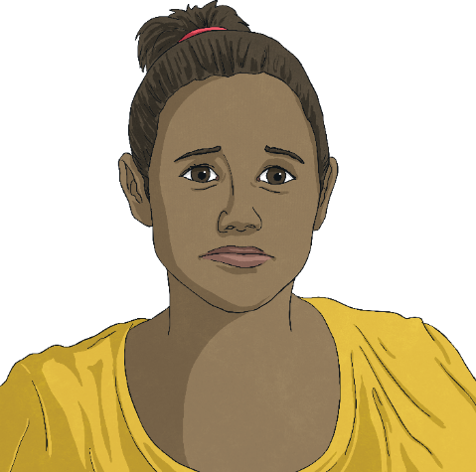
Sharing
Lilia has been feeling really sad inside, she’s not sure why and this is making her feel worried too. The thoughts she is having are also worrying her. She is trying really hard to pretend that she is fine. She thinks that if she shares how she is really feeling, people won’t want to spend time with her.

Slide 13
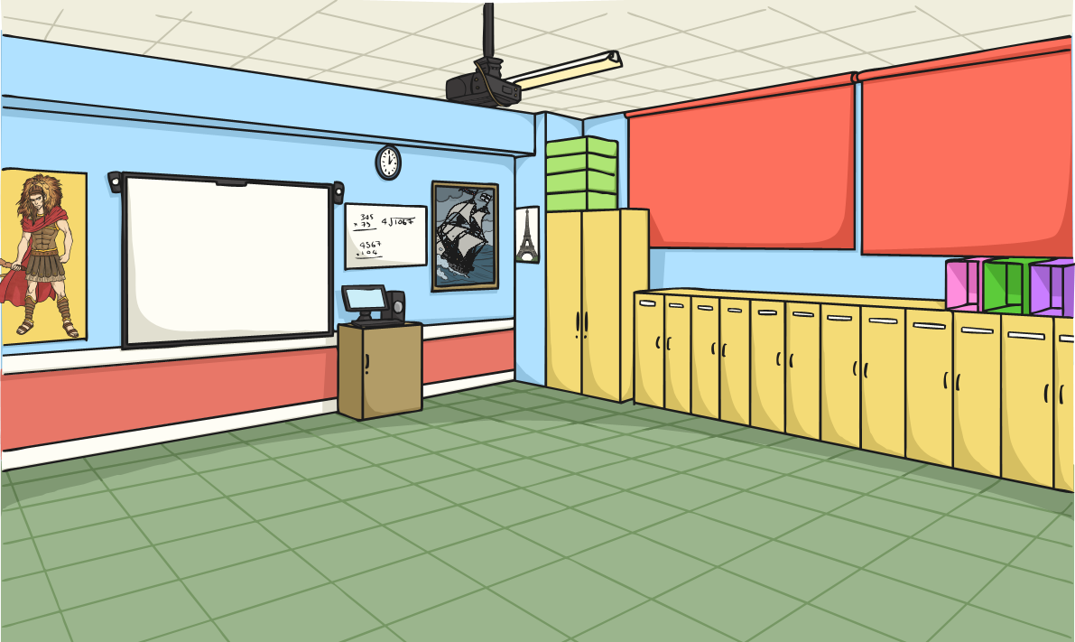
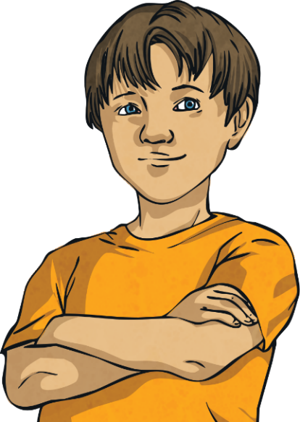
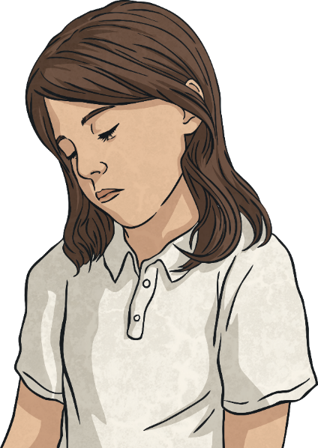
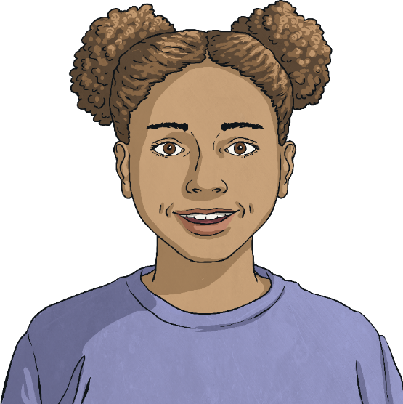
Sharing
Sometimes big things might happen in our lives which can bring big changes to our situation. Change can be hard and these changes can result in uncomfortable and confusing feelings and emotions, all of which are completely normal and OK.
We experience lots of different feelings and emotions all in one day. This is because we experience lots of different situations all in one day.
Can you think what changes these could be?

Slide 14
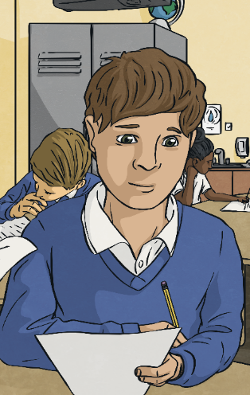
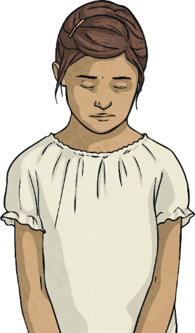
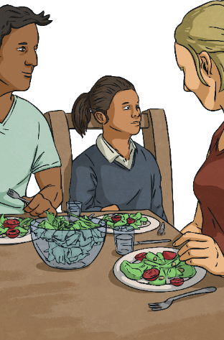
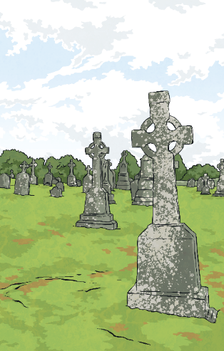
Sharing
Starting a new school or a
new class.
Losing something that we love or has played a big part in our lives.
Families separating
or parents
getting divorced.
Someone or something that we love dying.

Slide 15
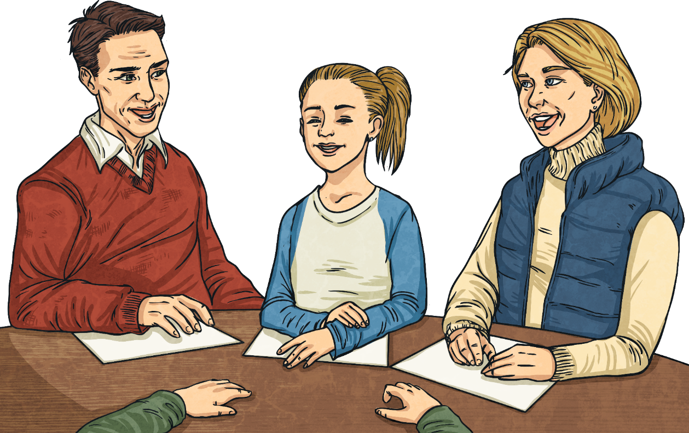

Sharing
If you experience any big changes in your life which you are finding hard, talk to someone you trust about how you are feeling.
There are lots of people who can help you manage and deal with times of change and help you to feel calm and happy again.

Slide 16
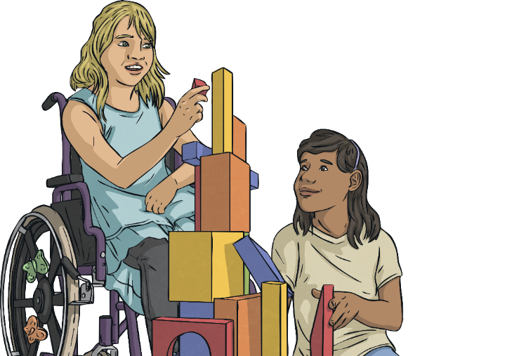
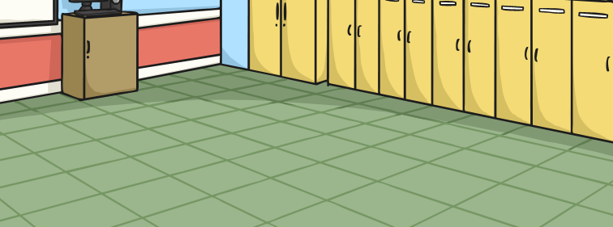
Sharing
However we are feeling or whatever thoughts we are having, it is important to share these.
This can help us manage our emotions and keep our minds healthy too.
Sharing our true thoughts and feelings can help others to feel comfortable sharing theirs too.

Slide 17

Communicating
When we are needing to share our thoughts and feelings, the way we communicate them makes a big difference to how we are understood and supported.
For example, by speaking calmly and politely we can disagree with someone without causing them any upset or offence. This requires us to think about what we are going to say before we say it.
We can also express our thoughts and feelings through our facial expressions and our body language. With a partner, practise showing them when you are upset or happy – use both your body language and facial expressions.
If we find speaking about our thoughts or feelings hard, we could write them down in a letter or draw a picture to express them.

Slide 18

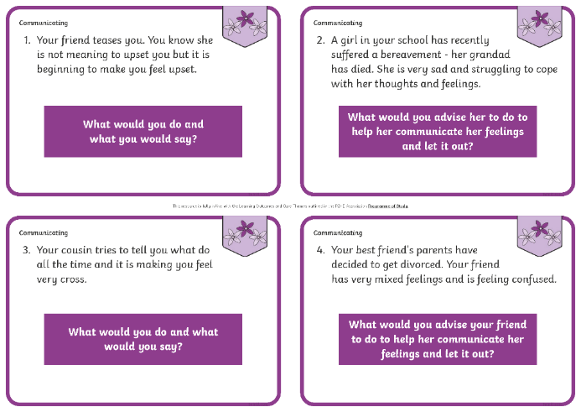
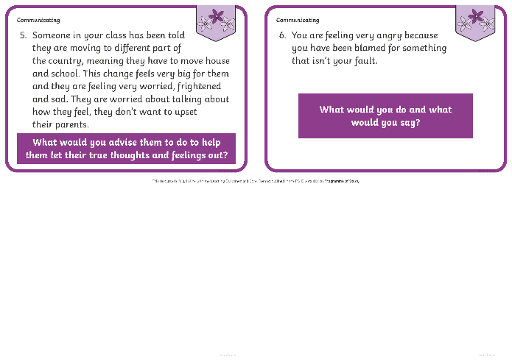
Communicating
In your group, read each given scenario and discuss how you might communicate your true thoughts and feelings in each situation.
Consolidating
Reflecting

Slide 19
Consolidating

Slide 20
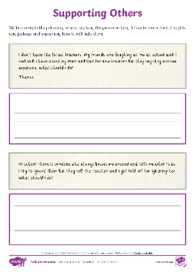
Supporting Others
Think carefully about the vast range of different feelings people experience.
How should we listen when others are sharing their thoughts and feelings?
Should we judge them?
Write a reply to each of the letters, advising the person involved how to share the thought or feeling they are experiencing.

Slide 21
Reflecting

Slide 22
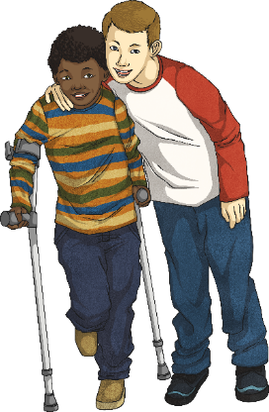
Being There
It is important to share our true thoughts and feelings with people.
What different ways can we help others to share their true thoughts and feelings with us?
How can we ‘be there’ for our friends?
Share your thoughts with a partner and then with the class.
Letting our thoughts and feelings out (and helping others to do the same) can help us all feel happier inside. It can also help us to build successful and trusting relationships with each other.
Let’s be a class that supports each other!

Slide 23
The Big Questions

Slide 24
Why is it important to share our thoughts and feelings with those around us?
How can we communicate our thoughts and feelings to others?
How will you use what you have learnt today in
your daily life?

Slide 25
Aim
I can explain why I should share my own thoughts and feelings and I know how to do this.
Success Criteria
I can identify the thoughts and feelings I am happiest to share.
I can identify when I am comfortable sharing my true thoughts
and feelings.
I can discuss the positive impact of sharing my true thoughts and feelings.
I can describe how I would communicate my thoughts and feelings in different situations.
I can reflect on how I can support others in sharing their thoughts and feelings with me.

Slide 26


