Slide 1
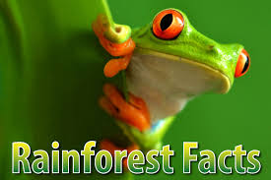
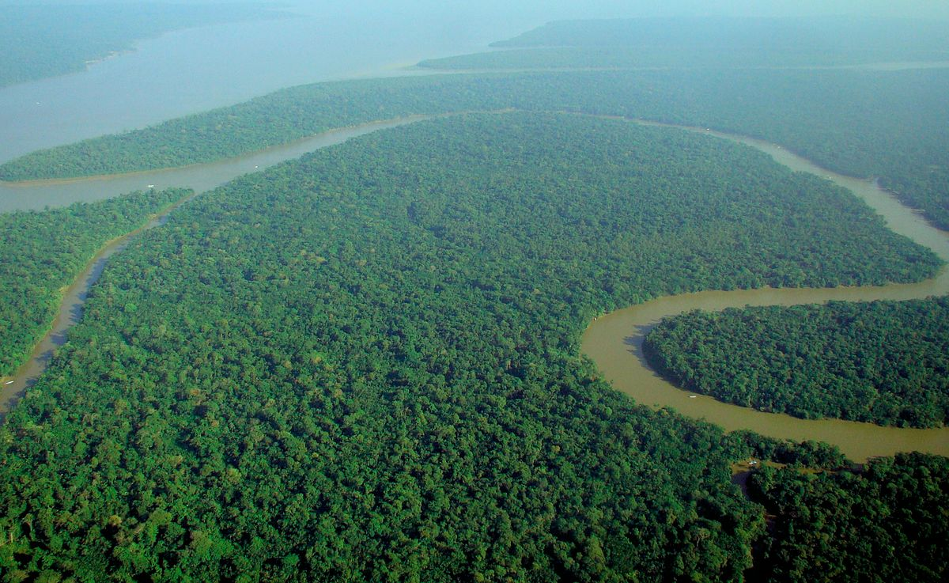
RAINFORESTS
What would we do without them ?
This Photo by Unknown Author is licensed under CC BY-SA

Slide 2

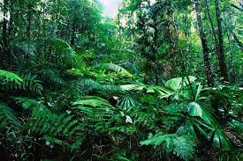
FACTS
Rainforests are two percent of the world’s surface.
Fifty percent of the world’s plants and animals live in the rainforests.
Rainforests got their name because of the high amounts of rainfall they get and because they are like forests.
Franciso de Orellana named and discovered the rainforest, he was a Spanish soldier.

Slide 3
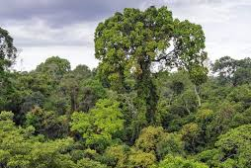
Animals that live in the rainforest
Here’s a dozen of the 10 million species that live in the rainforest:
Poison dart frog , toucan , jaguar, macaws , tapis ,anteaters , capybaras, ocelots, sloths, okapis, piranhas and harpy eagles.
If you want to see other animals simply click on the link: https://www.google.com/search?q=Animals+in+the+rainforests&rlz=1C1GCEB_enGB885GB885&oq=a&aqs=chrome.0.69i59j69i60l4j5l3.2871j0j7&sourceid=chrome&ie=UTF-8

Slide 4
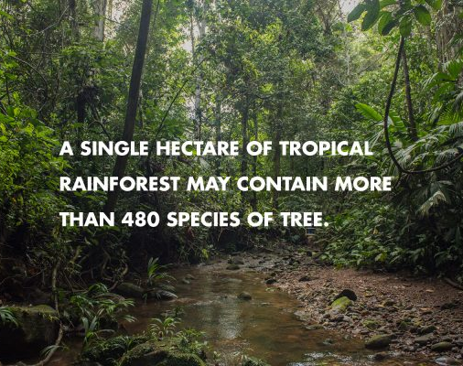
Where rainforests are found
Rainforests are found on every continent except Antartica.

Slide 5
https://www.google.com/search?q=who+named+the+rainforest&rlz=1C1GCEB_enGB885GB885&oq=who+named+the+rai&aqs=chrome.3.0j69i57j0l6.50133j0j7&sourceid=chrome&ie=UTF-8
For the other links click here:
https://www.google.com/search?q=rainforest+facts&rlz=1C1GCEB_enGB885GB885&oq=r&aqs=chrome.0.69i59j69i57j0l3j69i61j69i60l2.2693j0j7&sourceid=chrome&ie=UTF-8
https://www.conserve-energy-future.com/various-tropical-rainforest-facts.php

Slide 6

END

