Slide 1
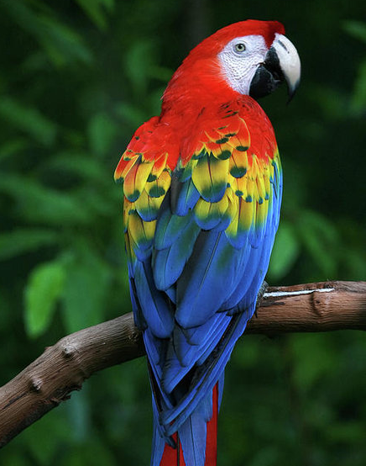
Scarlett macaw

Slide 2
It is a parrot that is attracted to humid evergreen forests of tropical Central and South America.
It is the national bird of Honduras.

Slide 3
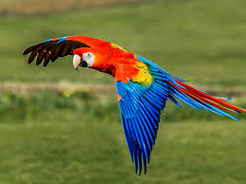
What they eat
They eat mostly fruits, nuts and seeds, including large, hard seeds.
They also eat sodium packed dirt and clay for minerals.

Slide 4
Parrot survival
In some areas , it has suffered local extinction because of habitat destruction.
People also capture the parrots for trade.
However, in other areas it still remains fairly common.

Slide 5
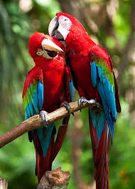
The average length of a Scarlett Macaw is 89cm.
They live for 40-50 years!!!

