Slide 1
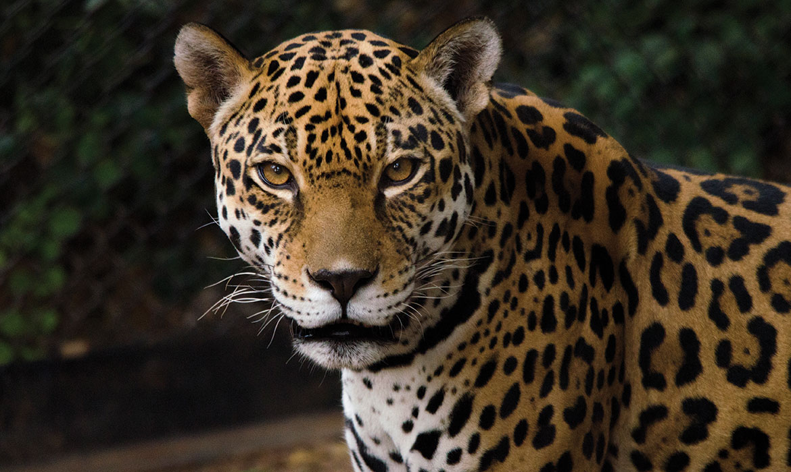
Jaguars!!!!!
By Gabriy’el ☺ ☺ ☺

Slide 2
The word 'jaguar' comes from the indigenous word 'yaguar', which means 'he who kills with one leap'. You’ll find out why later....

Slide 3
Jaguars used to be found from south-west USA, throughout South America to almost the far north in Argentina. Now, they’ve been virtually eliminated from half of their historic range. The jaguars’ stronghold is in Brazil – it may hold around half of the estimated 170,000 wild jaguars. Most of these big cats are found in the Amazon rainforest and the Pantanal, the largest tropical wet land.

Slide 4
The jaguar is the third biggest cat in the world - after the tiger and the lion - and is the largest cat in the Americas. They can grow up to 170cm long, not including their impressive tails which can be up to 80cm. Males can weigh 120kg (that’s almost 19 stone), but the size of jaguars can vary a lot between regions - jaguars in central America can be roughly half the size of jaguars in the Pantanal. They need that bulk behind them to take on big prey, including giant caiman.

Slide 5
To the untrained eye, jaguars can be mistaken for leopards, but you can tell the difference from their rosettes (circular markings): Jaguars have black dots in the middle of some of their rosettes, whereas leopards don’t. Jaguars also have larger, rounded heads and short legs. Jaguars can be “melanistic", where they appear almost black. Melanistic jaguars (and leopards) are known as “black panthers”.

Slide 6
Unlike many domestic cats, jaguars don’t avoid water. They often live near lakes, rivers and wetlands, and are confident swimmers, known to cross large rivers.

Slide 7
Both males and females roar, which helps bring them together when they want to mate. A jaguar's usual call is called a 'saw' because it sounds like the sawing of wood - but with the saw only moving in one direction. When jaguars greet each other, or reassure one another, they make a noise like a nasally snuffling.

Slide 8
Jaguars are opportunistic hunters and can prey upon almost anything they come across. Capybaras, deer, tortoises, iguanas, armadillos, fish, birds and monkeys are just some of the prey that jaguars eat. They can even tackle South America’s largest animal, the tapir, and huge predators like caiman. Jaguars hunt both in the day and at night and usually travel up to 10km (over 6 miles) a night when hunting.

Slide 9
Jaguars have a more powerful bite than any other big cat. Their teeth are strong enough to bite through the thick hides of crocodilians and the hard shells of turtles. They need powerful teeth and jaws to take down prey three to four times their own weight - usually killing it with a bite to the back of the skull rather than biting the neck or throat like other big cats. Like other cats, their tongues have sharp-pointed bumps, called papillae, which are used to scrape meat off bones.

Slide 10
When breeding, a pair of jaguars may mate up to 100 times a day. That’s exhausting. Pregnancy lasts around 14 weeks, then the female usually gives birth to two cubs (though she can have up to four). Cubs weigh about the same as a loaf of bread when they’re born, but they soon grow. At two years old, males can be 50% heavier than their female siblings.

Slide 11
Deforestation rates are high in South America, both for logging and to clear space for cattle ranching. This results in many new threats to jaguars, from the loss of their home to isolating their populations, making breeding harder. Less habitat also means jaguars’ prey is reduced - over a quarter of their range is thought to have depleted numbers of wild prey. This leads them to hunt livestock and be killed by people. They’re also vulnerable to poaching, despite this being illegal. Though demand for their skins has declined since the mid-1970s, jaguar paws, teeth and other parts are still sought after, mostly from China for traditional medicine and ornaments.

Slide 12

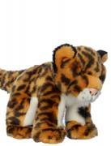

I think if Jaguars became extinct then the rainforests wouldn’t be the same so please ADOPT a jaguars at WWF
You will obtain various Items like
You will get to find out how YOUR jaguar is doing
https://support.wwf.org.uk/adopt-a-jaguar
An optional soft toy to love for ever.
A fact pack, packed with facts ,bookmarks and stickers

Slide 13

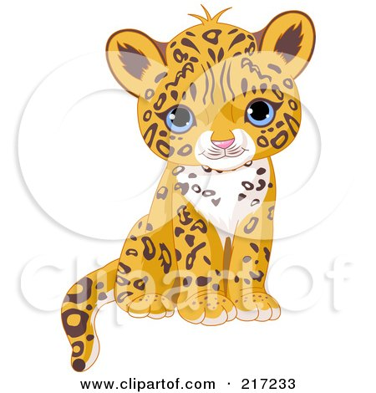
These cartoon Jaguars are SOOO CUTE!
Thank you for looking at my powerpoint

