Slide 1

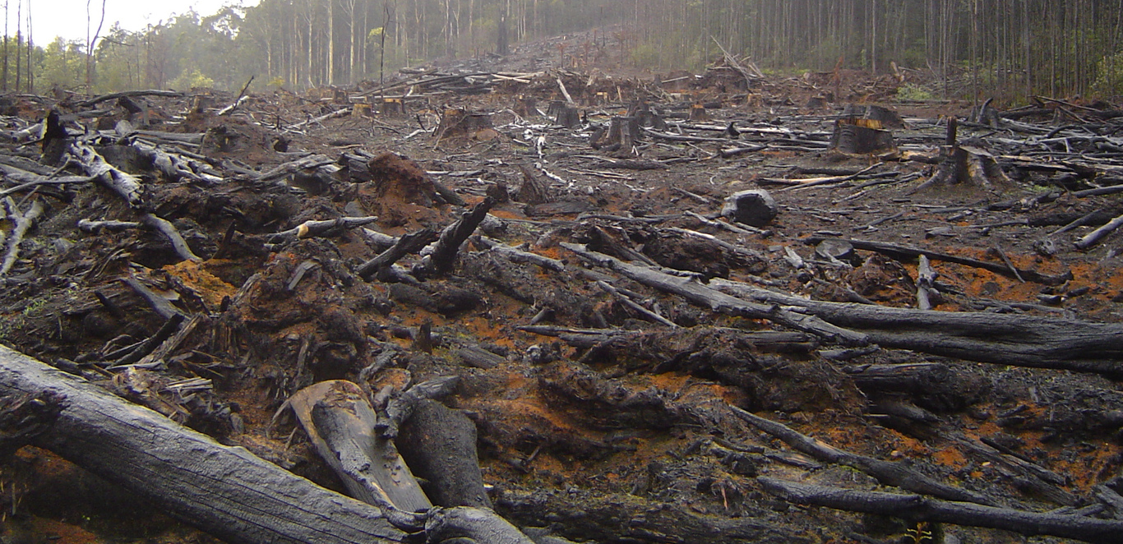
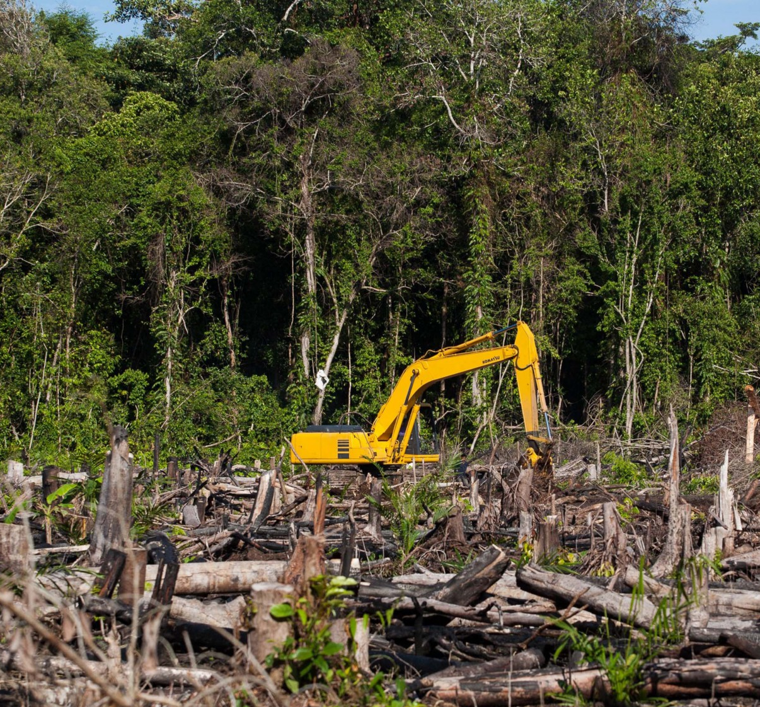
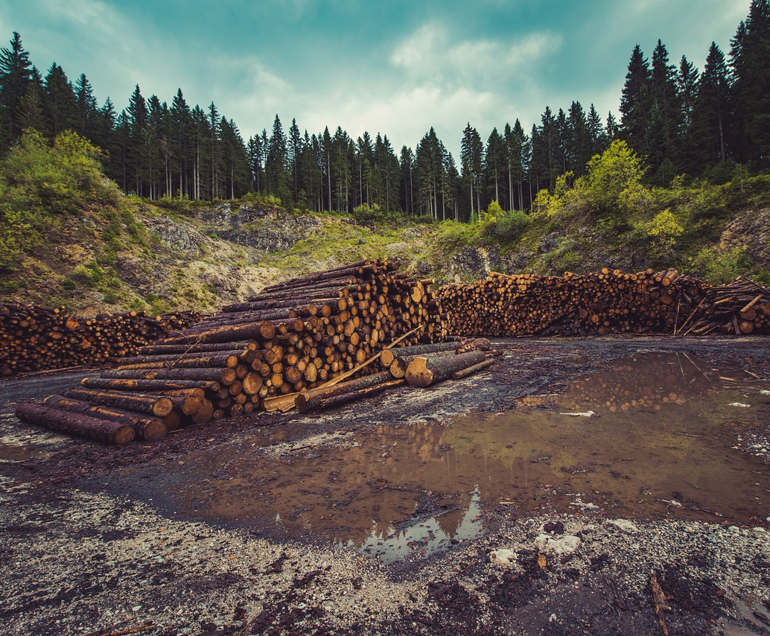
Rainforest
Rainforests are dying, save them – or there will be no more chocolate, shampoo and many other products. #SaveTheForests

Slide 2
What is happening?
WARNING:
You need to support the forests otherwise WE WILL NOT LIVE. Without the every-day products we use, we cannot be clean, have a good enough life.
We cannot live without these luscious forests.
Now to check what you already know I suggest you check your knowledge with this true and false quiz.

Slide 3
True and false quiz:
1. Do the following products come from the rainforest?
Pineapples, bananas, citrus fruits, yams, cocoa, sago, cassava, heart-of-palm, avocado, papayas, mangos, Brazil nuts, winged beans, rubber, vanilla, nutmeg, cinnamon, black pepper, rattan, latex, resins, tannins, steroids, waxes, bamboo, and several edible oils.
True!

Slide 4
True and false quiz:
2. Is a amount the size of a football pitch cleared from the amazon every second?
False! Don’t get confused – it’s that amount every minute.

Slide 5
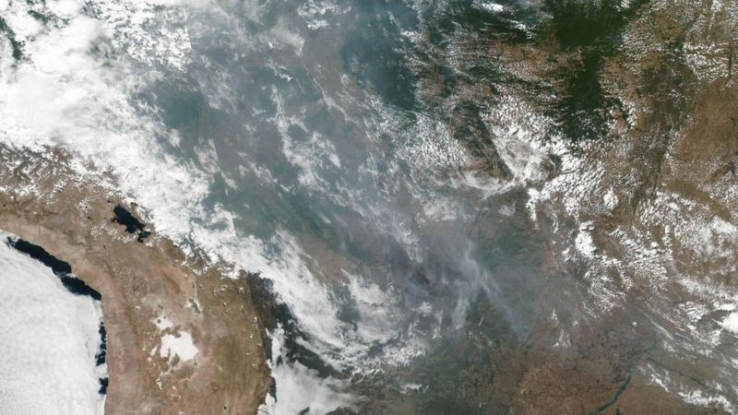
What is happening to our essential forests?
It is very bad, rainforests are being lost, before we’ve even be able to explore them.
Our forests are being destroyed, in 2019 great fires started, and then because it was so dry (it was in the summer) they just got bigger. You could see them from space!
That’s the smoke.
Palm oil and farming are the BIGGEST threats to deforestation except there’s others like log farming.

Slide 6


Palm oil
Palm oil is the WORST product in the whole world to buy if you love nature, the problem is though; it’s everywhere. You would have to spend at LEAST 3 hours at the supermarket if you wanted palm oil free products, and even then you probably still wouldn’t be able to avoid it!
Though, if you don’t want to spend 3hrs+ at the supermarket, just look for rainforest friendly
products (sustainable palm oil products) they should have one of the following logos:

Slide 7
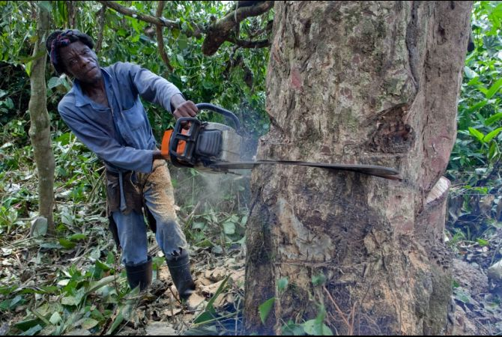
About wood chopping
Okay, so this is basically part of palm oil. To plant palm oil, you need to create space, so the easiest way to do that is destroy a rainforest…
Or to make room for cattle, you need space, to make roads, you need space.

Slide 8
What can I do?
There’s lots you can do, maybe try these:
What I can do | Link to get involved.
Protest against deforestation. | No link really, just walk around telling people about this horrible thing.
Make a poster about deforestation and stick it in your window. | No link for this either, I suggest draw a big poster (needs to be bold) or make something in electronic paint and send it to members of your family.
Donate to companies rescuing lost animals | I suggest WWF here’s the link: https://support.wwf.org.uk/adoptions
Use sustainable palm oil | (see slide 6 for info)

