Slide 1
Dangers of Deforestation
By GABRIY’EL ☺ ☺ ☺.

Slide 2

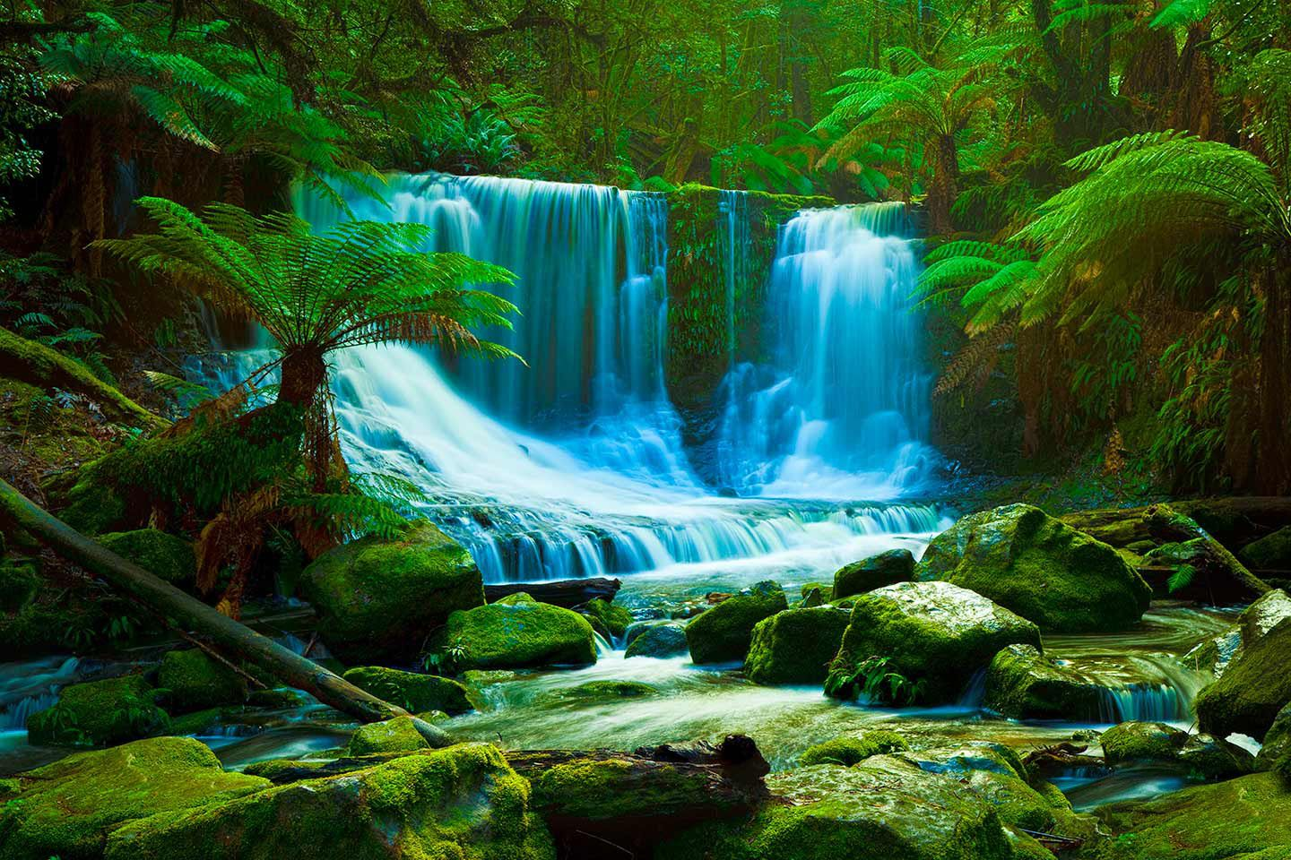
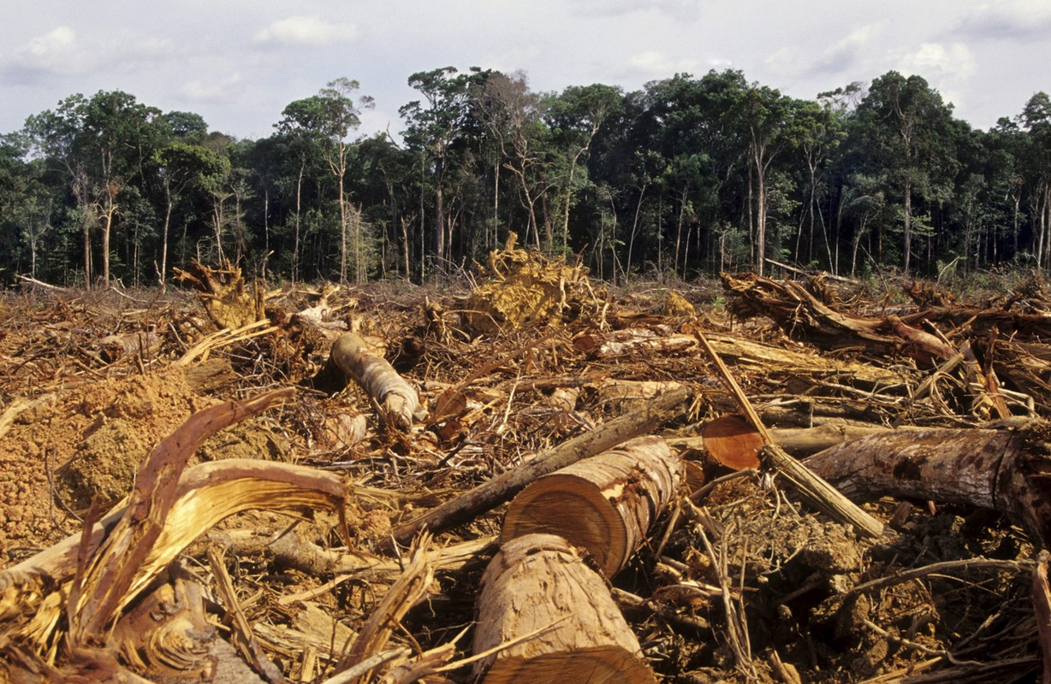
Before ☺
After ☹
See this it’s Pretty right?
You know these are both the Amazon!

Slide 3
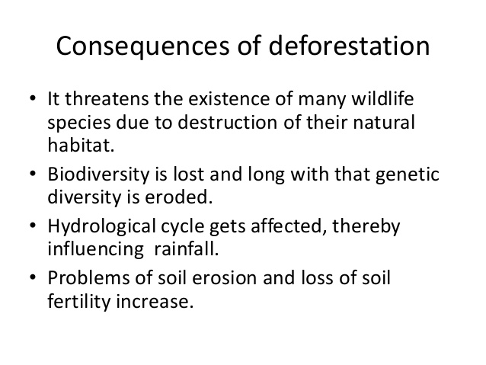
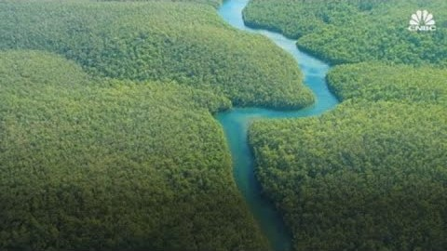
It causes some of the Indigenous tribes to find new homes and that’s not easy
🔎🏠
along
Here’s a clip!
.

Slide 4
It increases carbon dioxide in the atmosphere.
It further promotes the development of drought.
It focuses only on short-term gains.
It is a limited resource.
It contributes to the extinction of wildlife. T_T
😥😥

Slide 5


