Slide 1
PSHE and Citizenship
Living in the Wider World | Britain
PSHE and Citizenship | Year 5 | Living in the Wider World | Britain | Communities | Lesson 2

Slide 2
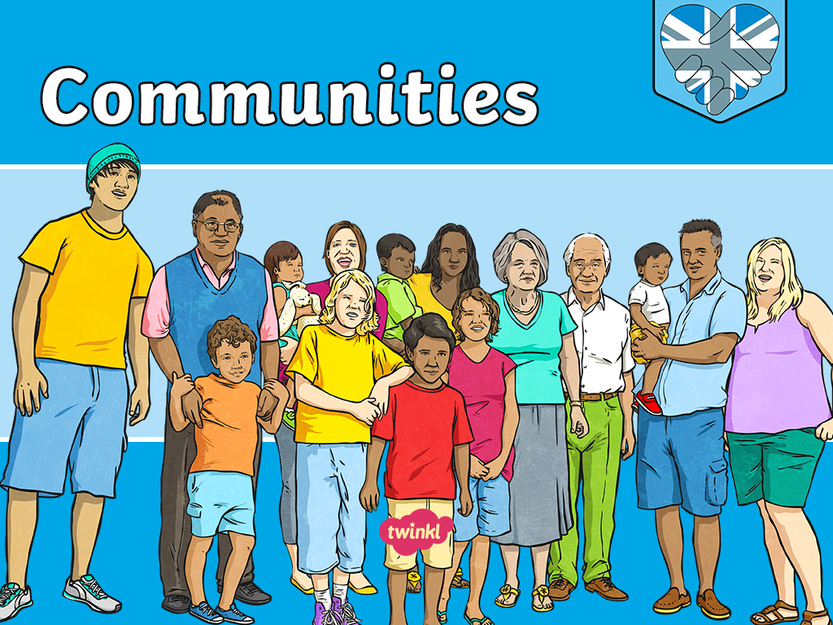

Slide 3
Aim
I can explain what a community is and what it means to belong
to one.
Success Criteria
I can talk about what a community is.
I can identify who makes a community.
I can discuss how the actions of people affect the community they are a part of.
I can think of ways I can make a positive contribution to my community.
This resource is fully in line with the Learning Outcomes and Core Themes outlined in the PSHE Association.

Slide 4
The Big Questions

Slide 5

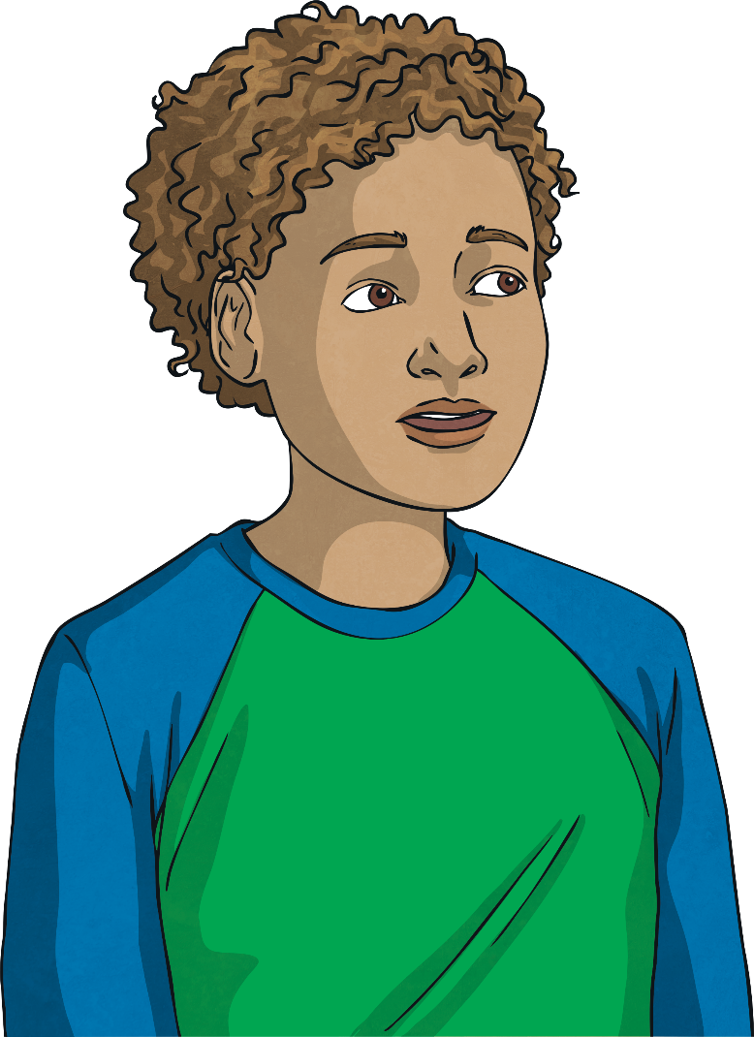
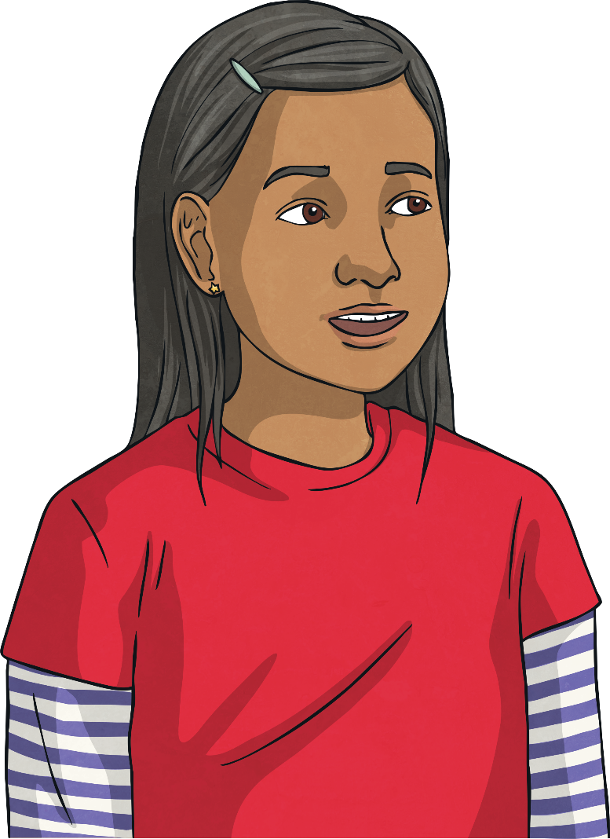
What is a community and who makes it what it is?
How can we contribute to our community?

Slide 6
Reconnecting

Slide 7

Community
What is a community?
Share your thoughts with a partner and then feed back all you have talked about to the class.
What We Think a Community Is

Slide 8
Exploring

Slide 9
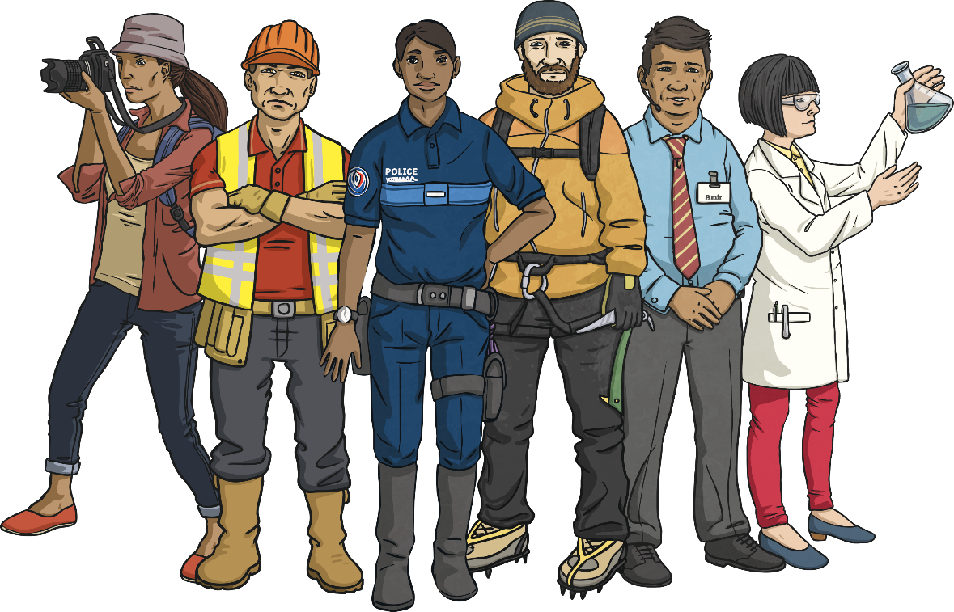
Making a Community
A community is a group of people living or working in the same place.
It is made up of the people who live there or belong to it.
The people of a community make it what it is. Their choices and actions can help make a community a positive place; they can also make it a negative place.
It is important we all make choices which help the communities we are a part of to be happy and successful places.
We can choose to be kind, helpful, thoughtful and selfless, thinking of the needs of others and not just our own.

Slide 10
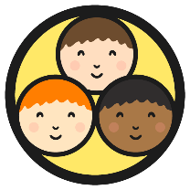
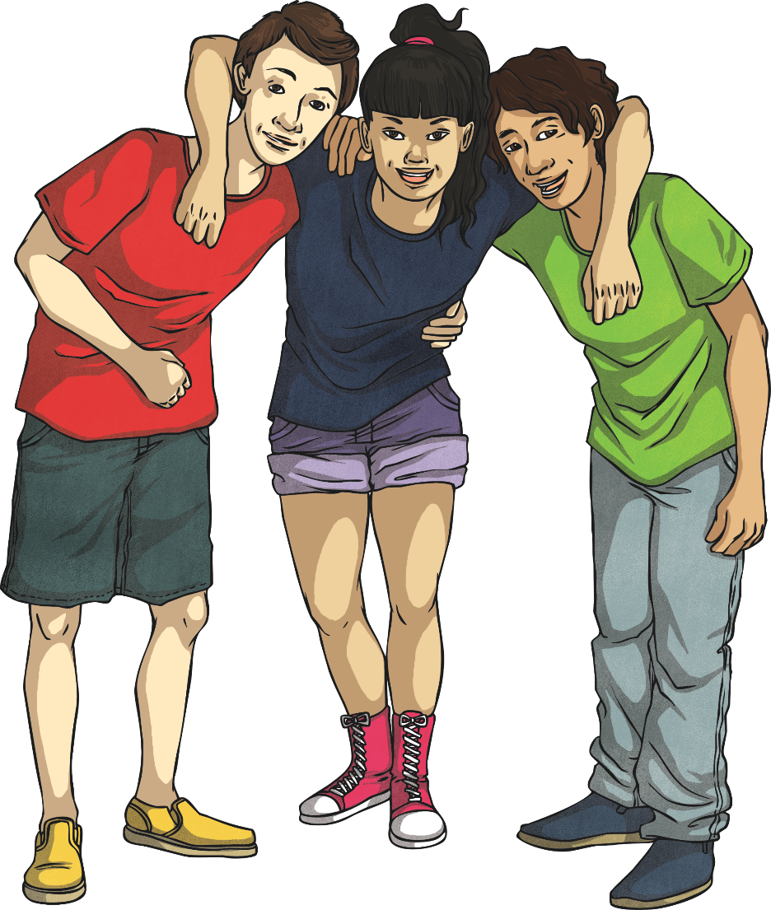
Community Spirit
Have you heard of the term ‘community spirit’?
What do you think this means?
It means being involved in, and caring about, the community you belong to and the people in it.
It means acting in a way which helps those in your community and wanting to make it a better place for all.

Slide 11
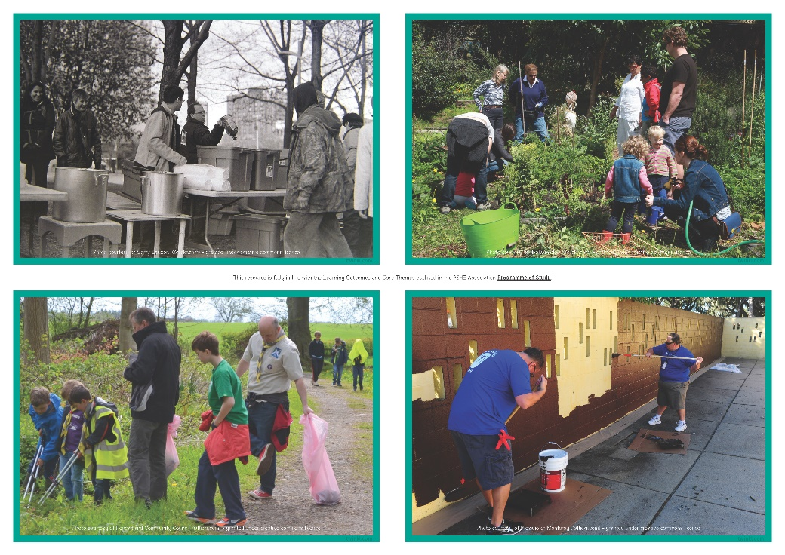
Community Spirit
You are going to work in a small group to look at an image of a community.
In your groups, look carefully at your image and discuss your answers to these questions:
What is happening in the picture?
How are the people contributing to their community?
How are the people showing ‘community spirit’?
Now, share your image and thoughts with the rest of the class.
People make the communities to which they belong. We can all make a positive contribution to our communities by making positive and helpful choices and acting in a way which shows community spirit.
Reflecting
Consolidating

Slide 12
Consolidating

Slide 13

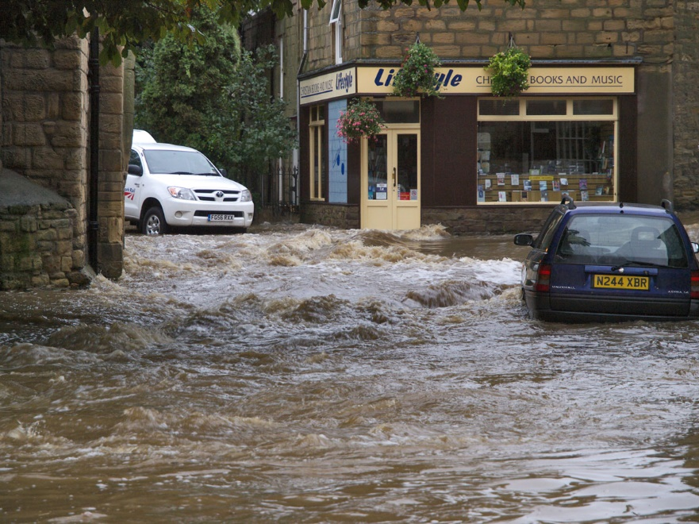
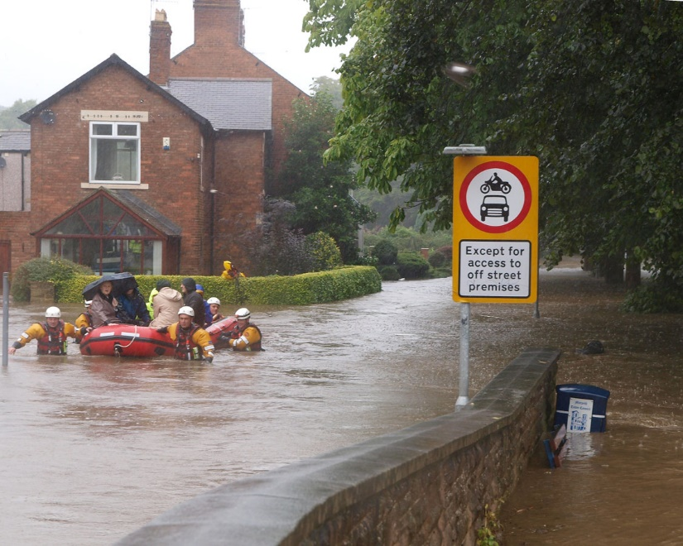
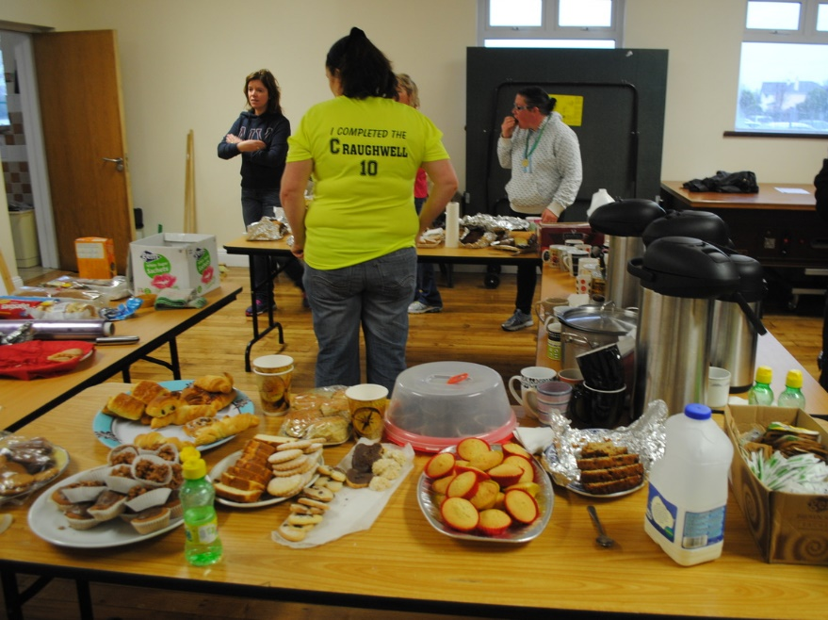
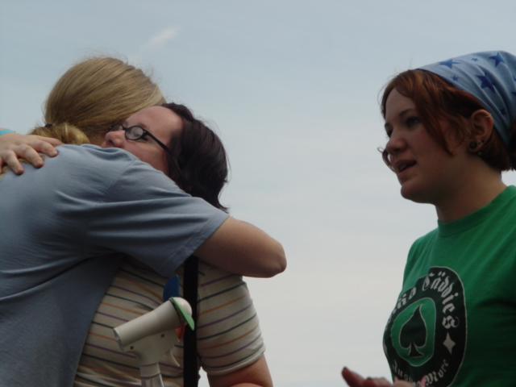
Being Part of a Community
Have a look at the images below.
What can you see? What has happened? What are the people of the community doing to help?
Photo courtesy of Johndal (@flickr.com) - granted under creative commons licence
Photo courtesy of Peter Mooney (@flickr.com) - granted under creative commons licence
Photo courtesy of Klif (@flickr.com) - granted under creative commons licence
Photo courtesy of Johndal (@flickr.com) - granted under creative commons licence

Slide 14
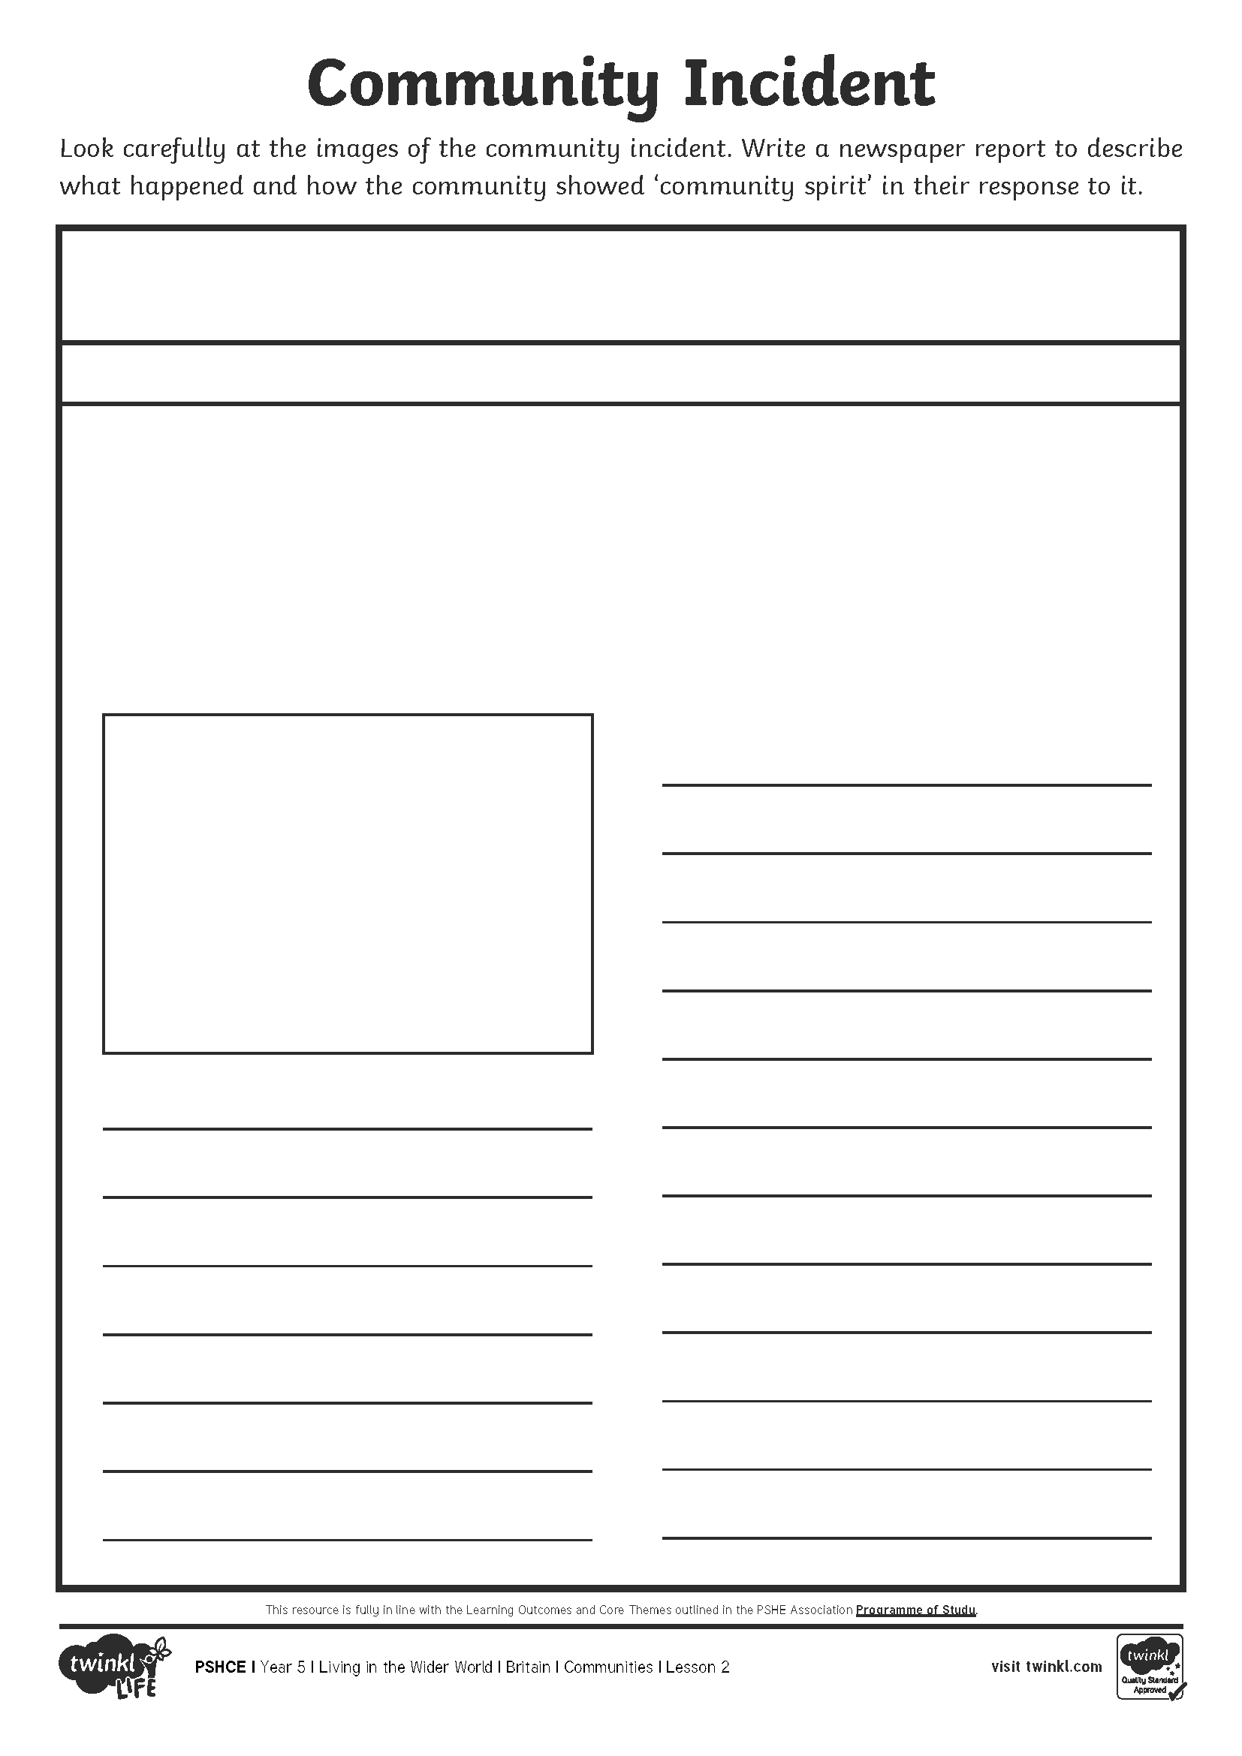
Being Part of a Community
Write a newspaper report which describes the incident and explains how the people of the community helped each other, contributed positively and showed community spirit.
Word Bank:
community
community spirit
impact
positive
help
donate

Slide 15
Reflecting

Slide 16

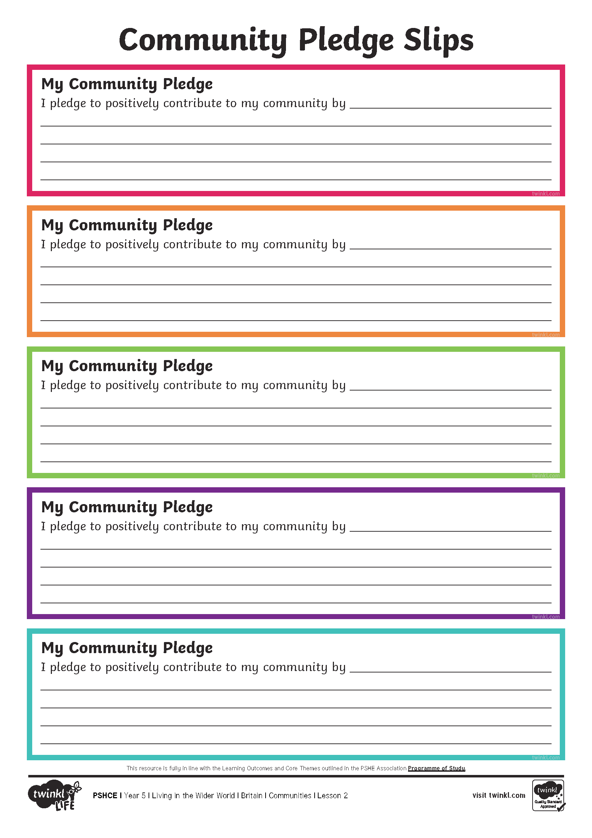
Making a Positive
Contribution
All people can positively contribute to the communities they live and work in, making them a better place for all people and living things within them.
How could you positively contribute to your community?
Take a moment to think about this.
Write it down on your Community Pledge Slip.
Share these with the class if you feel happy to do so.

Slide 17
The Big Questions

Slide 18


What is a community and who makes it what it is?
How can we contribute to our community?
How can you use what you have learnt today to make a positive contribution to the school community?

Slide 19
Aim
I can explain what a community is and what it means to belong
to one.
Success Criteria
I can talk about what a community is.
I can identify who makes a community.
I can discuss how the actions of people affect the community they are a part of.
I can think of ways I can make a positive contribution to my community.
This resource is fully in line with the Learning Outcomes and Core Themes outlined in the PSHE Association.

