Slide 1
Why do humanists celebrate new life?

Slide 2
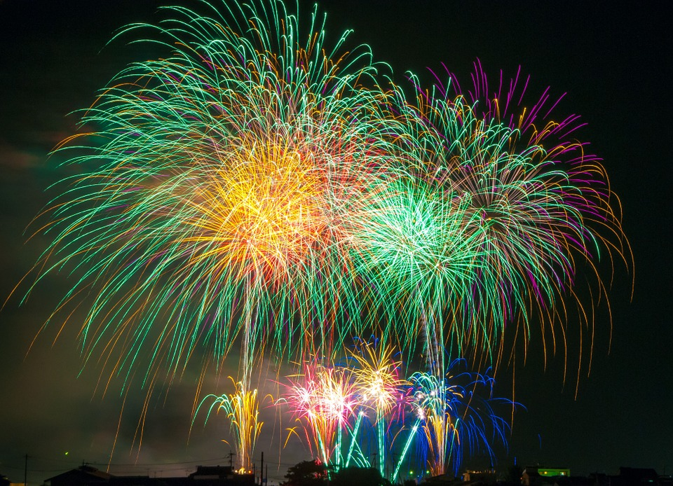
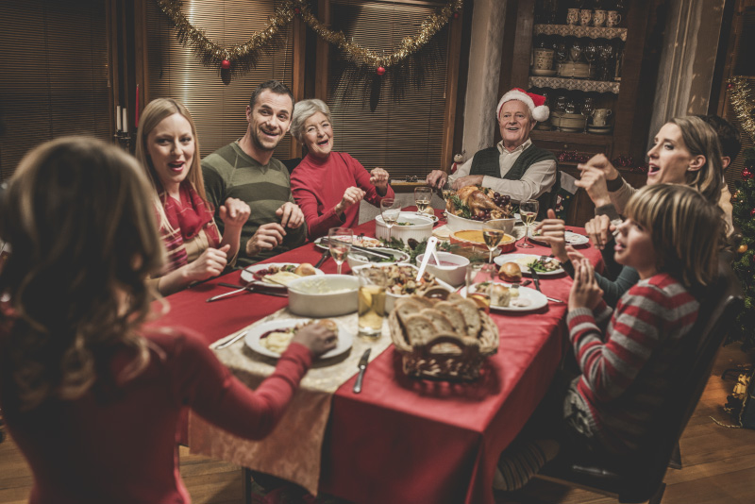
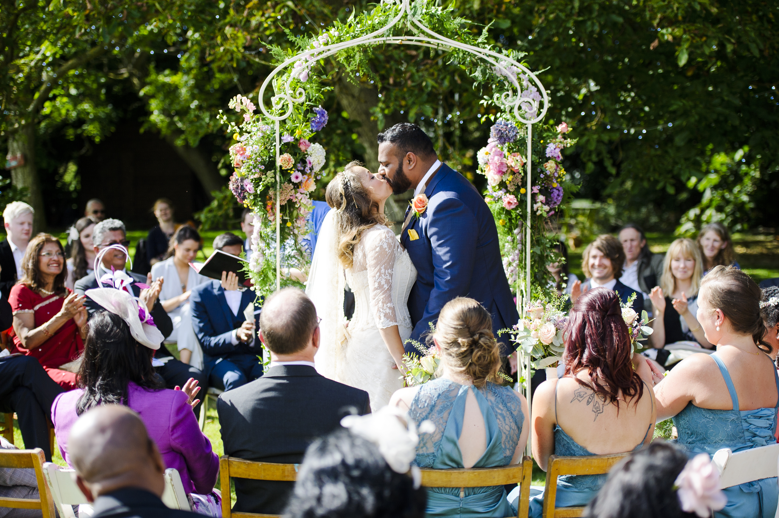
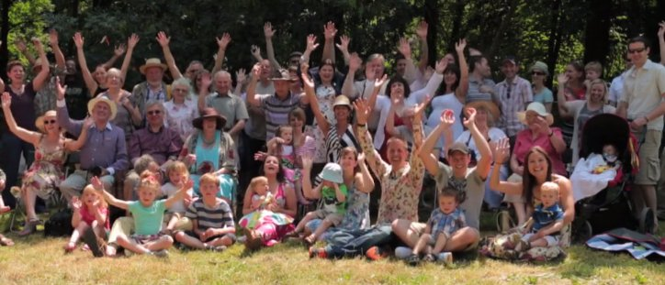
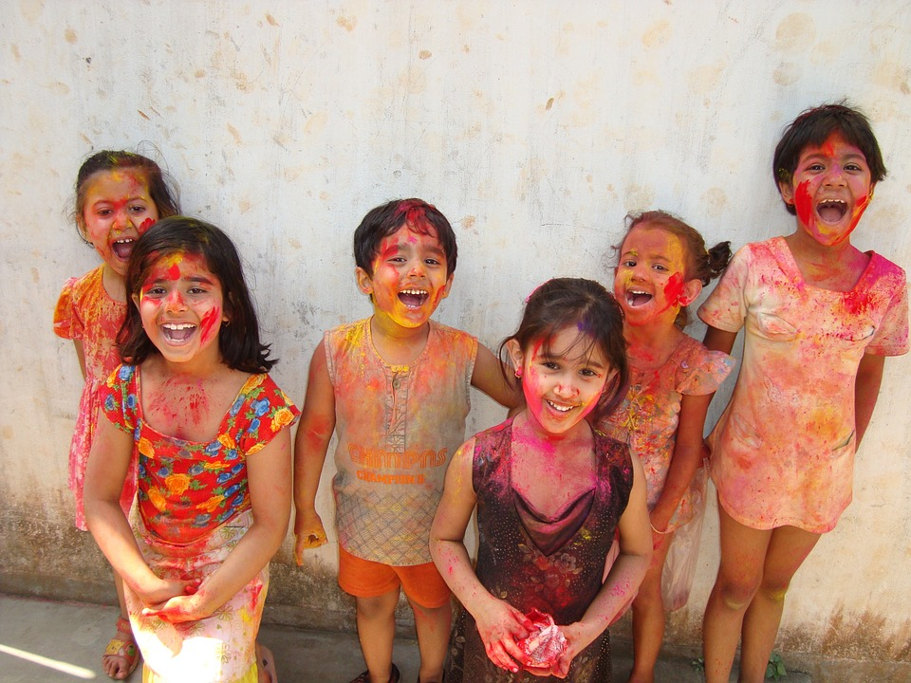
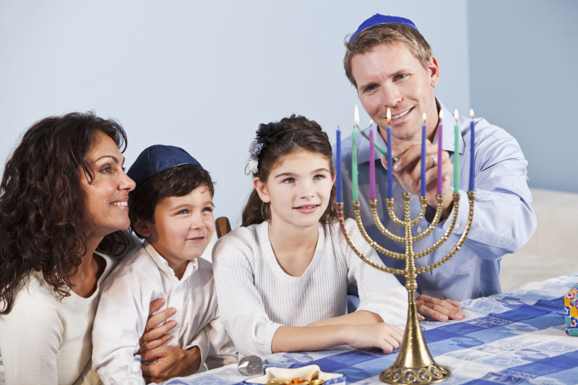
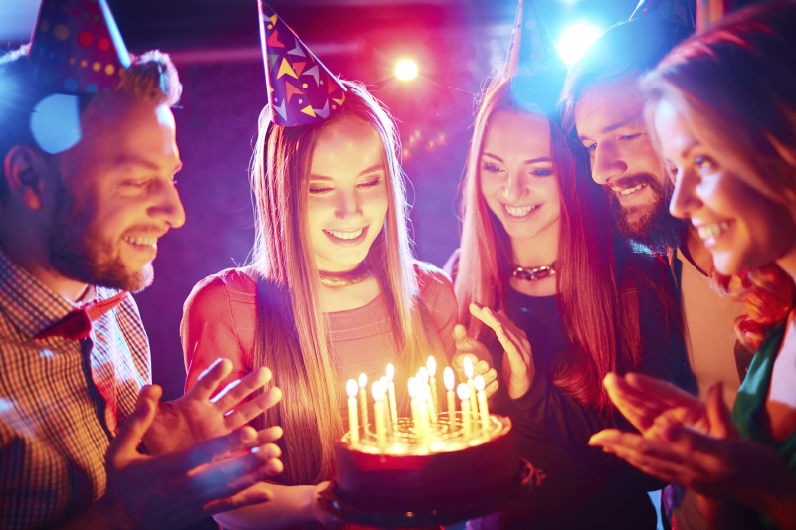
What do you celebrate?

Slide 3
What do humanists believe?
Human beings are special and human life is valuable
Humanists don’t believe in a god, or believe we can never know if there is a god
Humanists believe we only have one life and we should make the most of this life
Human beings should try to live full and happy lives and should help others do the same

Slide 4
What do you think humanists celebrate?

Slide 5
When you celebrate...
... who do you celebrate with?
... where do you celebrate?
... how do you celebrate? (What do you do?)
... why do you celebrate?

Slide 6
Why might we celebrate the arrival of a new baby?
Which is the most important?
To have a party
To name the child
To give special people roles in the child’s life
To bring family and friends together
To receive gifts for the child
To create photos and videos of the child as a baby

Slide 7
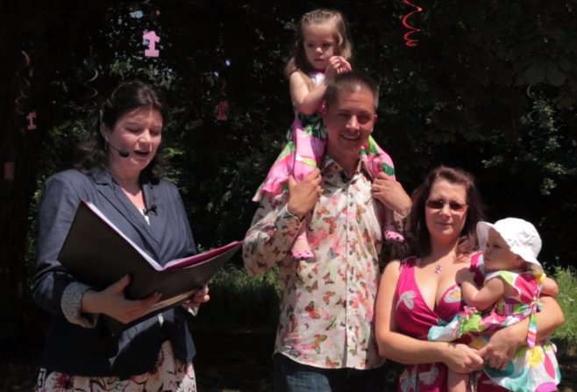
A humanist naming ceremony
Celebrate new life
Celebrate the community of family and friends
Show love and support
The parents can decide exactly what happens and what they want to say

Slide 8

Why do humanists celebrate new life?
Every new human being has the potential to lead a happy and fulfilling life.
Every new human being has the potential to improve the lives of others and possibly everyone.
Every new human being has the potential to improve our understanding of the world and ourselves.

Slide 9
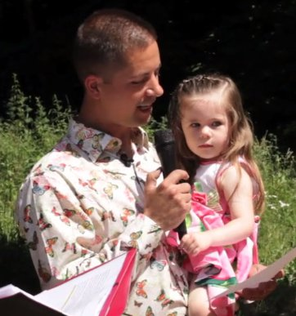
Statements
You are special
God loves you
Be happy
God will take care of you
I promise to take care of you
Make the most of your life
Be good to other people

Slide 10
Statements
Statements you might hear at a humanist naming ceremony are highlighted in green
You are special
God loves you
Be happy
God will take care of you
I promise to take care of you
Make the most your life
Be good to other people

Slide 11
Planning a naming ceremony
Think about:
1) Where would you hold it?
2) Who would you invite? Why are these people important?
3) What would you do to make it special?
4) What would you say and why?
5) What promises would you make?
6) What advice would you give?
7) Why do we need support from other people in our lives?
Words:
Love
Care
Support
Friendship
Family
Help
Teach
Play

Slide 12

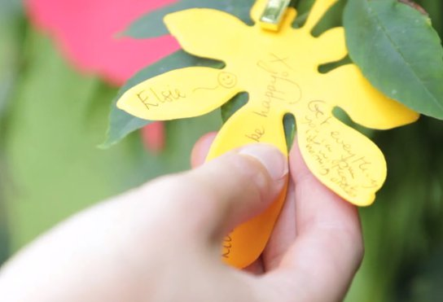
Write a promise on a leaf

Slide 13
What would you want to ask a humanist about Humanism?

Slide 14
understandinghumanism.org.uk
Understanding Humanism
39 Moreland Street
London
EC1V 8BB
British Humanist Association (registered charity 285987) ©2015

