Slide 1

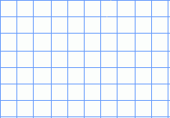

Find areas of squares and rectangles in cm².
What is the area of this rectangle?
Do we need to count the squares
in every row?
Why not?
area = 40cm²
How many square centimetres would be inside this rectangle?
7cm
3cm
area = 21cm²
How do you know? How can you calculate the area of the rectangle without counting squares?
To find the area, we can
multiply the length by the width.
We abbreviate square centimetres to cm².

Slide 2
Find areas of squares and rectangles in cm².
If the school hall was having a new floor and the price was based on its area, how could we calculate the area?
Would we measure it in square centimetres?
The hall’s length and width would be measured in metres, so the area would be a number of square metres, m².
12m², 120m², 12cm², 28cm², 100mm², 28mm²
Which of these could be the area of a bedroom floor?
The surface area of a little finger nail?
One face of a credit card?
Answers
Finger nail is 100mm²
Credit card is 28cm²
Bedroom floor is 12m²

