Slide 1
Weddings
from
Different
Religions
Celebrations Around the World

Slide 2
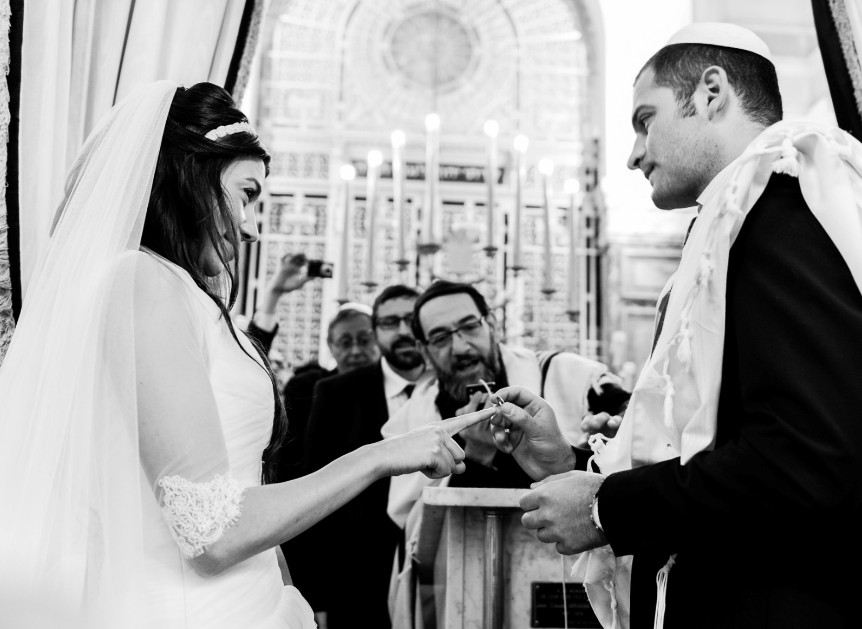
Jewish wedding
Photo courtesy of Agence Tophos (@flickr.com) - granted under creative commons licence - attribution

Slide 3
Jewish Wedding Traditions
Ketubah is the marriage contract traditionally signed by two witnesses.
Chuppah is the wedding canopy which the bride and groom stand under during the ceremony. It symbolises their future home together.
Exchange of rings which symbolises the unbroken circle and union of the married couple.
Breaking of glass symbolises the destruction of the Jewish temple in Jerusalem, reminding the couple that sorrow exists even during personal joy. There are many varying reasons for this tradition.

Slide 4
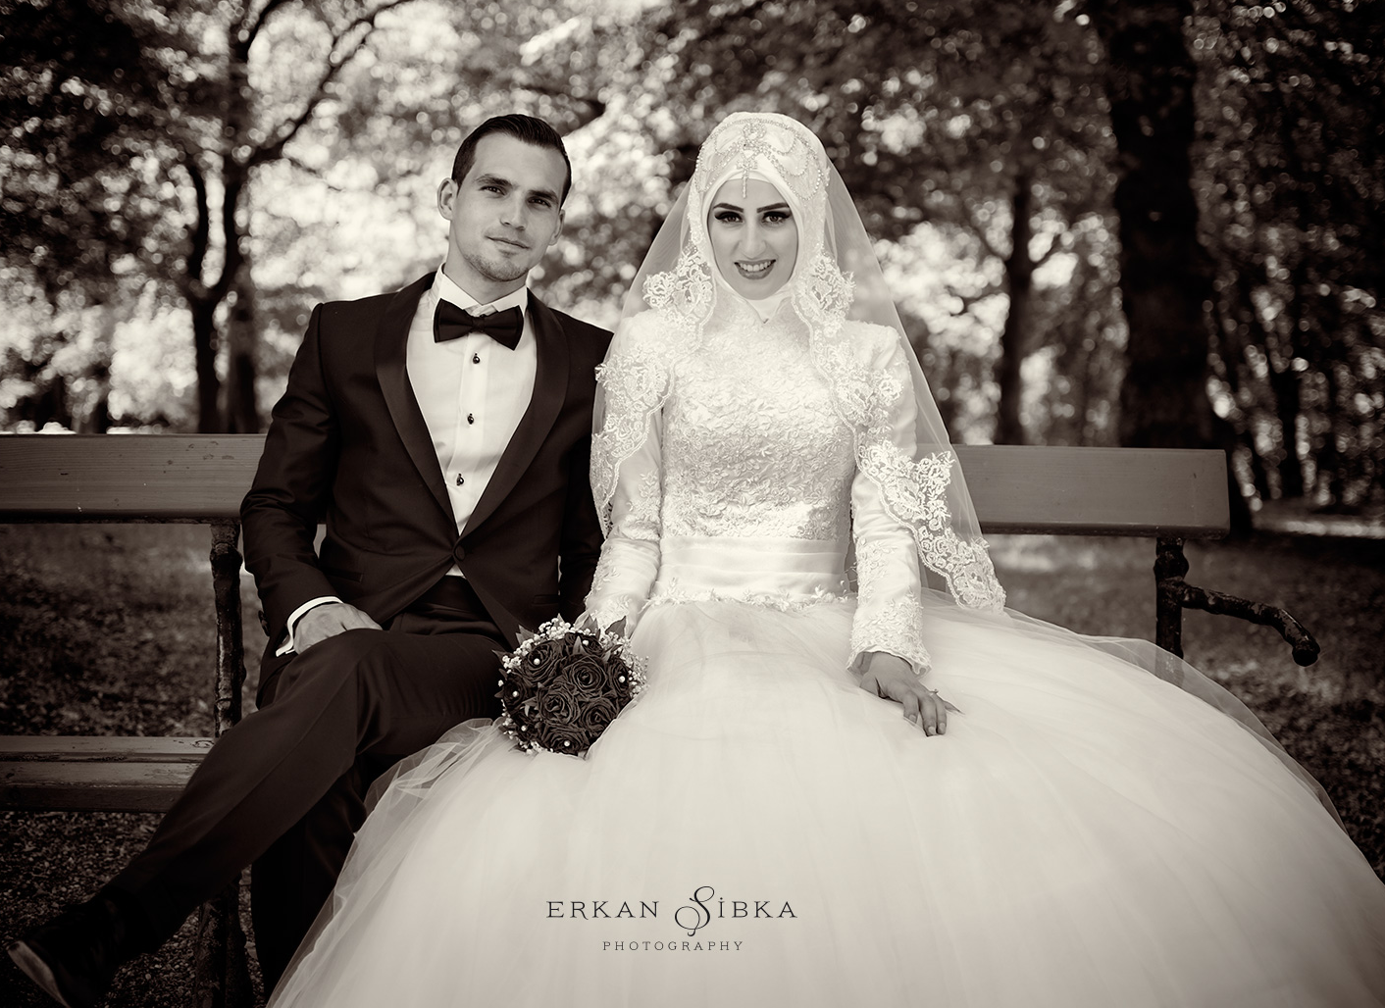
Islamic wedding
Photo courtesy of imajfoto. (@flickr.com) - granted under creative commons licence - attribution

Slide 5
Islamic Wedding Traditions
Nikkah is the legal contract signed by the bride and groom.
Walima is the second part of the wedding (after the Nikkah) where performances, speeches and the feasting happen.
Clothing is traditionally brightly coloured.

Slide 6
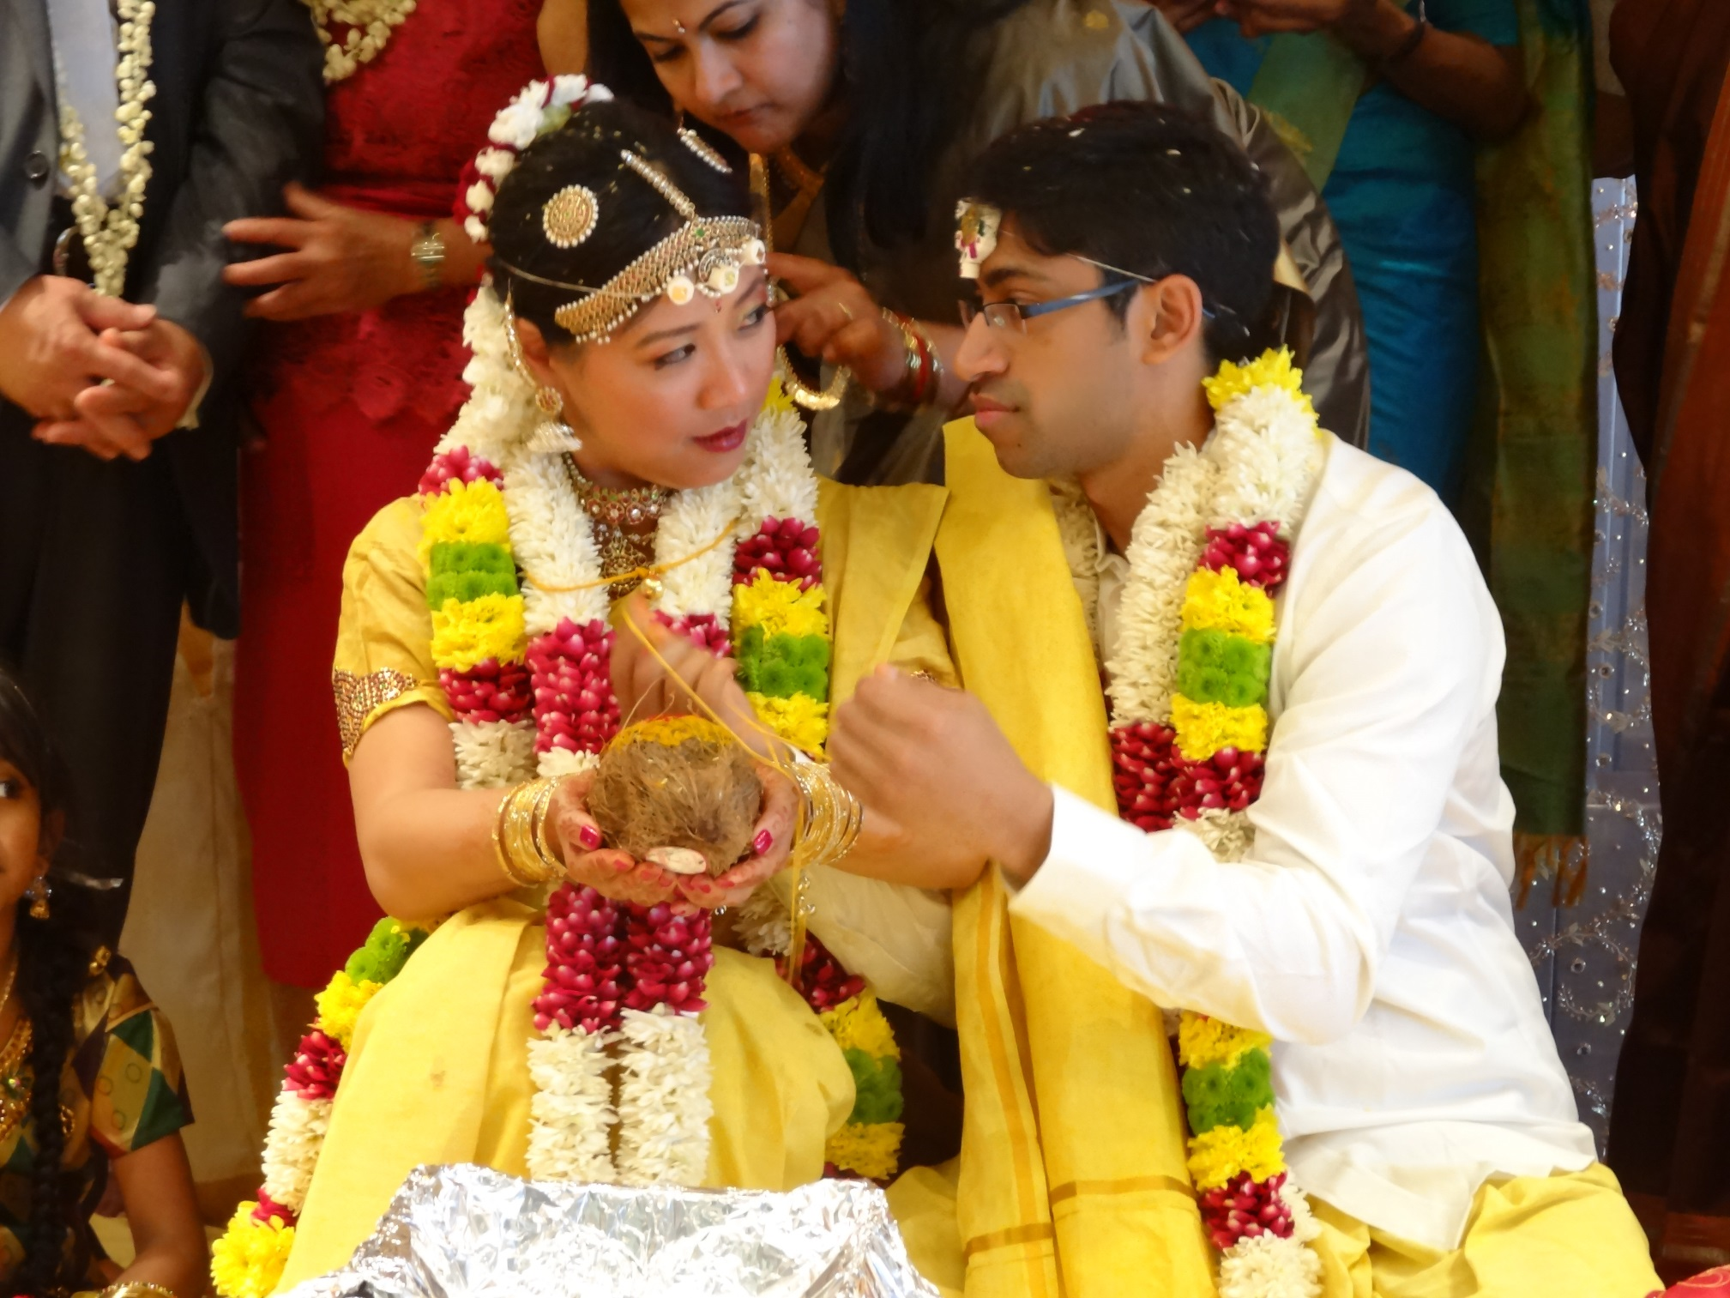
Hindu wedding
Photo courtesy of denisbin. (@flickr.com) - granted under creative commons licence - attribution

Slide 7
Hindu Wedding Traditions
Hindu weddings are extremely colourful and can last for a few days.
Kanyadaan is the part of the ceremony where the father gives his daughter away to the groom (a very emotional time for the family).
Panigrahana is a ritual taken place near fire, where the groom takes the bride’s hands to represent their union.
Saptapadi means ‘seven steps’ and is the most important part of the wedding traditions. The bride and groom take seven steps around the holy fire (the divine witness to their marriage) as they say their vows in Sanskrit.

Slide 8
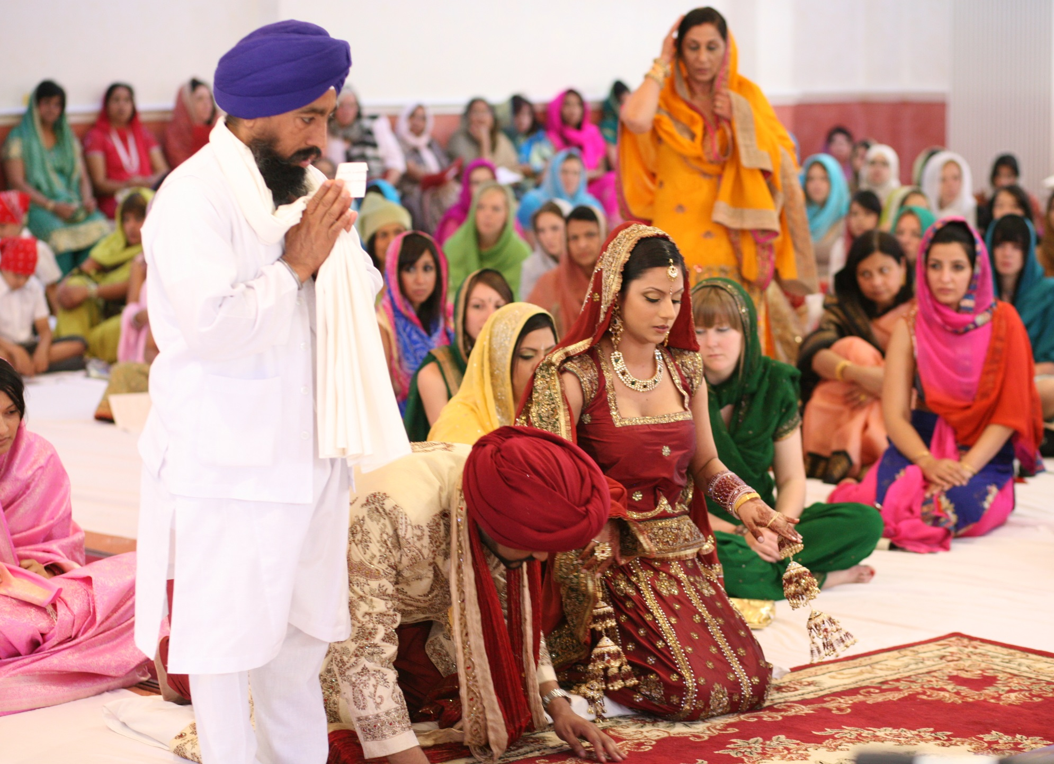
Sikh wedding
Photo courtesy of Ami and Debo's Wedding. (@flickr.com) - granted under creative commons licence - attribution

Slide 9
Sikh Wedding Traditions
The Sikh wedding ceremony is called the Anand karaj.
Gurdwara is the place of worship for Sikhs and is where the bride and groom will have their ceremony.
Milni is the beginning of the ceremony where the two sides meet. Usually dancing and a banquet follow the ceremony.
A red wedding dress is traditionally worn in India. In other countries, the bride may wear white with a chunni (scarf) covering her head.

Slide 10
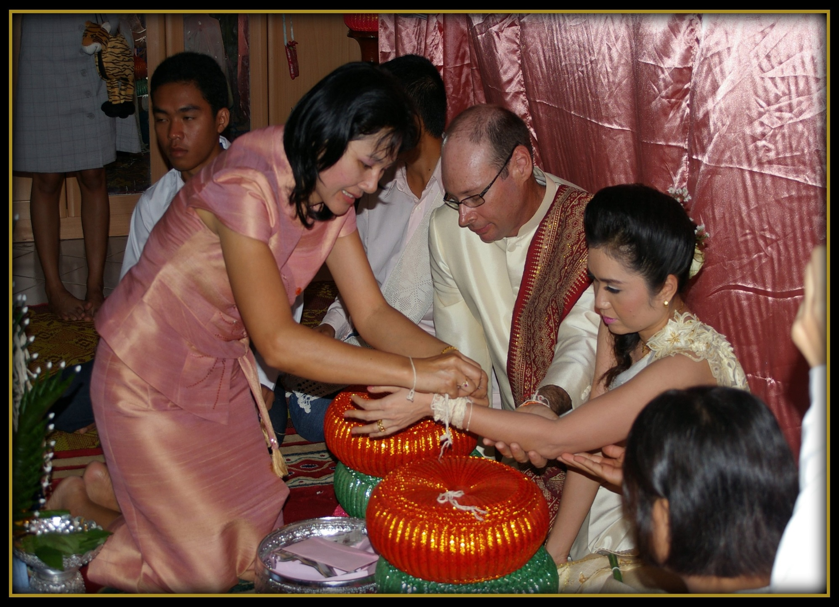
Buddhist wedding
Photo courtesy of G4Glenno (@flickr.com) - granted under creative commons licence - attribution

Slide 11
Buddhist Wedding Traditions
In Buddhism, marriage is not viewed as a religious duty, instead it is seen as a personal, social choice and therefore traditions vary depending on the customs of the country.
You will most likely find a shrine of Lord Buddha with candles and flowers around. The bride and groom will light incense and then deliver their vows from the Sigilovdda Sutta.

Slide 12
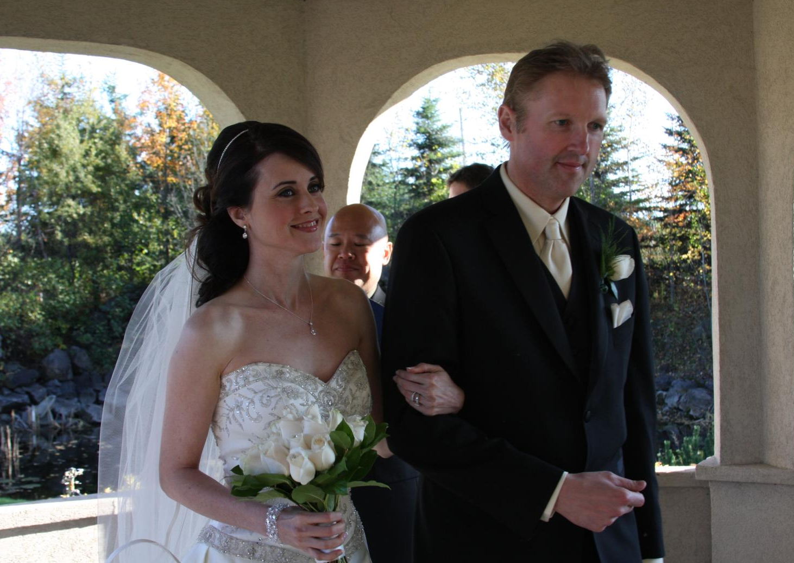
Christian wedding
Photo courtesy of Loimere (@flickr.com) - granted under creative commons licence - attribution

Slide 13
Christian Wedding Traditions
Bridal veil shows the modesty of the bride and her reverence for God. It also reminds of the temple veil which was torn in two When Jesus died on the cross – taking away separation and revealing a new union.
Vows and declarations from the couple are made in front of God, promising to love and cherish each other. Being pronounced husband and wife officially publicly declares that the two are now one in the eyes of God.
Exchanging of the rings represents eternal love (there is no beginning or end to a ring). Some people believe the ring is placed on the fourth finger because this finger has a vein which leads directly to the heart. Rings are also a seal of authority with the couple recognising God’s authority over their marriage.
Signing of the register is a legal requirement to certify the marriage.

Slide 14
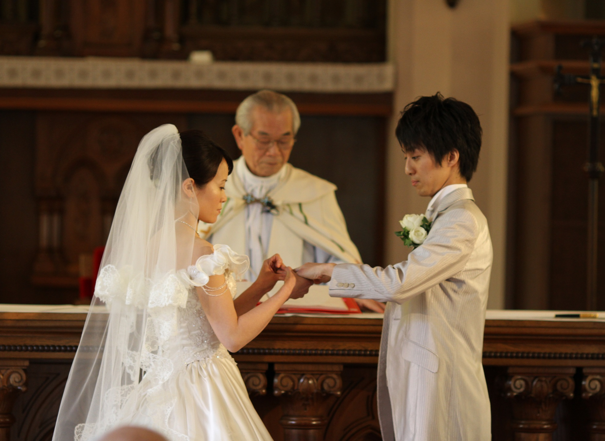
Catholic wedding
Photo courtesy of bm.iphone (@flickr.com) - granted under creative commons licence - attribution

Slide 15
Catholic Wedding Traditions
Lighting the unity candle symbolises two lives being joined together.
Binding the couple with a veil and cord also symbolises two people’s lives becoming one.
In some Catholic weddings, the couple may choose to include the following tradition:
Placing flowers at an image of Mary honours her relationship with Jesus as the mother of Christ and a model of obedience and submission to the will of God.

Slide 16
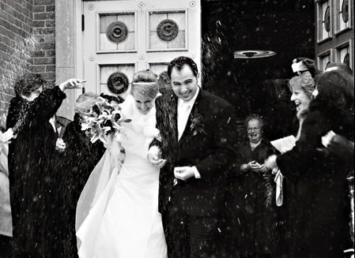
Greek Orthodox wedding
Photo courtesy of bm.iphone (@flickr.com) - granted under creative commons licence - attribution

Slide 17
Greek Orthodox Wedding Traditions
Betrothal ceremony takes place at the beginning of the wedding where the rings are blessed. They are usually placed on the right hand of the bride and groom as the right hand has many biblical references. It is seen as the hand of authority, power and it is the right hand of God that blesses.
Candles are lit to symbolise the spiritual willingness of the couple to receive the ‘Light of the World’ into their lives together.
The crowning is the focal point of the ceremony. The priest places crowns (joined by white ribbon) on the couple’s head to show a sealing of the union. The crowns (Stefana) symbolise the glory and honour given to the couple by God.
The common cup follows a reading of the Gospel telling of the wedding when Jesus turned water into wine – His first miracle. It symbolises a transformation from the old into the new. The couple take three sips of wine from the same cup reminding them that they will share everything from now on.
Circling the table is led by the priest as an expression of joy and gratitude to God. As the bride and groom are led around the table three times, hymns are sung and the couple take their first steps in marriage together with the priest representing the Church guiding their direction.

