Slide 1
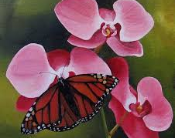
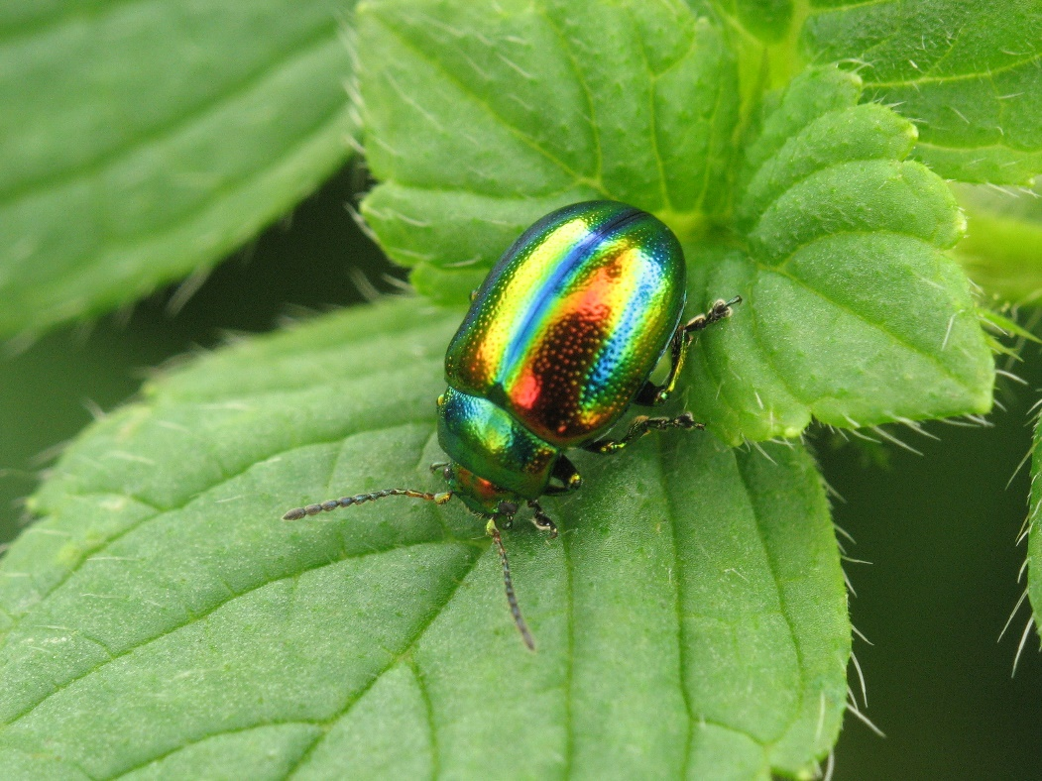
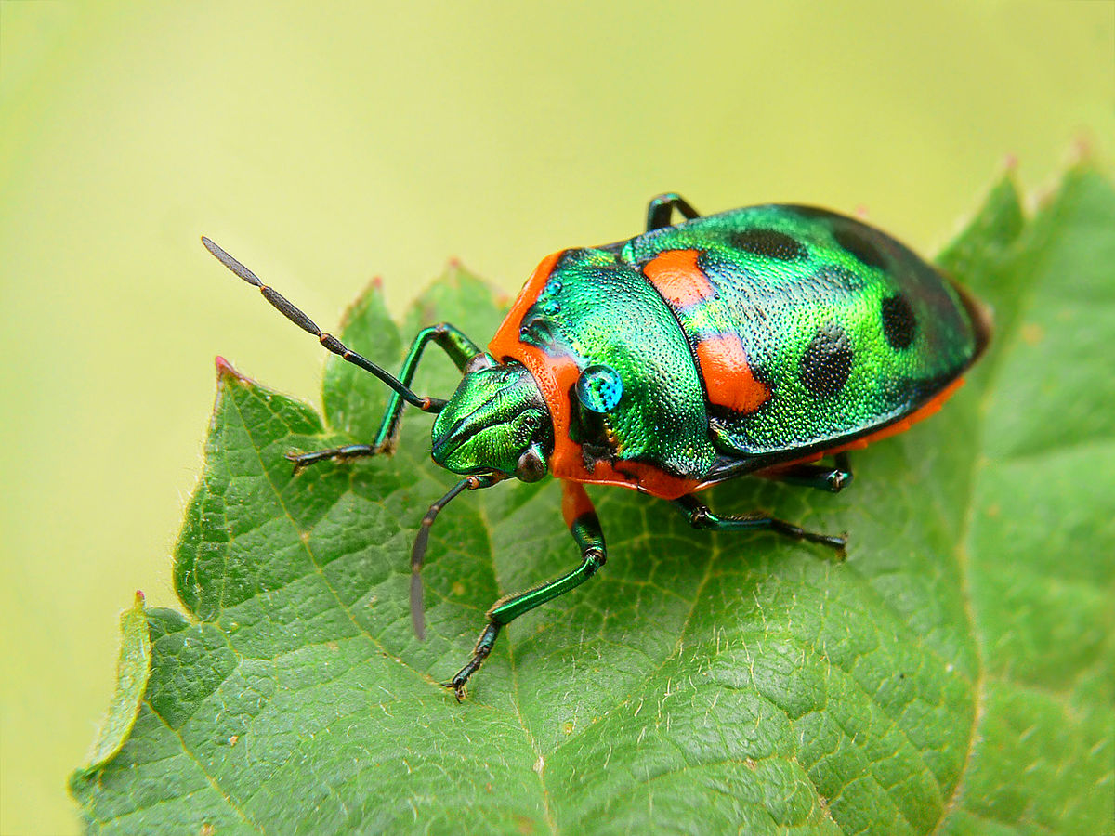
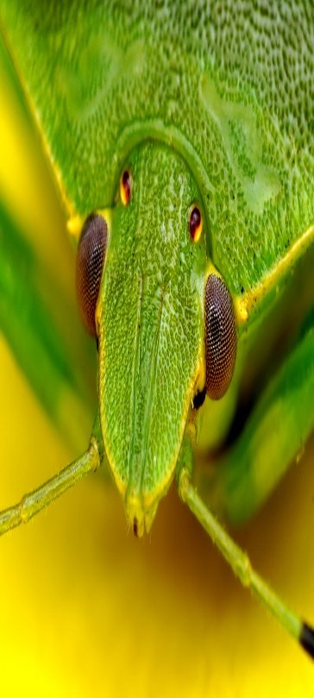
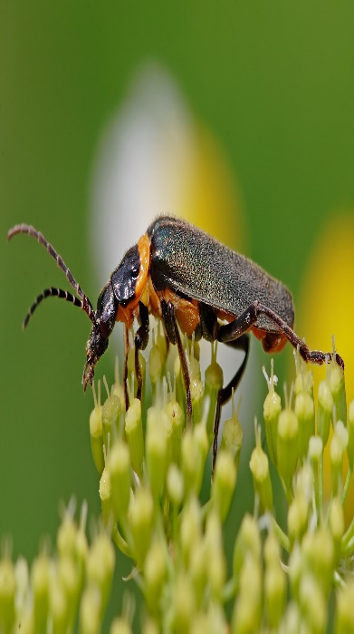
Insects
Title | Slide:
Introduction (this slide) | 1
What are insects? | 2
Are bugs and insects the same thing? | 2
Can you eat bugs? | 3
Gross alert warning about: What do bugs eat? | 4
What do bugs eat? | 5
Credits | 6
Pictures that were in the background | 7
Summary | 8
The guide to all things buggy!

Slide 2
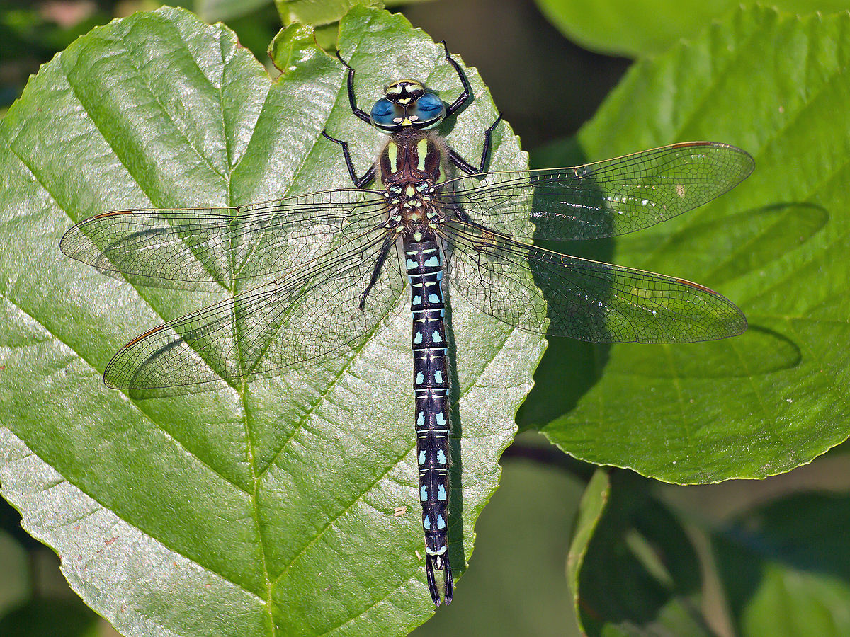

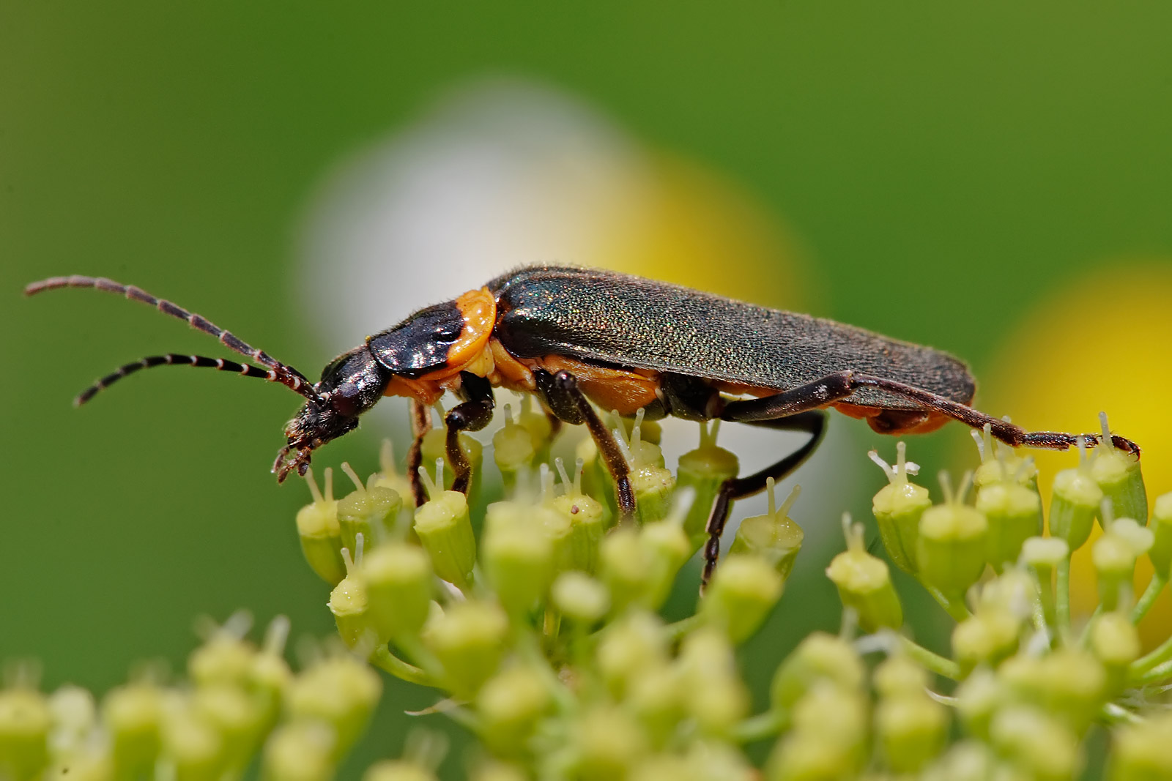
What are insects?
Start
Insects are small little creatures that can usually fly. They normally have 6 legs and are very colourful.
Are bugs and insects the same thing?
In case you were wondering about this fact the answer is KIND OF!

Slide 3
Start
Can you eat bugs?
Yes you can! True but gross. The good side of that is if you accidentally swallow one it won’t kill you.* Except you are supposed to cook them, so yes, it will probably damage you a bit if you swallow one without cooking it.
*Unless it gets stuck in your throat and stops you from breathing.

Slide 4

⚠GROSS ALERT WARNING GROSS ALERT ABOUT FOOD WARNING THIS MAY PUT YOU OF ANY FOOD⚠
Start

Slide 5
Start
What do bugs eat?
Some bugs eat meat, some are vegetarian, some have both and some eat poo!
Here is a list of what a vegetarian bug might have too eat:
Leaves, roots, seeds, nectar, or wood.
Why they might choose plants?
If you eat plants in the animal kingdom you don’t have a massively stressful life, yes you may still be the prey of another animal (s) but nothing can change that really. Eating plants makes your life a bit easier though because plants cannot run away, whereash animals can (unless they’re dead).

Slide 6
Credits. . .
Start
Facts: BBC for some facts though most I already knew.
Pictures: Pinterest for the pink flower painting and the other pictures power point says are unknown.

Slide 7


Start

Slide 8
Summary
Start
So to summarise, insects eat poo, meat, vegetables and meat and vegetables. Insects are the same as bugs (kind of) and you can do something gross – eat bugs.

