Slide 1

PSHE and Citizenship
Living in the Wider World | Britain
PSHE and Citizenship | Year 5 | Living in the Wider World | Britain | Respecting the Law | Lesson 3

Slide 2
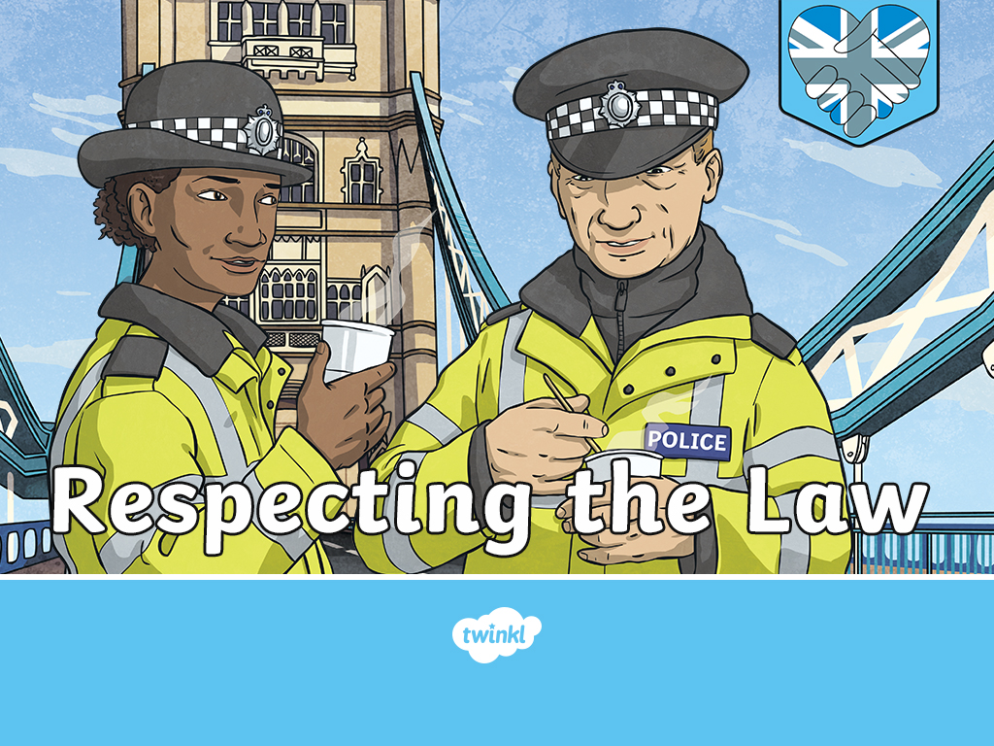

Slide 3
Aim
I can explain why and how laws are made and identify what might happen if laws are broken.
Success Criteria
I can explain what laws are.
I can talk about how laws help me.
I can discuss images which show anti-social and aggressive behaviour and their consequences.
I can write a Beginner’s Guide to British Law.
I can think about what society would be like if we didn’t have laws.
This resource is fully in line with the Learning Outcomes and Core Themes outlined in the PSHE Association.

Slide 4
The Big Questions

Slide 5

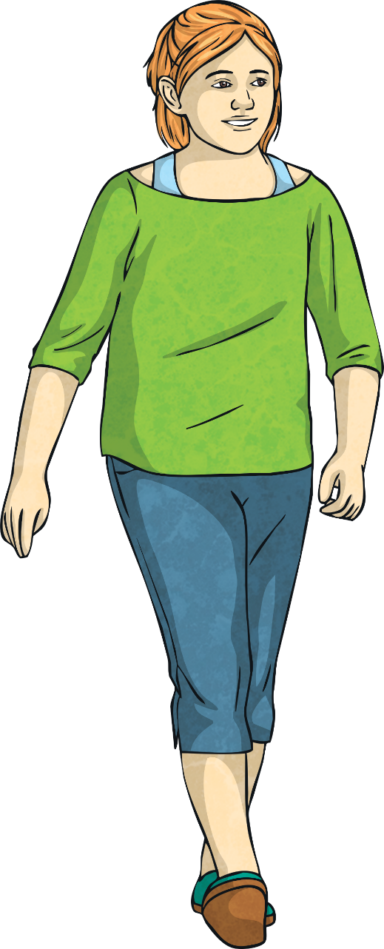
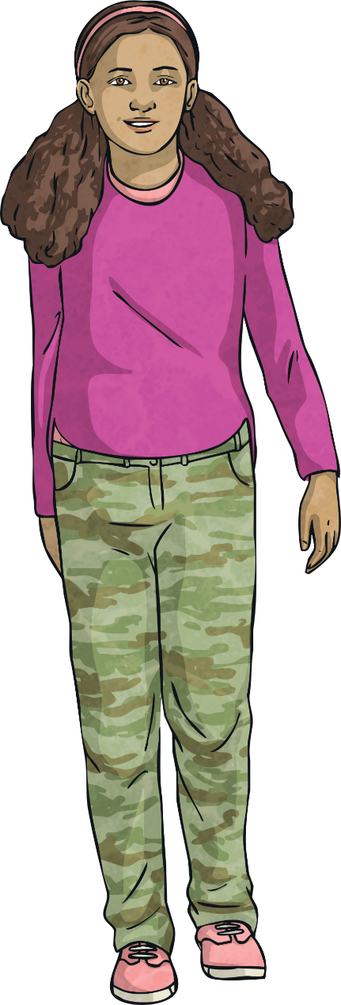
How does the law help us?
What could happen if laws are broken?

Slide 6
Reconnecting

Slide 7

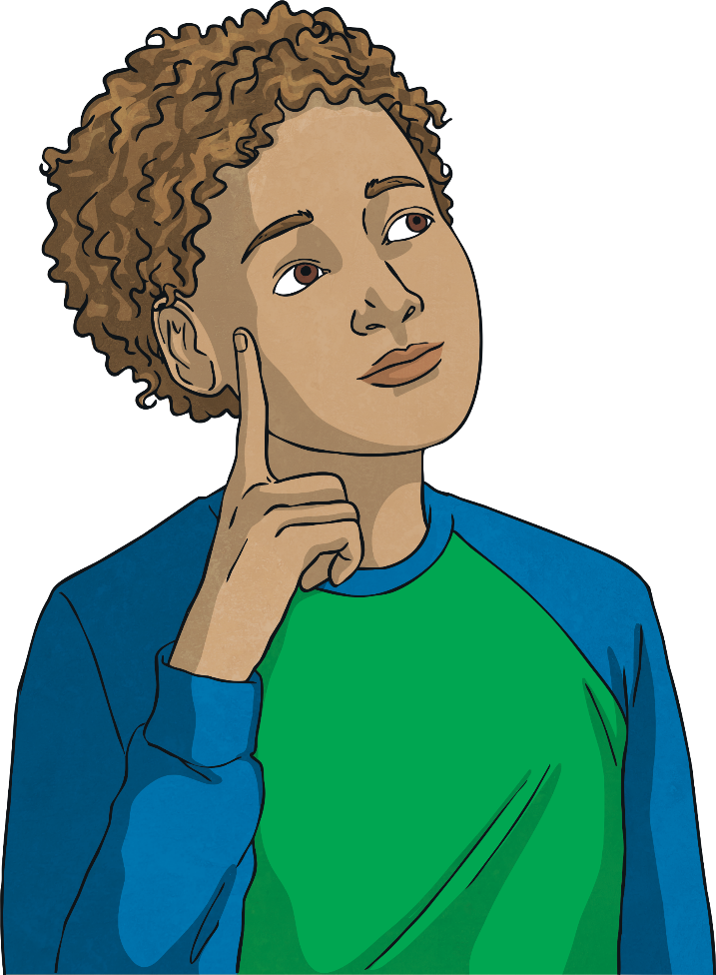
The Law
What do you already know about the law in Britain?
With a partner, write down everything you already know about the law in Britain.
Now, share all you know with the class.

Slide 8
Exploring

Slide 9
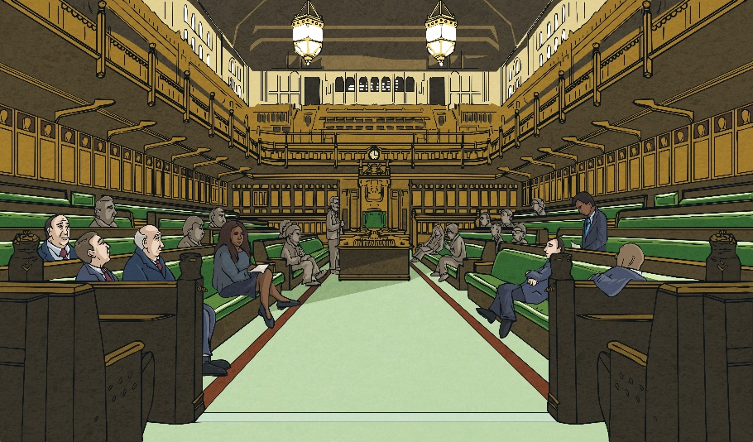
How British Law Helps Us
In Britain, there are many laws.
Laws are rules which we have to keep when living and working in Britain.
They are made to protect all British people, helping to keep them safe, happy and well.
British laws are made in parliament at Westminster. Some British laws are also discussed in the Welsh Assembly, Scottish Parliament and the Northern Ireland Assembly. Some laws apply in the whole of the United Kingdom, while others only in one, two or three of the countries.
Most of the laws in Britain are enforced by police officers in the different regions of the United Kingdom. Police officers are helped to enforce the laws by other groups, such as the National Crime Agency.

Slide 10

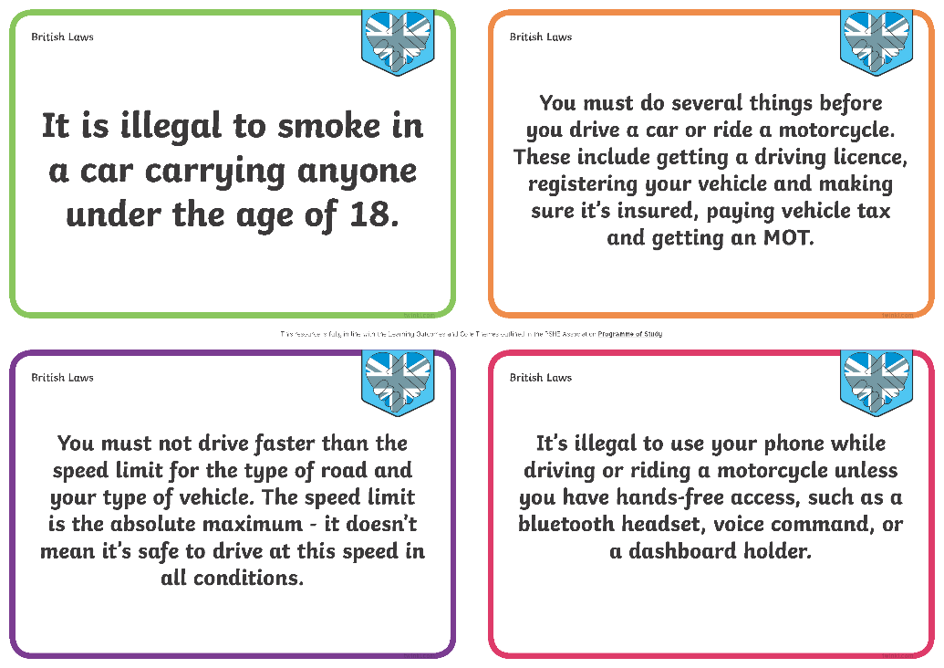
How British Law Helps Us
You are going to work in a group to take a closer look at some British laws.
Look carefully at the British law you have been given. In your group, discuss how it helps and protects British people.
Share your law and your thoughts as to how it helps British people with the class.

Slide 11


Consequences of Breaking the Law
There are consequences if we break the laws of our country.
What consequences can you think of?
The consequences are different depending on the age of the person who has broken the law, but they could include getting a warning from the police, getting arrested, having to pay a fine or being sent to prison.

Slide 12
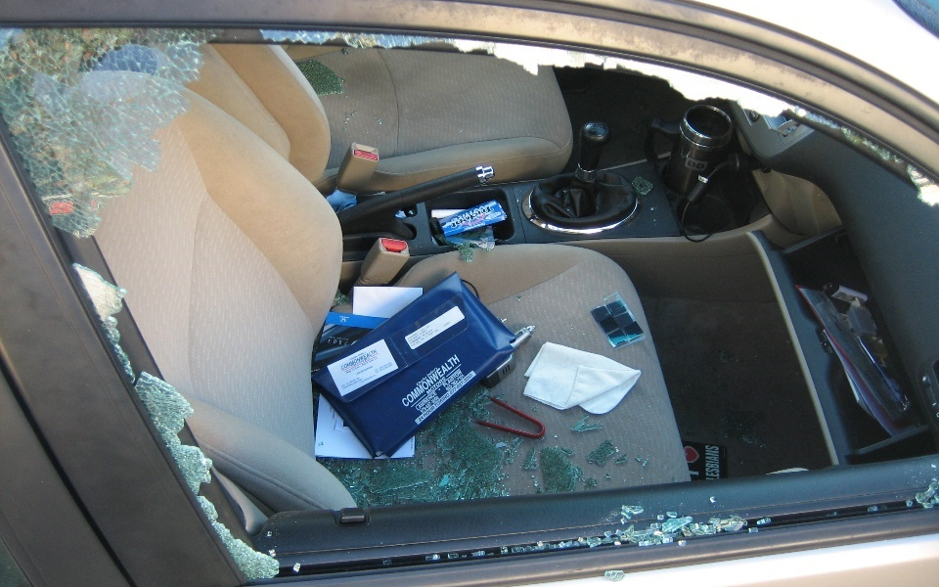
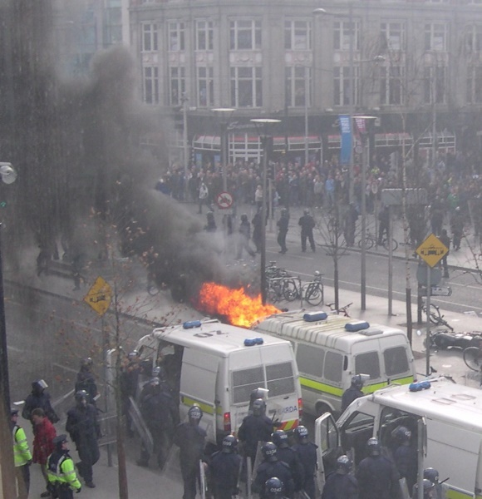
Consequences of Breaking the Law
Choosing to act in a way which breaks British law can have harmful consequences for the person breaking the law, but also for the community.
Look carefully at the images below, which show people making bad choices and breaking British laws.
Consolidating
Reflecting
Photo courtesy of jon collier (@flickr.com) - granted under creative commons licence
Photo courtesy of debaird (@flickr.com) - granted under creative commons licence
What do you think the consequences were for the person who broke the law?
We all have the freedom and power to make good choices, which means we won’t face the consequences of breaking British Law. Let’s all be good British citizens and keep British Laws, for our own good and for the good of others.
What do you think the consequences were for the community?

Slide 13
Consolidating

Slide 14

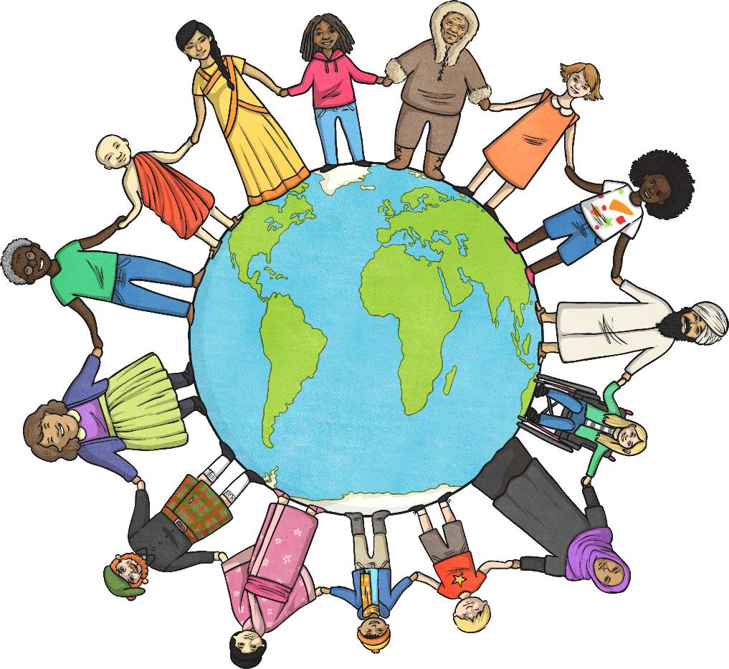
A Beginner’s Guide to
British Law
British law is in an important part of our society. It keeps British people safe and happy.
Help others to understand this by writing a Beginner’s Guide to British Law. Explain what the law is, how it helps us and the consequences of breaking it.
Word Bank:
law
protect
help
safe
happy
consequence
break
choice

Slide 15
Reflecting

Slide 16
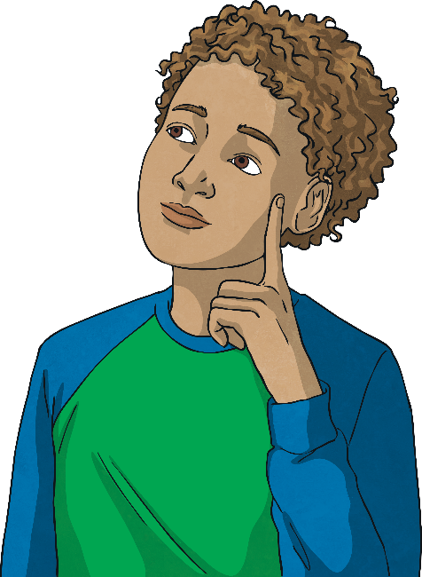
Imagining a
Lawless Society
What would Britain be like if we didn’t have any laws?
Close your eyes and try to imagine this.
Open your eyes and think of one word to describe what you saw.
Share your word with the class.
Our Words to Describe a Lawless Society
British laws are an important part of our country; they protect us and keep us safe. Let’s all work hard to respect our country’s laws.

Slide 17
The Big Questions

Slide 18
How does the law help us?
What could happen if laws are broken?
What have you learnt today which will help you make positive choices in the future?

Slide 19
Aim
I can explain why and how laws are made and identify what might happen if laws are broken.
Success Criteria
I can explain what laws are.
I can talk about how laws help me.
I can discuss images which show anti-social and aggressive behaviour and their consequences.
I can write a Beginner’s Guide to British Law.
I can think about what society would be like if we didn’t have laws.

