Slide 1
Minibeast Hunt
1st June 2020
Samuel Matthews

Slide 2
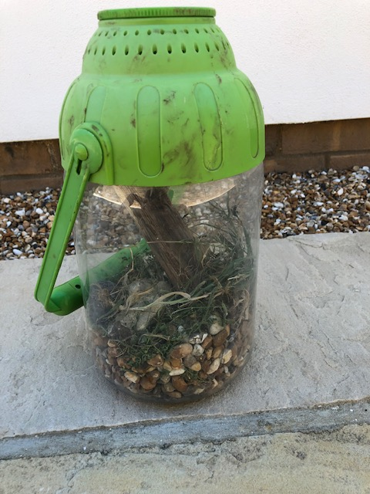
MY BUG HUNT
Today I went outside and did a bug hunt. I found 5 or 6 species and housed them in my bug house or container
The bugs included:
Woodlice
Snails
Beetles
Flies
Ants
Caterpillar
Aphids
Wood Moth
Some minibeasts were shy, so I could not get any pictures of them. However, if they were too shy I found images from the internet.

Slide 3
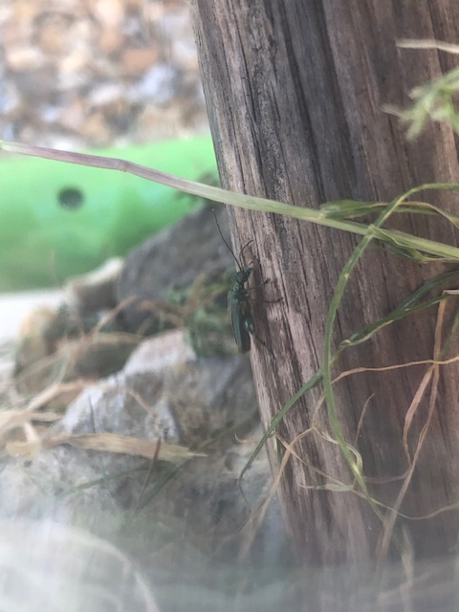
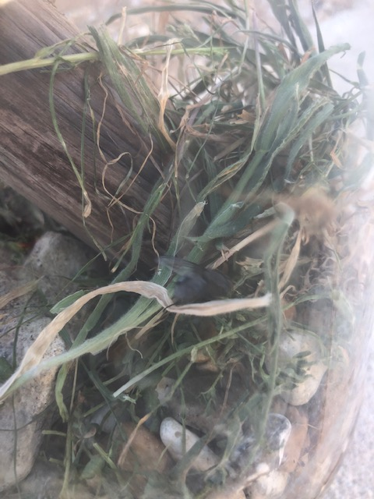
FLYING THINGS
The blue bottle is most common around rotting food.
The green beetle is most common on trees.

Slide 4
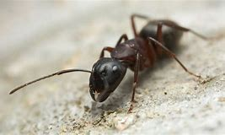
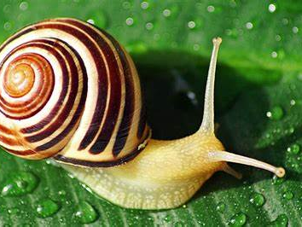
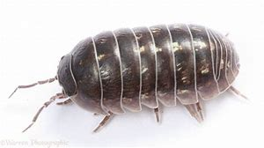
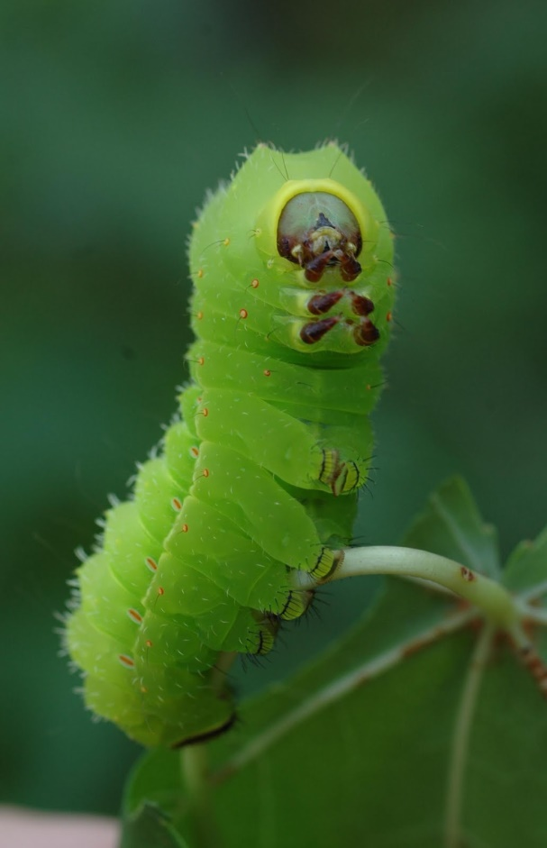
UNSEEN
These snaps are similar to my bugs you did not see. However,
the photos didn’t show them at their best, so I copied these
images for you to see.

Slide 5
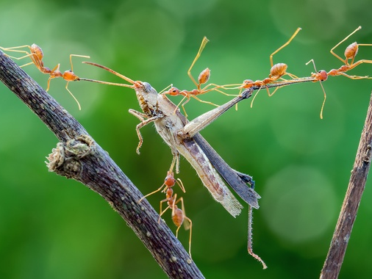
THE ANTS
The ants are a carnivorous species which will prey on almost anything. From flies to butterflies these little critters had to be caged separately to the others.

Slide 6
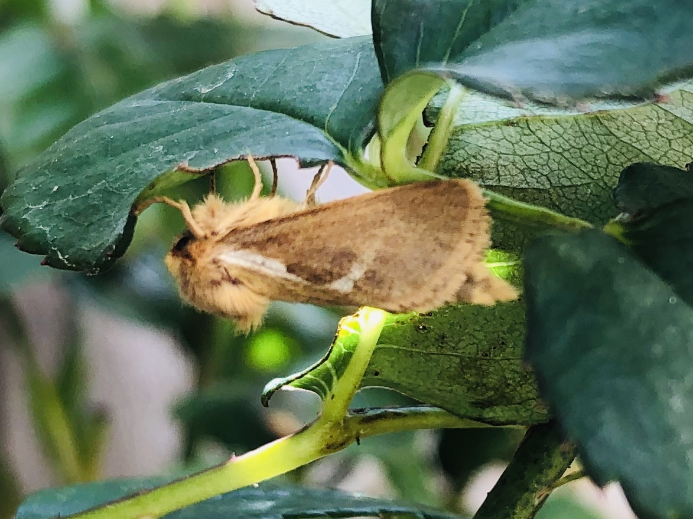
THE WOOD MOTH
The wood moth adults never feed but when they are caterpillars they feed on rotting leaves and wood, hinting the name “wood moth”.
This is the real one from our garden.

Slide 7
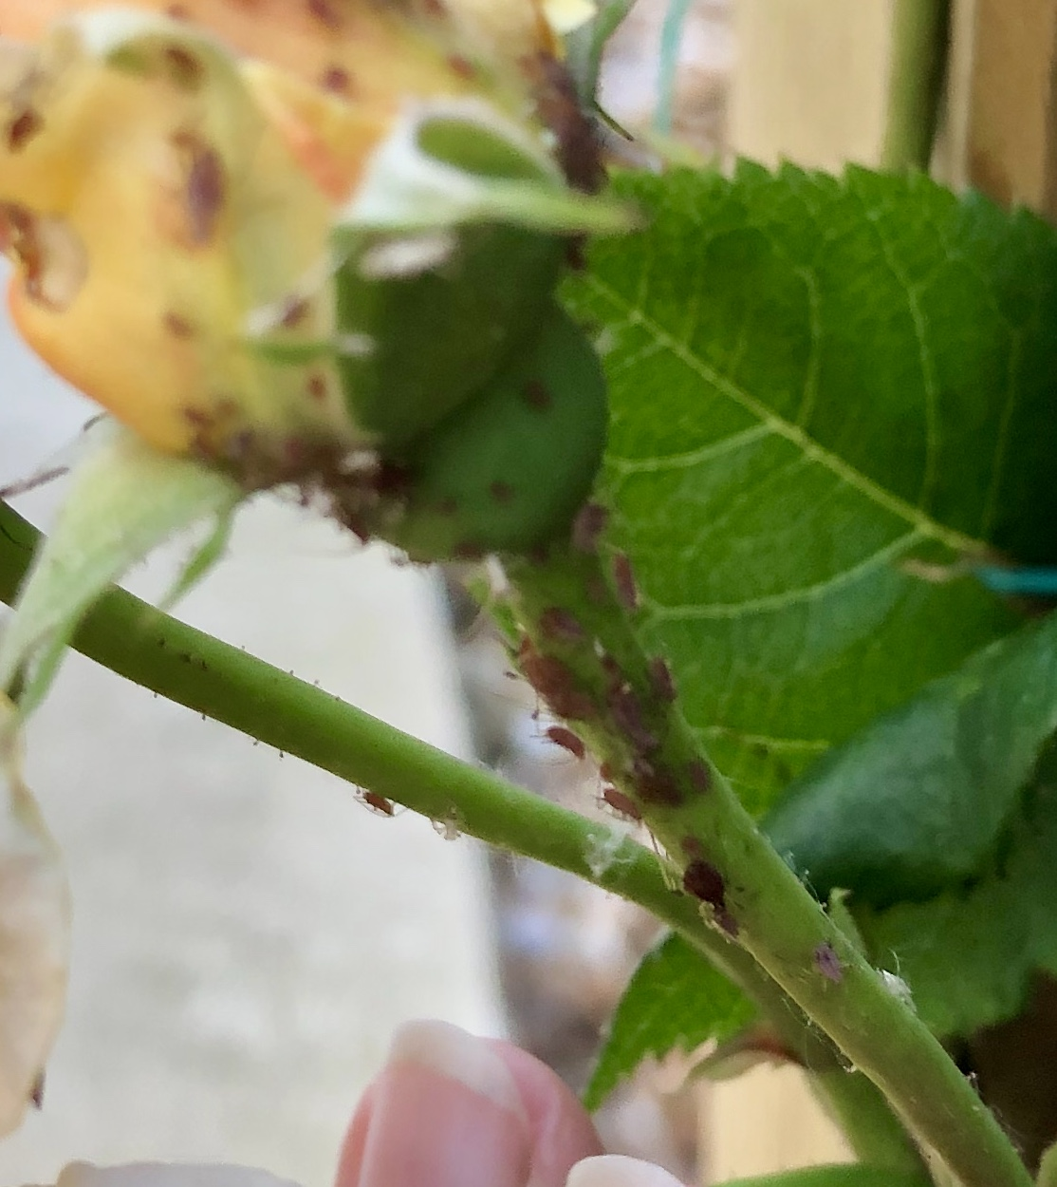
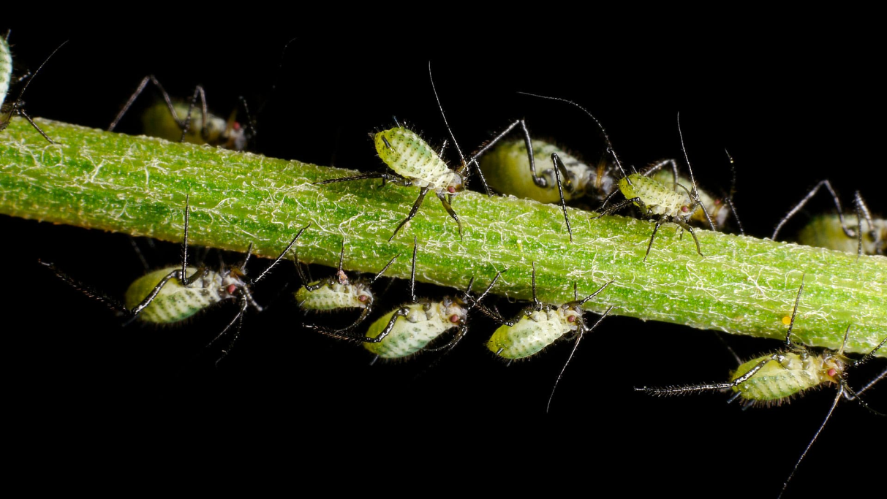
APHIDS
The largest aphids are around 6 mm long. The aphids are the smallest bug I found. They feast upon: plant stems, buds (or shoots) , petals and sap.

Slide 8
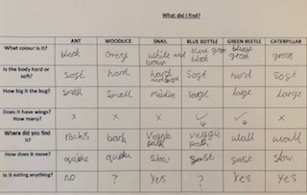
SOME KEY FACTS

