Slide 1
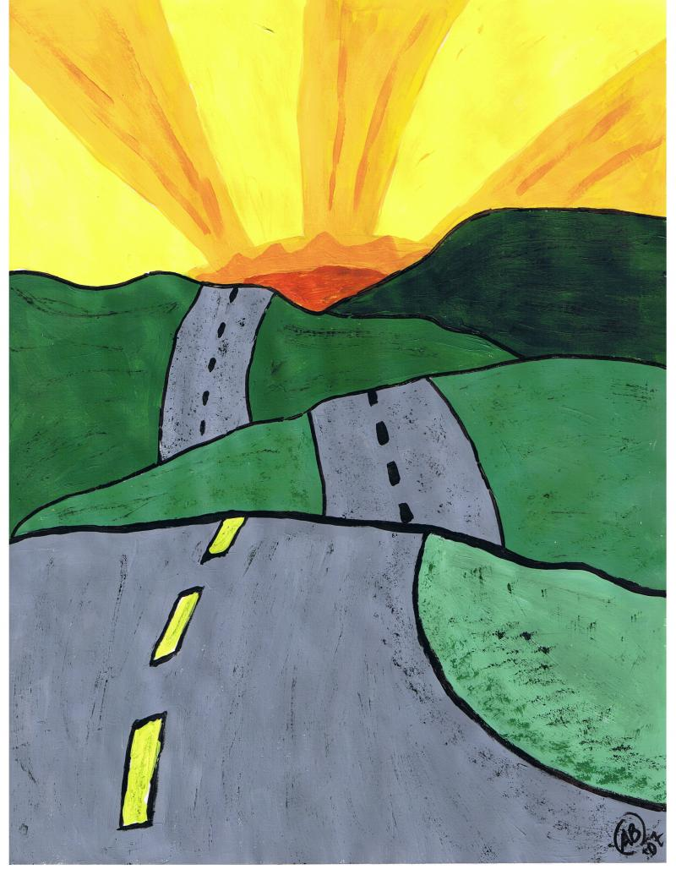

What do you think?
Complete the sentence: ‘Life is like a journey because …’
THINK
PAIR
SHARE
Lesson Objectives
Discuss and explain why life might be a journey and what is a rite of passage.
Examine how rites of passage affect everyone.
Interpret the connection between significant events and religious belief.
Think of your reasons
and complete the sentence.
2 minutes
In groups of two,
discuss the reasons
for your view.
Be prepared to share
your ideas with the
whole class
RIP

Slide 2
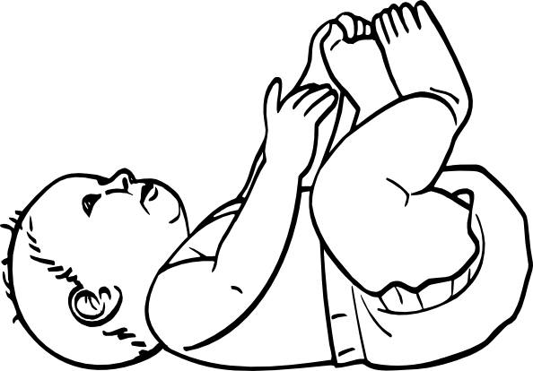
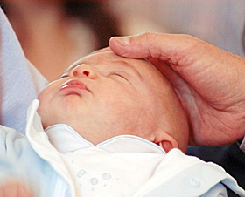






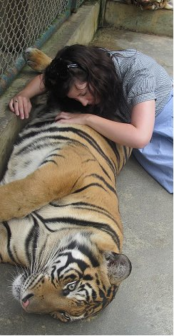
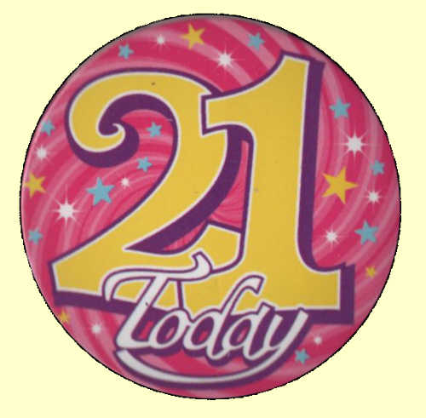
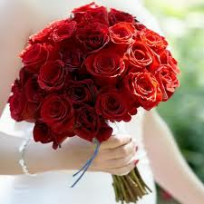
My Journey
Graduated from Leeds University
My cat died ☹
Born in 1989 in Cambridge
I was baptised but never confirmed.
Lesson Objectives
Discuss and explain why life might be a journey and what is a rite of passage.
Examine how rites of passage affect everyone.
Interpret the connection between significant events and religious belief.
I went to Ramsey Abbey College till I was 18
Went into Teaching!
I went to Ramsey Spinning Infants School
My mum got married to my step-dad
Who knows what will happen next!
I had a party with friends & family for my 21st
I went travelling by myself!

Slide 3


Your Journey So Far…
Write or draw out events on your journey grid.
What has happened in your life?
Lesson Objectives
Discuss and explain why life might be a journey and what is a rite of passage.
Examine how rites of passage affect everyone.
Interpret the connection between significant events and religious belief.
Write down what made these events so important. For example, because they involved all your family and friends OR it was a big change?

Slide 4
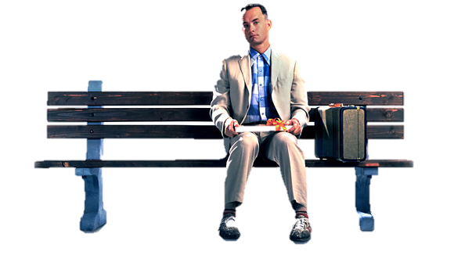
What else is Life like?
Now it’s your turn!
‘Life is like … ‘
Be creative with your language!
"Life is like a box of chocolates. You never know what you're going to get."
Forrest Gump
Lesson Objectives
Discuss and explain why life might be a journey and what is a rite of passage.
Examine how rites of passage affect everyone.
Interpret the connection between significant events and religious belief.

