Slide 1
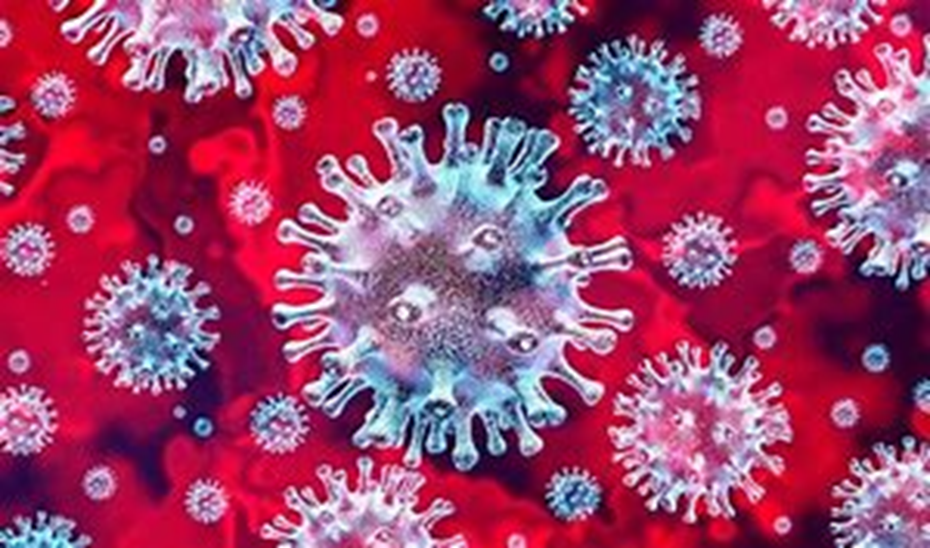
Covid-19
By Theo Towers

Slide 2
What is Covid-19?
Covid-19 is a type of Coronavirus, it is a respiratory disease (lung disease) and has lots of different symptoms, such as:
A dry cough,
A fever,
Shortness of breath,
Headaches,
Aches and pains,
Sore throat,
And fatigue.
However, you won’t necessarily get all of the symptoms, some have been known to get no symptoms, especially children. From what scientists can see, 80% of people will have mild symptoms, 15% will have severe symptoms and only 5% will have critical symptoms.

Slide 3

Is it dangerous?
Not to the average person, however people who either have underlying health issues, are immunosuppressed or are over the age of 70 are at more risk. According to the data so far, it has a mortality rate of 3-4%.
The people with no faces are dead.

Slide 4
Where did Covid-19 originate from?
Covid-19 originated from Wuhan, China, Asia. There are lots of different theories behind its sudden appearance, some crazier than others. The most believable theory is, that it travelled and mutated across species in an illegal ‘wet market’ in China and was eventually either ingested or caught by a human.
Bat
Pangolin
Human
The world

Slide 5
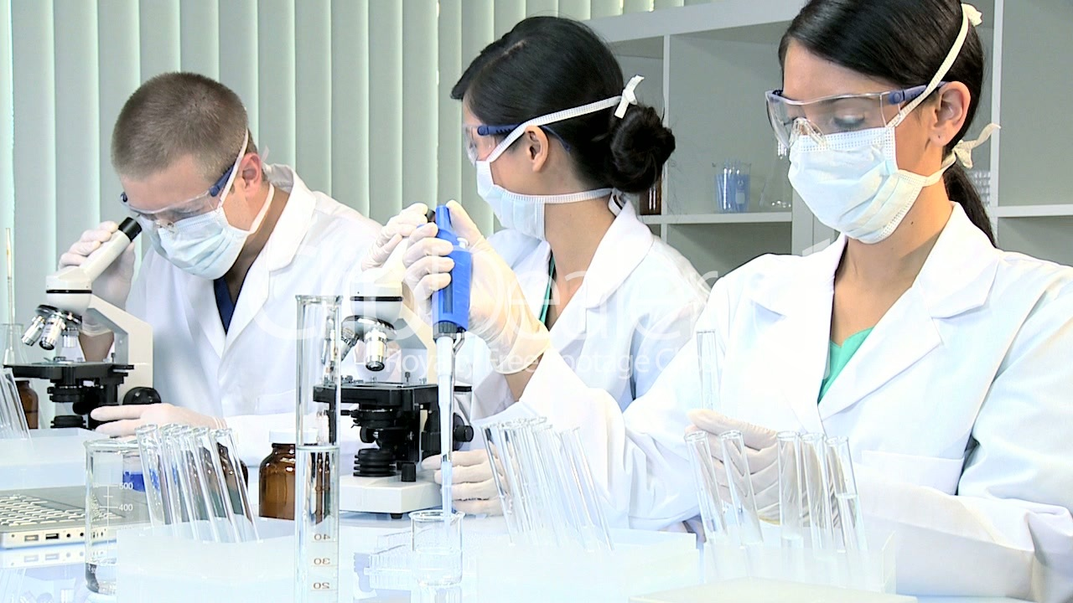
Is there a cure?
Currently, on the 29th of April, there is no cure, but scientists globally are working very hard to create a vaccine for it, much like we have for influenza (flu). There are ways of treating the symptoms however.

Slide 6

How can I tell if my symptoms are Covid-19?
Covid-19 has many symptoms and the virus mutates from person to person very subtly however. The symptoms to look out for can be found on the NHS website. For me personally I have a constant dry cough, I have been experiencing unusual shortness of breath, a temperature that went up and down in the first few days and I’m very tired.
https://www.nhs.uk/conditions/coronavirus-covid-19/check-if-you-have-coronavirus-symptoms/

Slide 7
What can I do to protect myself or others who are vulnerable from it?
Some of the precautions you can take to prevent infection are:
Distance yourself from others,
When you cough or sneeze do it in your elbow,
Wash your hands after coughing or sneezing,
Wash your hands after going to the toilet,
Don’t shake hands with others,
When you cannot wash your hands use hand sanitiser,
If you are socially distancing you can still walk or exercise outside, try to avoid supermarkets and Doctors’ surgeries.

Slide 8
What should I do if I get it?
https://www.nhs.uk/conditions/coronavirus-covid-19/what-to-do-if-you-or-someone-you-live-with-has-coronavirus-symptoms/staying-at-home-if-you-or-someone-you-live-with-has-coronavirus-symptoms/
The link above leads to guidelines from the NHS, please follow it if you are showing symptoms or someone in your household is.

Slide 9
This is how it spreads.
This link goes to a YouTube video that shows how Covid-19 spreads very well:
https://www.youtube.com/watch?v=8Hi9-5F2zW4
You
Your vulnerable friend
Your colleague
Your sibling
Your parents

Slide 10
Do not panic.
Covid-19 is not a very deadly disease, listen to your government. I implore you to take this seriously but please do not panic buy or hoard food or medicine. Take the necessary precautions and stay safe.

Slide 11


