Slide 2
What could happen if you don’t take care of your mobile phone?
Taking Care of Your Mobile Phone
Notes:
Explain: This mini PowerPoint drama is a scenario about a stolen mobile phone. You could choose two or more members of the class to read and act out the characters’ speech bubbles.

Slide 3
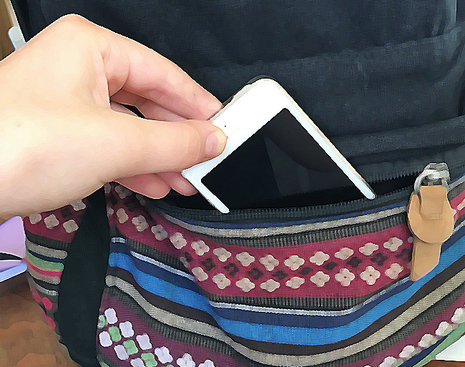
What is happening here?
Taking Care of Your Mobile Phone
Notes:
Ask: What is happening here? How could you stop this happening?

Slide 4
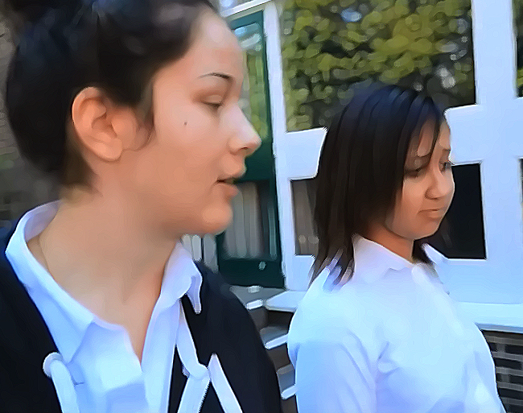
Taking Care of Your Mobile Phone
Oh yes. I forgot someone stole your phone. I hope you reported it to the police.
We’re very early today. Ever since my phone got nicked on Tuesday, I’ve had no alarm.
Notes:
Ask: We use our mobile phones for far more than just making calls. What else do we rely on them for? (Alarm, sat nav, photos, news, weather, games, Google, texts etc.)

Slide 5
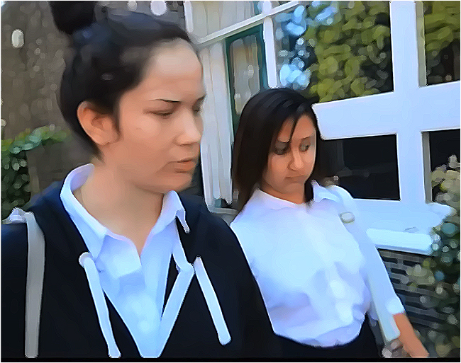
Taking Care of Your Mobile Phone
I haven’t reported it yet. My parents went bananas! But not as angry as me. I spent a fortune on data and apps. And I’ve lost all my photos.
Notes:
Ask: How would you feel if you lost your phone?

Slide 6
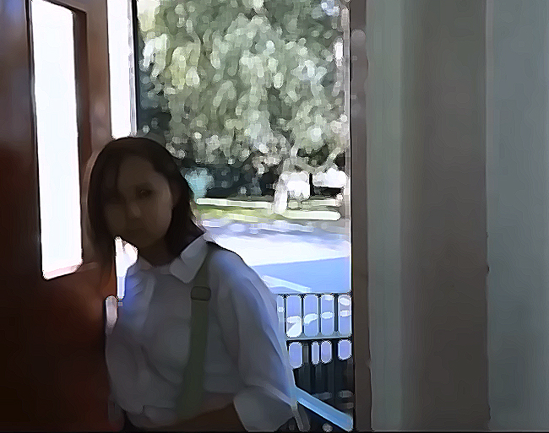
Taking Care of Your Mobile Phone
Oh – looks like something strange is going on.
Notes:
Ask: Where are the girls?

Slide 7
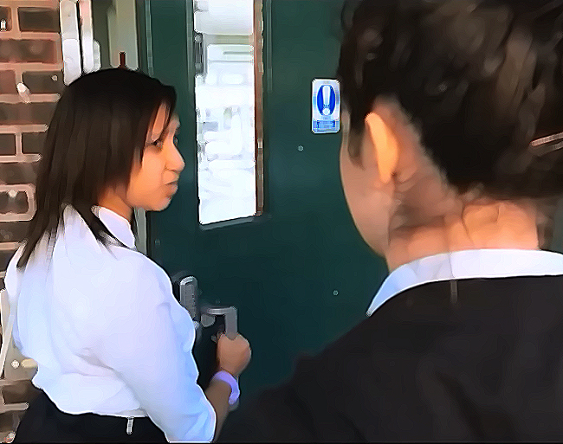
Taking Care of Your Mobile Phone
Did you have a PIN or password on your phone?
Notes:
Why is Izzy looking so worried? What might she have seen in the classroom?

Slide 8
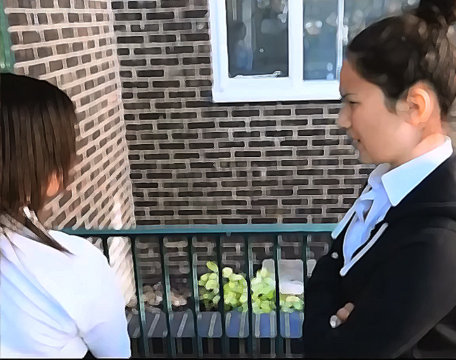
Taking Care of Your Mobile Phone
No I didn’t! What has that got to do with anything?
Notes:
Ask: Do you think Lucy was sensible not having a PIN or password on her phone?

Slide 9
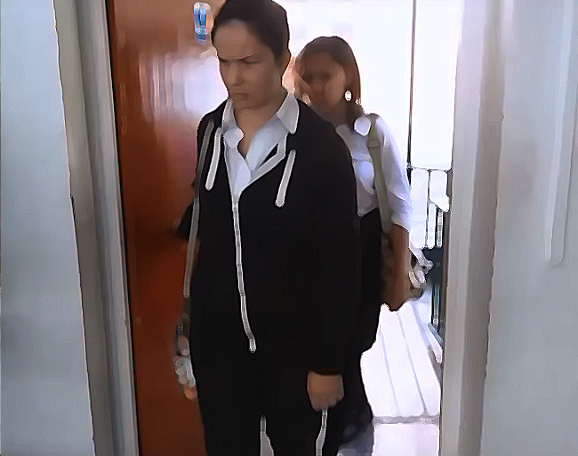
Taking Care of Your Mobile Phone
Oh my goodness!
Notes:
Ask: does Lucy look happy?

Slide 10
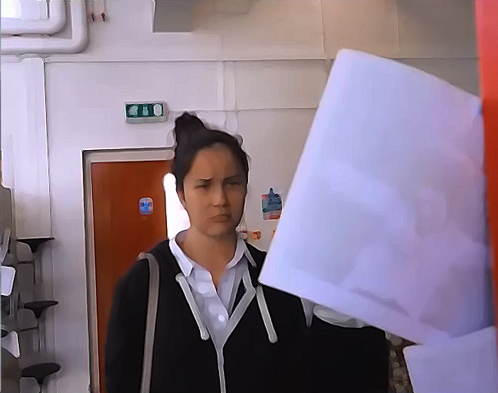
Taking Care of Your Mobile Phone
Oh no! Somebody has printed lots of pictures of me and stuck them round the room!
Notes:
Ask: Why would people do this? Are photos always printed? What else could happen to them?

Slide 11
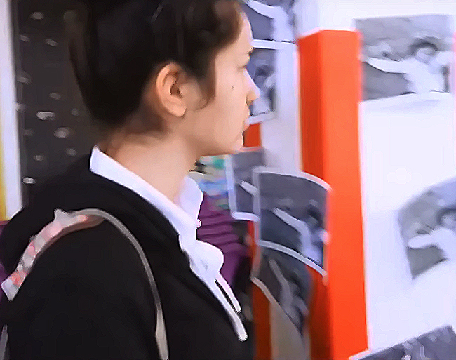
Taking Care of Your Mobile Phone
Your Mobile Phone
They’re everywhere!
Notes:
Ask: What is happening here? How could you stop this happening?

Slide 12
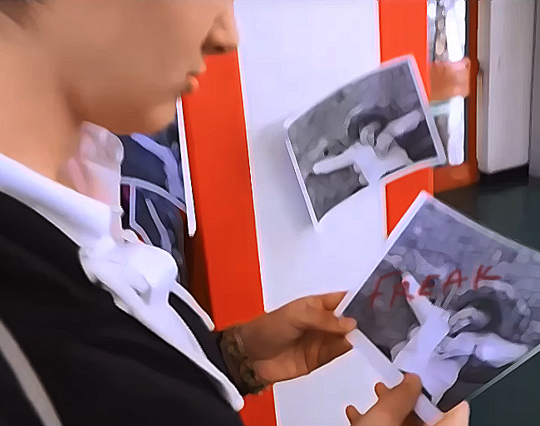
Taking Care of Your Mobile Phone
This is horrible! Someone has written ‘FREAK’ on my photo!
Notes:
Ask: what is happening here? (someone is cyberbullying Lucy – they’ve got hold of her photos and printed private pictures of her.)

Slide 13
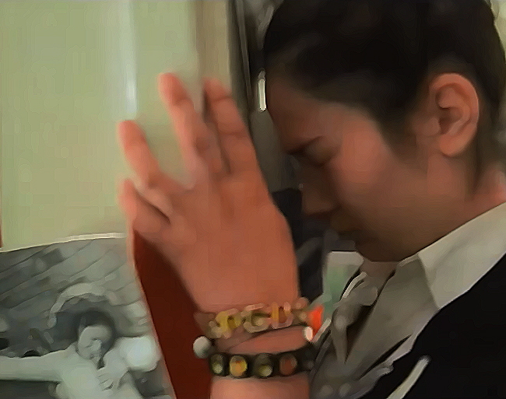
Taking Care of Your Mobile Phone
I can’t believe this is happening! People are going to be laughing at me.
Notes:
Ask: how upset would you feel if this happened to you?

Slide 14
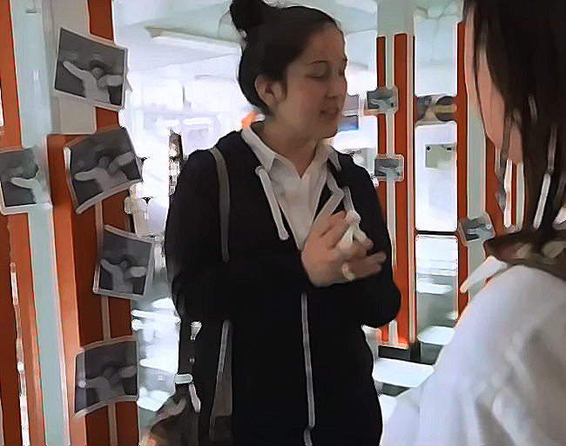
Taking Care of Your Mobile Phone
Help me take down all these photos before all the other kids get here.
Notes:
Ask: Why doesn’t Lucy want anyone else seeing the photos?

Slide 15
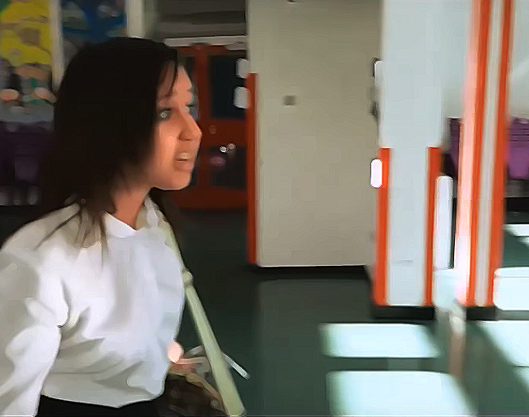
Taking Care of Your Mobile Phone
Lucy - didn’t you say you’ve got your mum’s credit card details saved on your phone?
Notes:
Ask: do you know what credit card details are? Sometimes people have their mum’s credit card details in case they need money in an emergency. But do you think it’s a good idea to save sensitive things like these in your phone? If you do this, how should you protect your phone?

Slide 16
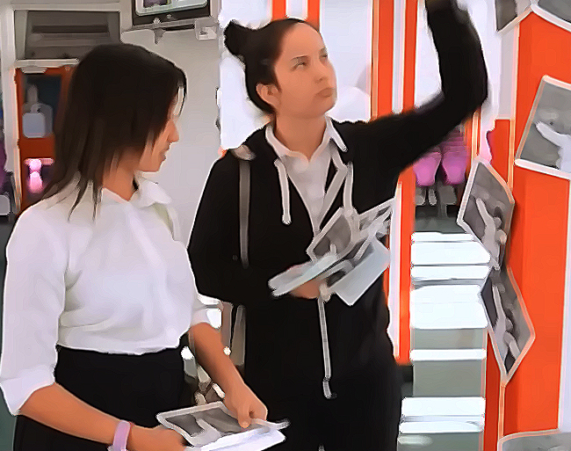
Taking Care of Your Mobile Phone
You realise if they could get your pictures, they could also use your apps, email and messages to send nasty things?
Notes:
Ask: what things do you have on your mobile phone that other people could use?

Slide 17
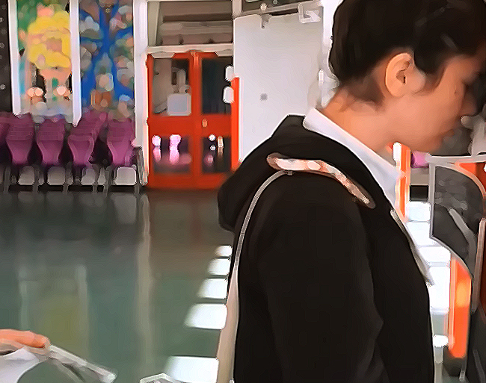
Taking Care of Your Mobile Phone
Oh Izzy! What am I going to do? Mum’s going to kill me!
Notes:
Ask: Would Izzy’s mum really kill her?

Slide 18

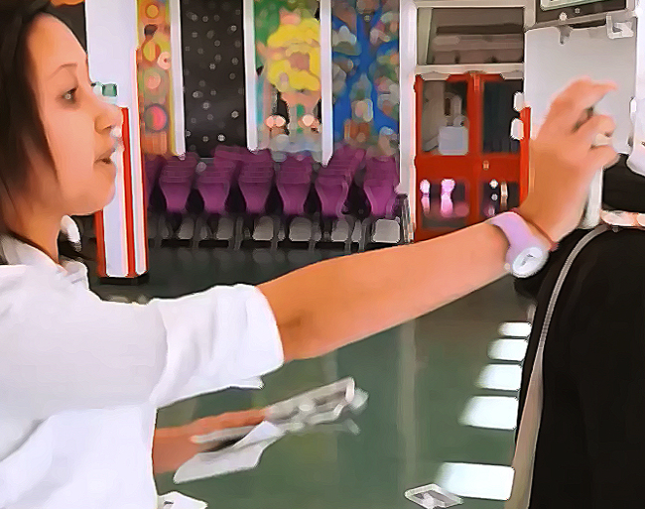
Taking Care of Your Mobile Phone
I know! You can still register your stolen phone with immobilise.com and the police might get it back to you.
When you get your next phone, don’t forget to use a PIN and password. And register your new one with immobilise.com
Notes:
Say: there is a site called immobilise.com where you can register you phone even if it has been stolen. If the police recover it they can get it back to you.

Slide 19
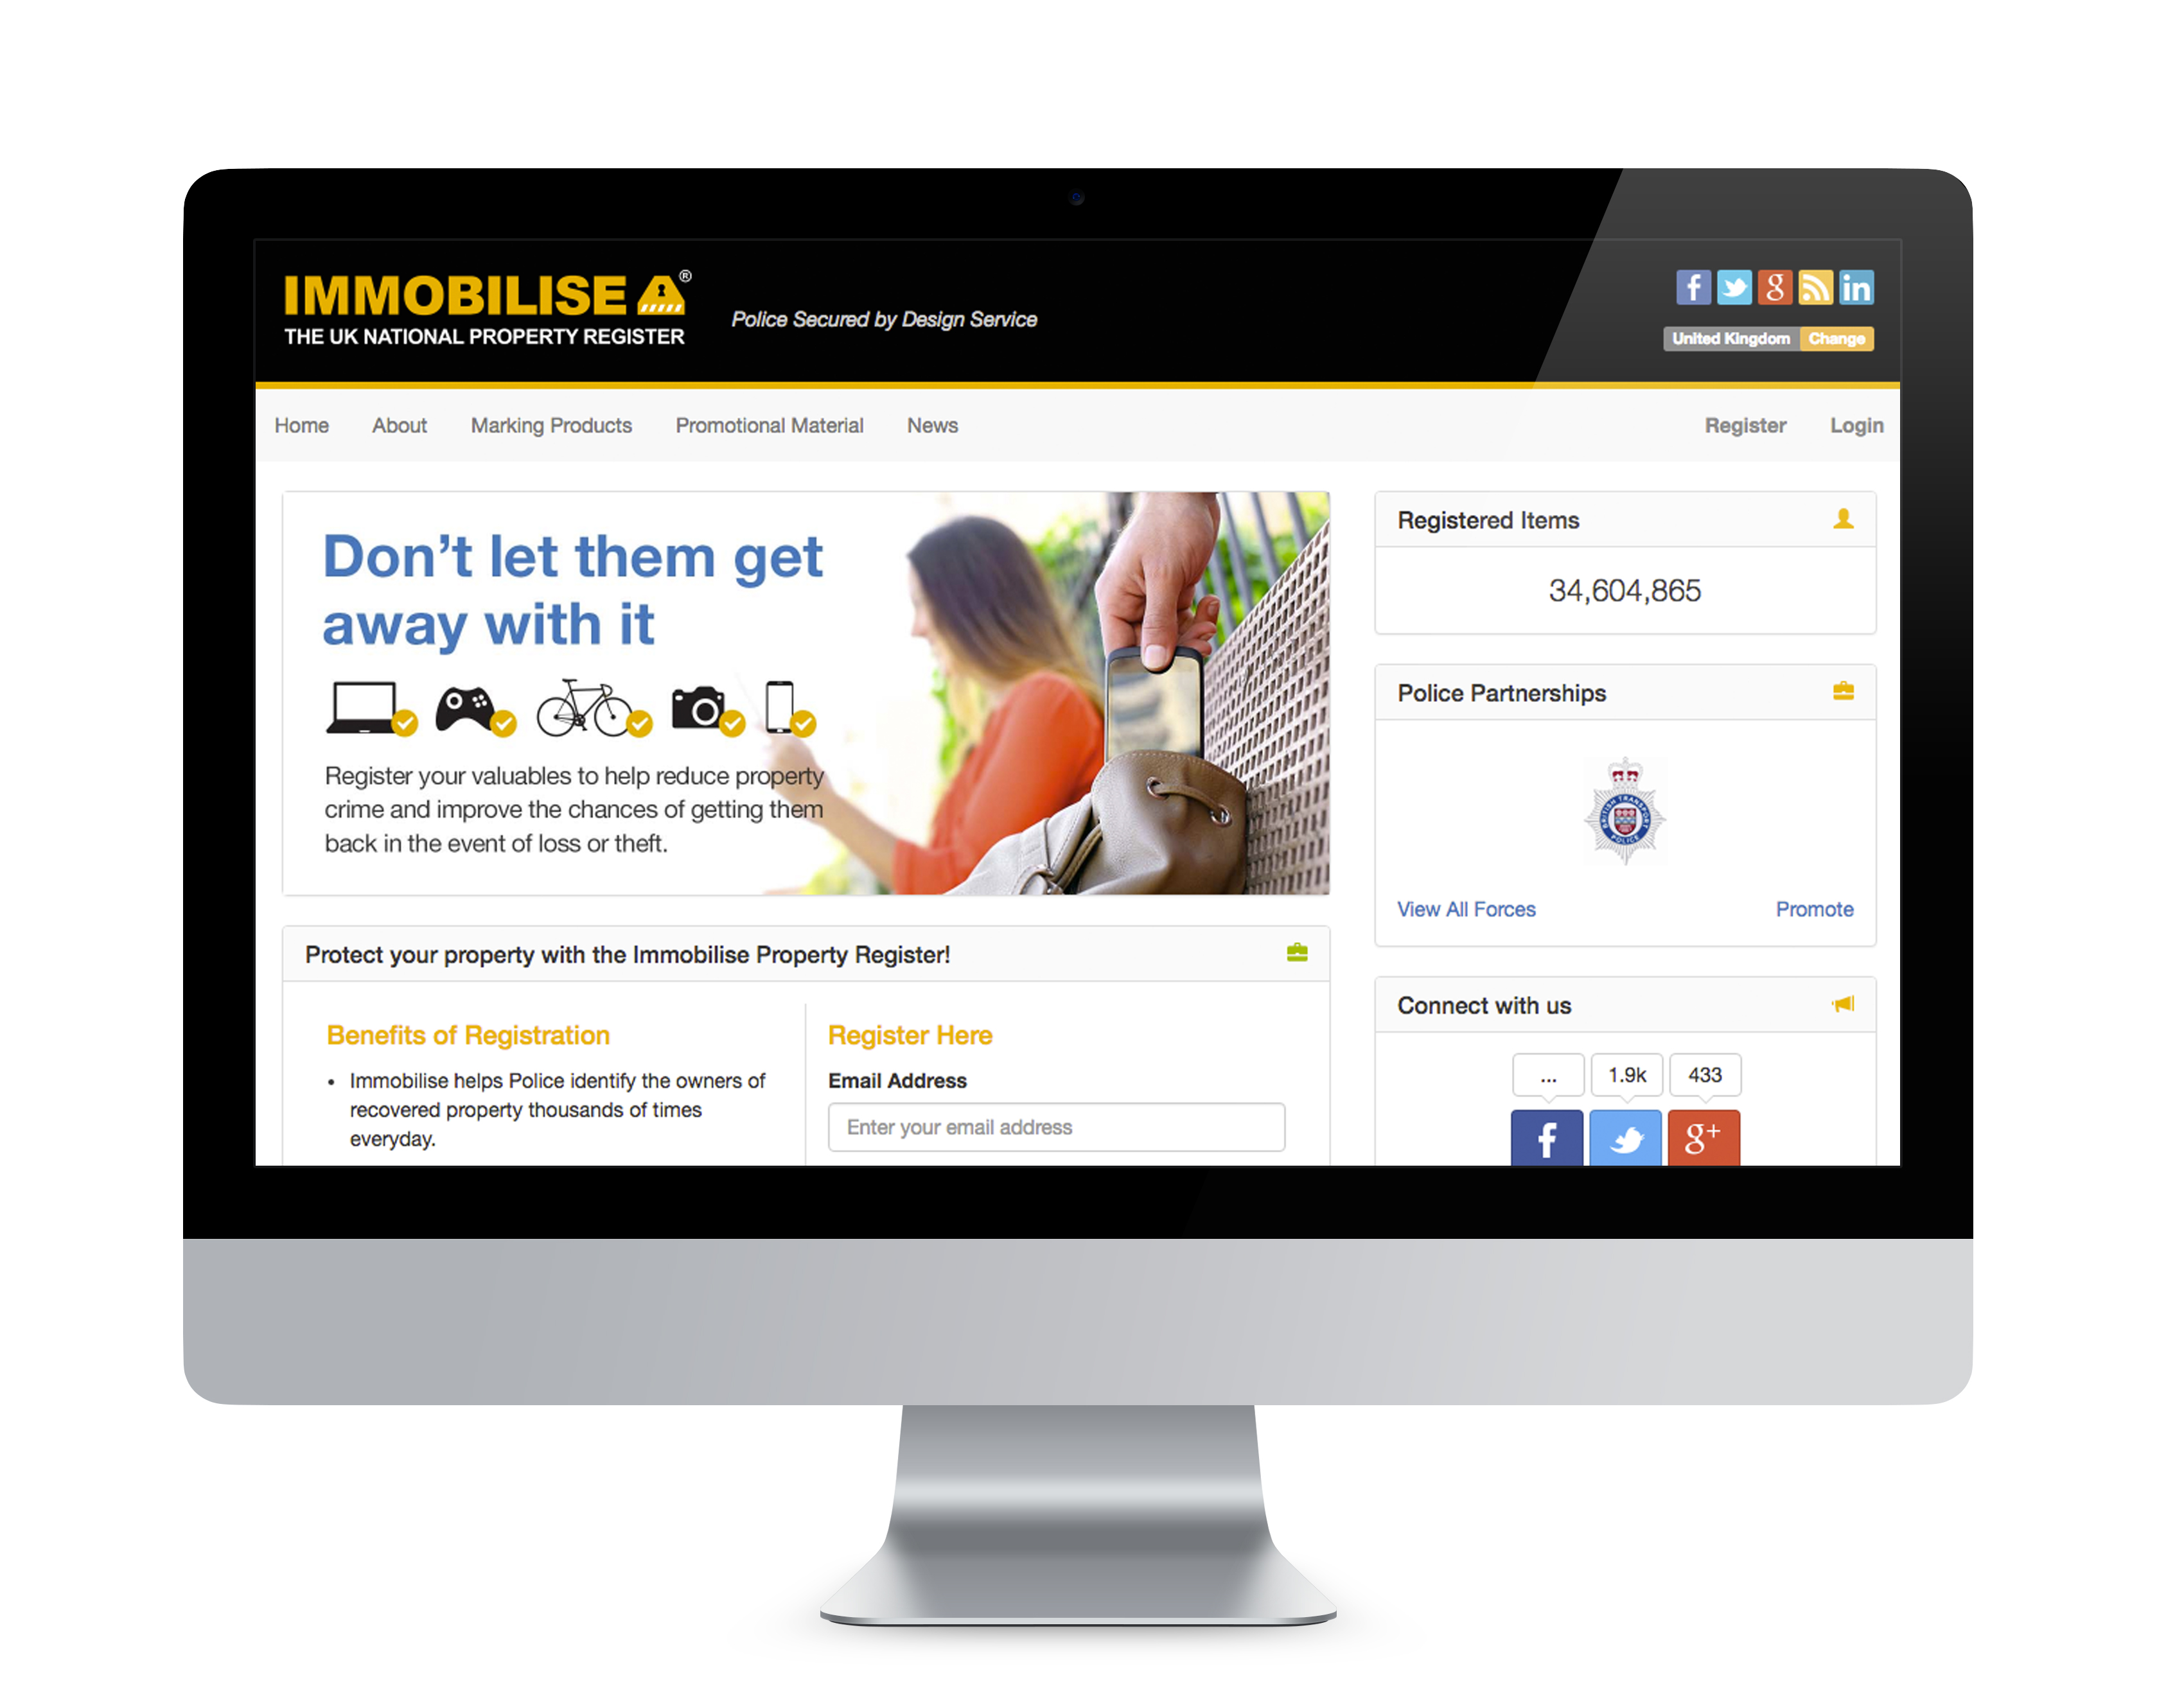
Taking Care of Your Mobile Phone
www.immobilise.com
Notes:
Show the pupils how to register for immobilise – you may need a practice run first. Pupils need their phone’s IMEI number which is on the packaging, or can be found by keying in some numbers as the site shows.

Slide 20


