Slide 1
Notes:
Show the pupils pictures of places where you could use a mobile phone, and ask whether it would be safe or silly, both or neither, to do so. Ask pupils to give their reasons. Some of these have no right or wrong answers as children should be free to use their personal property out and about, but they need to be aware of their surroundings.

Slide 2
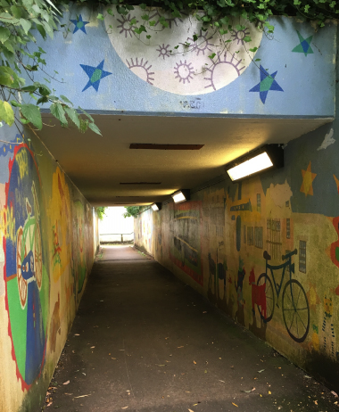
An underpass?
Your Mobile Phone
Notes:
Ask: Safe or silly? Why? (Could be either, but generally it’s better not to use a mobile phone in lonely places)

Slide 3
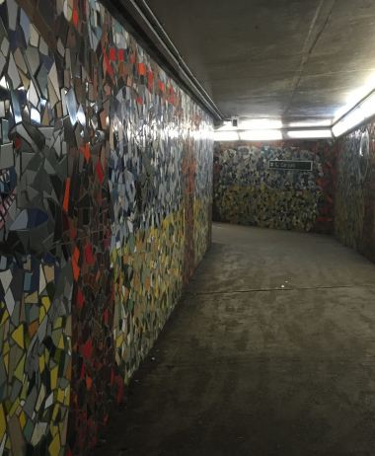
Your Mobile Phone
A tunnel?
Notes:
Ask: Safe or silly? Why? (Could be either, but generally it’s better not to use a mobile phone in lonely places)

Slide 4
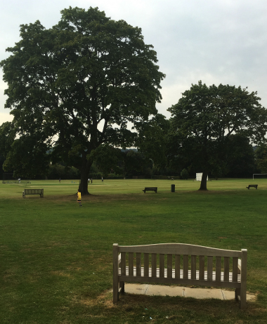
A leafy park?
Your Mobile Phone
Notes:
Ask: Safe or silly? Why? (Could be either, but generally it’s better not to use a mobile phone in lonely places)

Slide 5
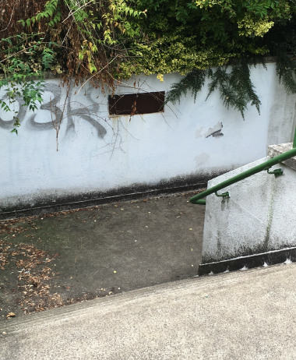
Your Mobile Phone
A lonely back street?
Notes:
Ask: Safe or silly? Why? (Could be either, but generally it’s better not to use a mobile phone in lonely places)

Slide 6
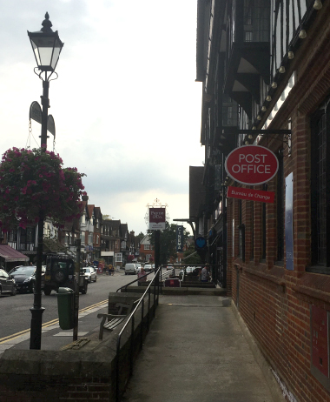
Your Mobile Phone
On the high street?
Notes:
Ask: Safe or silly? Why? (Could be either, but generally it’s better not to use a mobile phone in lonely places)

Slide 7
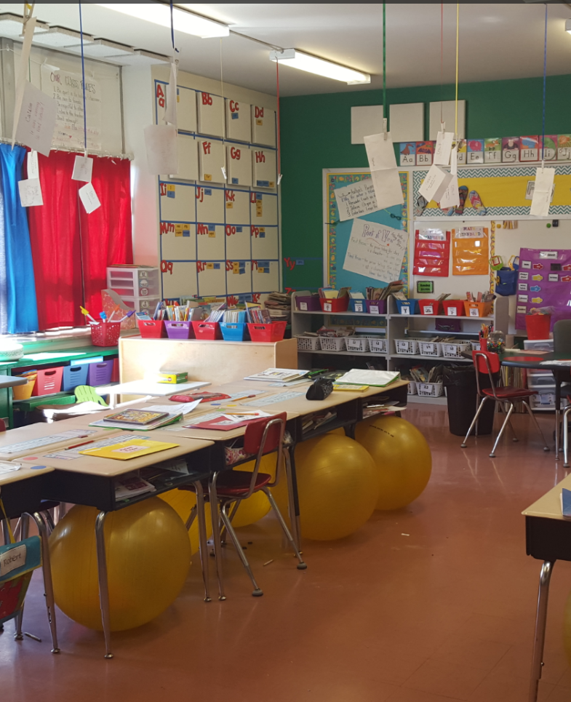
Your Mobile Phone
At school?
Notes:
Ask: Safe or silly? Why? (You should not use a mobile phone at school unless a teacher has specifically asked you.)

Slide 8
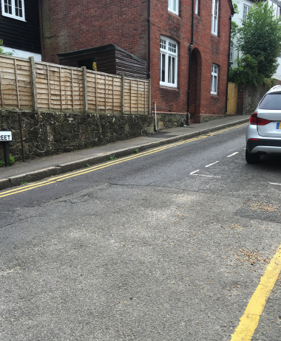
Your Mobile Phone
Crossing the road?
Notes:
Ask: Safe or silly? Why? (Very unsafe to use a mobile while crossing the road)

Slide 9
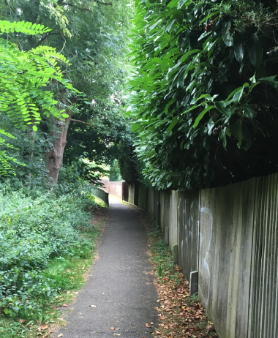
Your Mobile Phone
In a side street or alley?
Notes:
Ask: Safe or silly? Why? (Could be either, but generally it’s better not to use a mobile phone in lonely places)

Slide 10
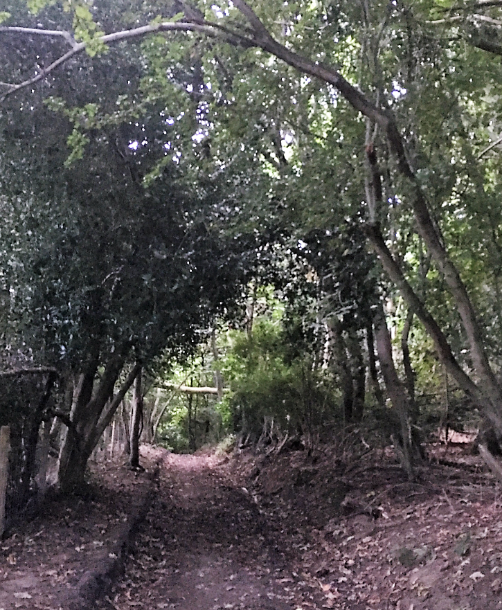
Your Mobile Phone
In the woods?
Notes:
Ask: Safe or silly? Why? (Could be either, but generally it’s better not to use a mobile phone in lonely places)

Slide 11
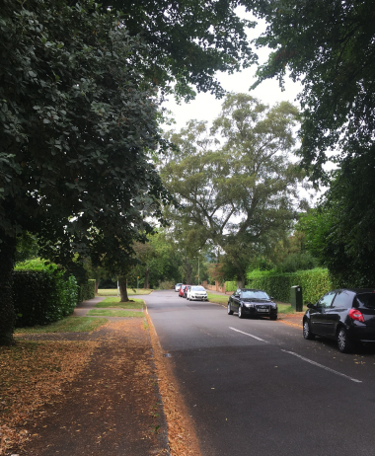
Your Mobile Phone
On a quiet road?
Notes:
Ask: Safe or silly? Why? (Could be either, but generally it’s better not to use a mobile phone in lonely places)

Slide 12
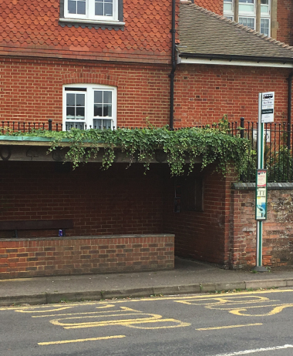
Your Mobile Phone
At a bus stop?
Notes:
Ask: Safe or silly? Why? (Could be either, but generally it’s better not to use a mobile phone in lonely places)

Slide 13
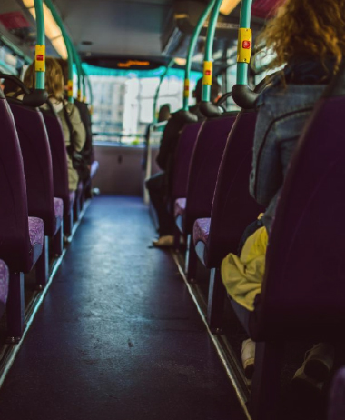
Your Mobile Phone
On a bus?
Notes:
Ask: Safe or silly? Why? (Could be either, but generally it’s OK to use a mobile phone on a bus to text, but don’t annoy other passengers!)

Slide 14
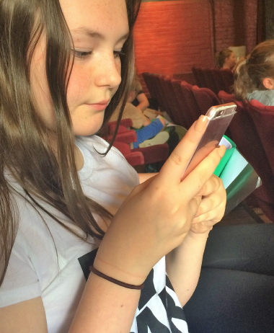
Your Mobile Phone
In a theatre or cinema?
Notes:
Ask: Safe or silly? Why? (You shouldn’t use a mobile phone in the theatre or cinema)

Slide 15
Your Mobile Phone
If you play Pokémon Go…
It’s safest to play Pokémon Go with a friend or friends, or your family. Let someone know where you are going and don’t be out late.
Make sure you are aware of surrounding at all times when playing, and look where you are going.
Make sure your username doesn’t identify you. Although you cannot chat on Pokémon Go, usernames appear if you are in a ‘gym’. As you need to be physically near a gym to battle, it’s best that those around you cannot identify you.
Be very cautious of ‘Pokestops’ and ‘lures’. A ‘lure’ is an item people can set up to lure Pokémon to a location. Anyone can go there saying they’re catching Pokémon.
Be aware that apps may also access to your personal information and other things on your phone, such as your location and camera.
There are in-app purchases, so don’t forget ask your parents/carers if you can make purchases, before you make them.
Notes:
Talk to the pupils about Pokémon Go – CEOP have issued these guidelines on its use as it’s considered a risk if children are unaware of the dangers. You can delete this slide when the Pokémon Go craze ends.

Slide 16


