Slide 1
LI:To be able to write a simple sentence SC:I can write a sentence with a cap letter, finger space and full stop. I can write using the sounds including digraphs that I know.

Slide 2


Slide 3

https://www.youtube.com/watch?v=3CCOWHa-qfc

Slide 4
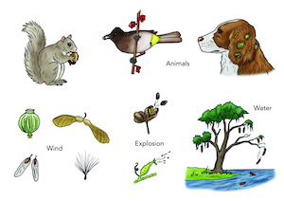

Slide 5


Slide 6
LI:To be able to write a diary/recount of planting a seed SC:I can write a sentence with a cap letter, finger space and full stop. I can write using the sounds including digraphs that I know.

Slide 7

What is this?
Can we find one ?

