Slide 1
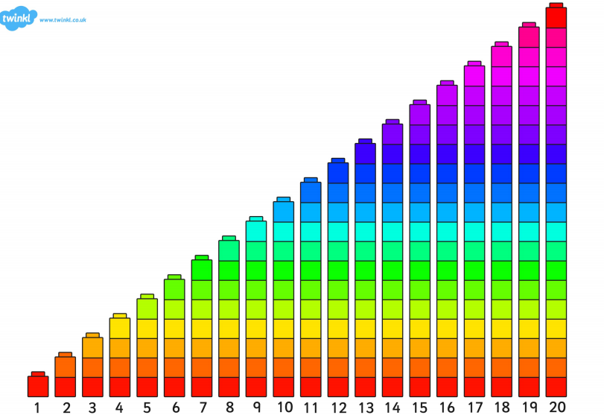

Slide 2
LI: to be able to count in 2s SC: I can count in 2s

Slide 3
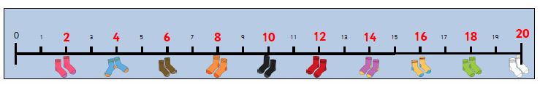

Slide 4


Slide 6
LI: to know be able to count in 2s SC: I can count in 2s

Slide 7


Slide 8
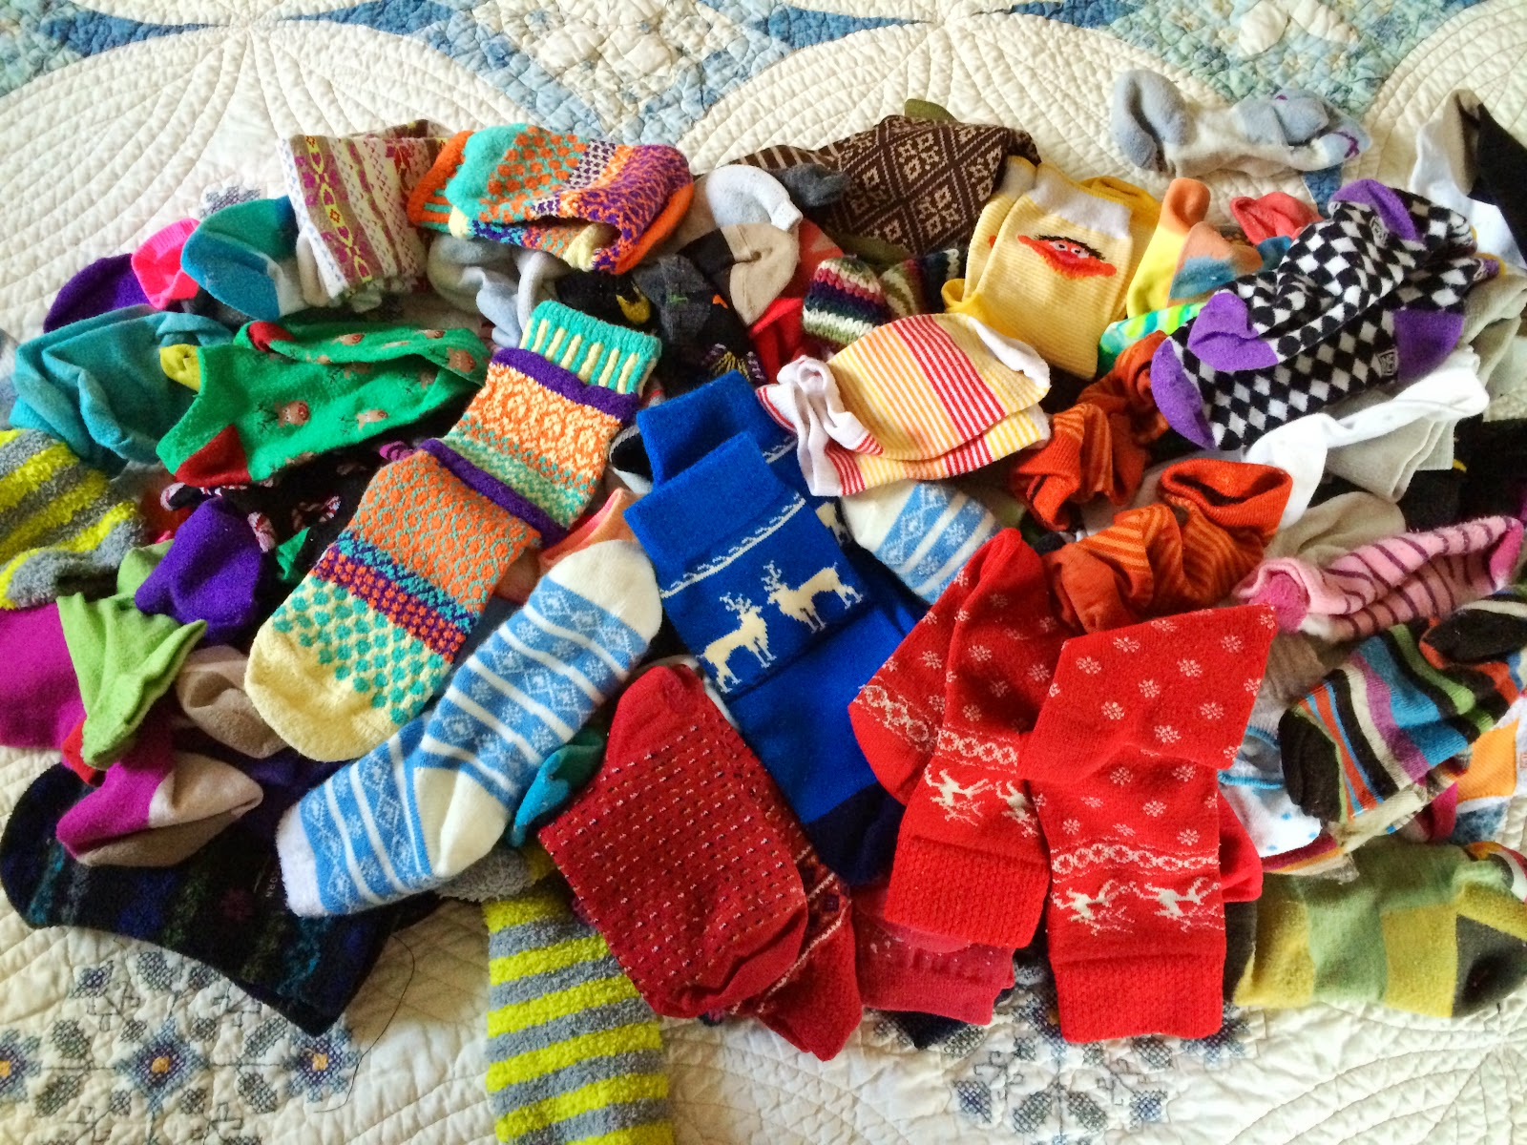

Slide 9


