Slide 1
LI:To be able to sequence an order of events. To write captions in order SC:I can remember the sequence of events. I can write a simple caption to explain what is happening.

Slide 2
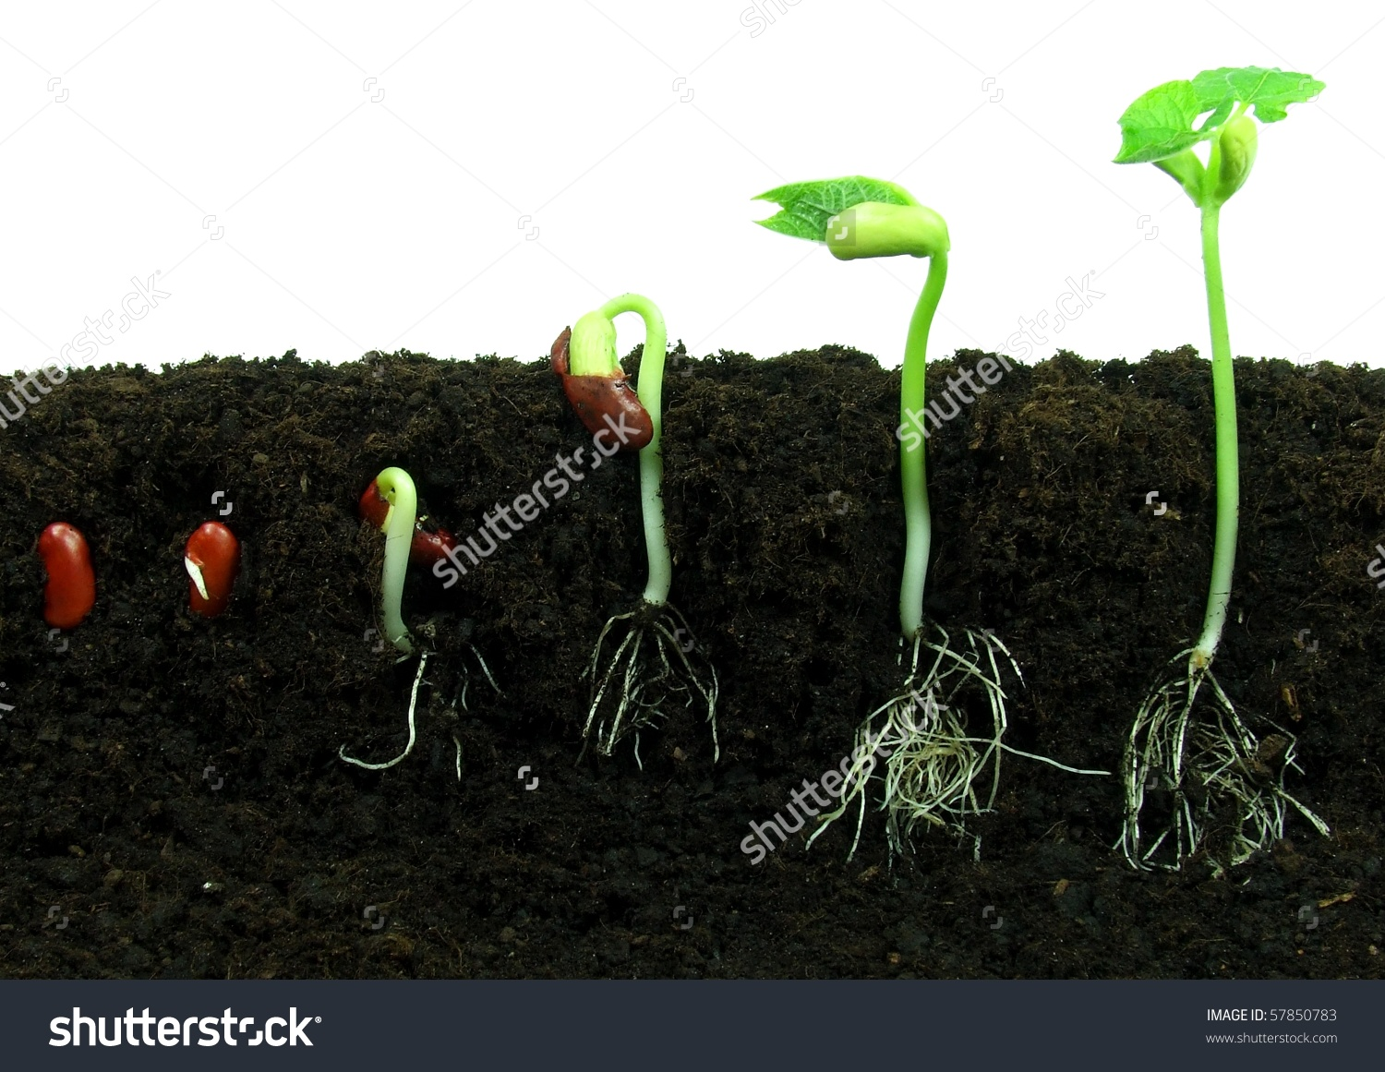

Slide 3


Slide 4
LI:To be able to sequence an order of events. To write captions in order SC:I can remember the sequence of events. I can write a simple caption to explain what is happening.

Slide 5
rain
sun
soil
grow
water
seed

