Slide 1
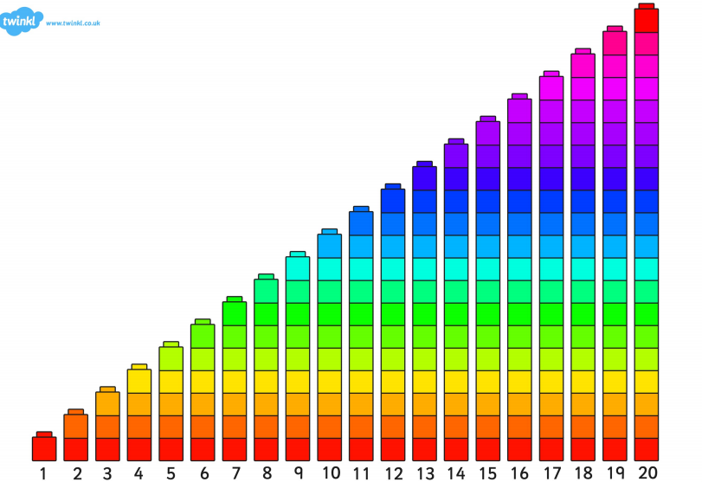

Slide 2
LI: to know be able to double a given number to 10 SC: I can double numbers to 10

Slide 3



Slide 4


