Slide 1
LI: To be able count to 10/20 and to order numbers correctly SC: I can count and order numbers from 1-10/20

Slide 2
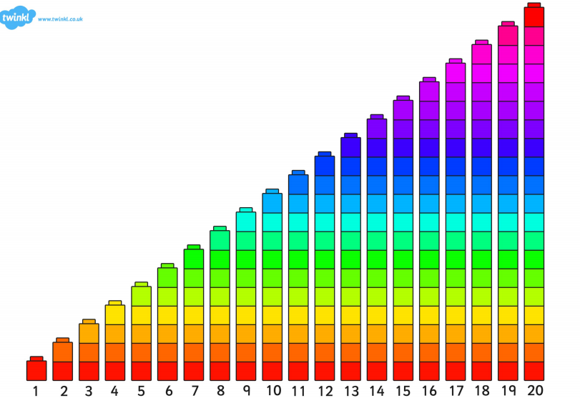

Slide 3
LI: to be able to make a symmetrical pattern. SC: I can use words related to symmetry and make a symmetrical pattern

Slide 4


Slide 5
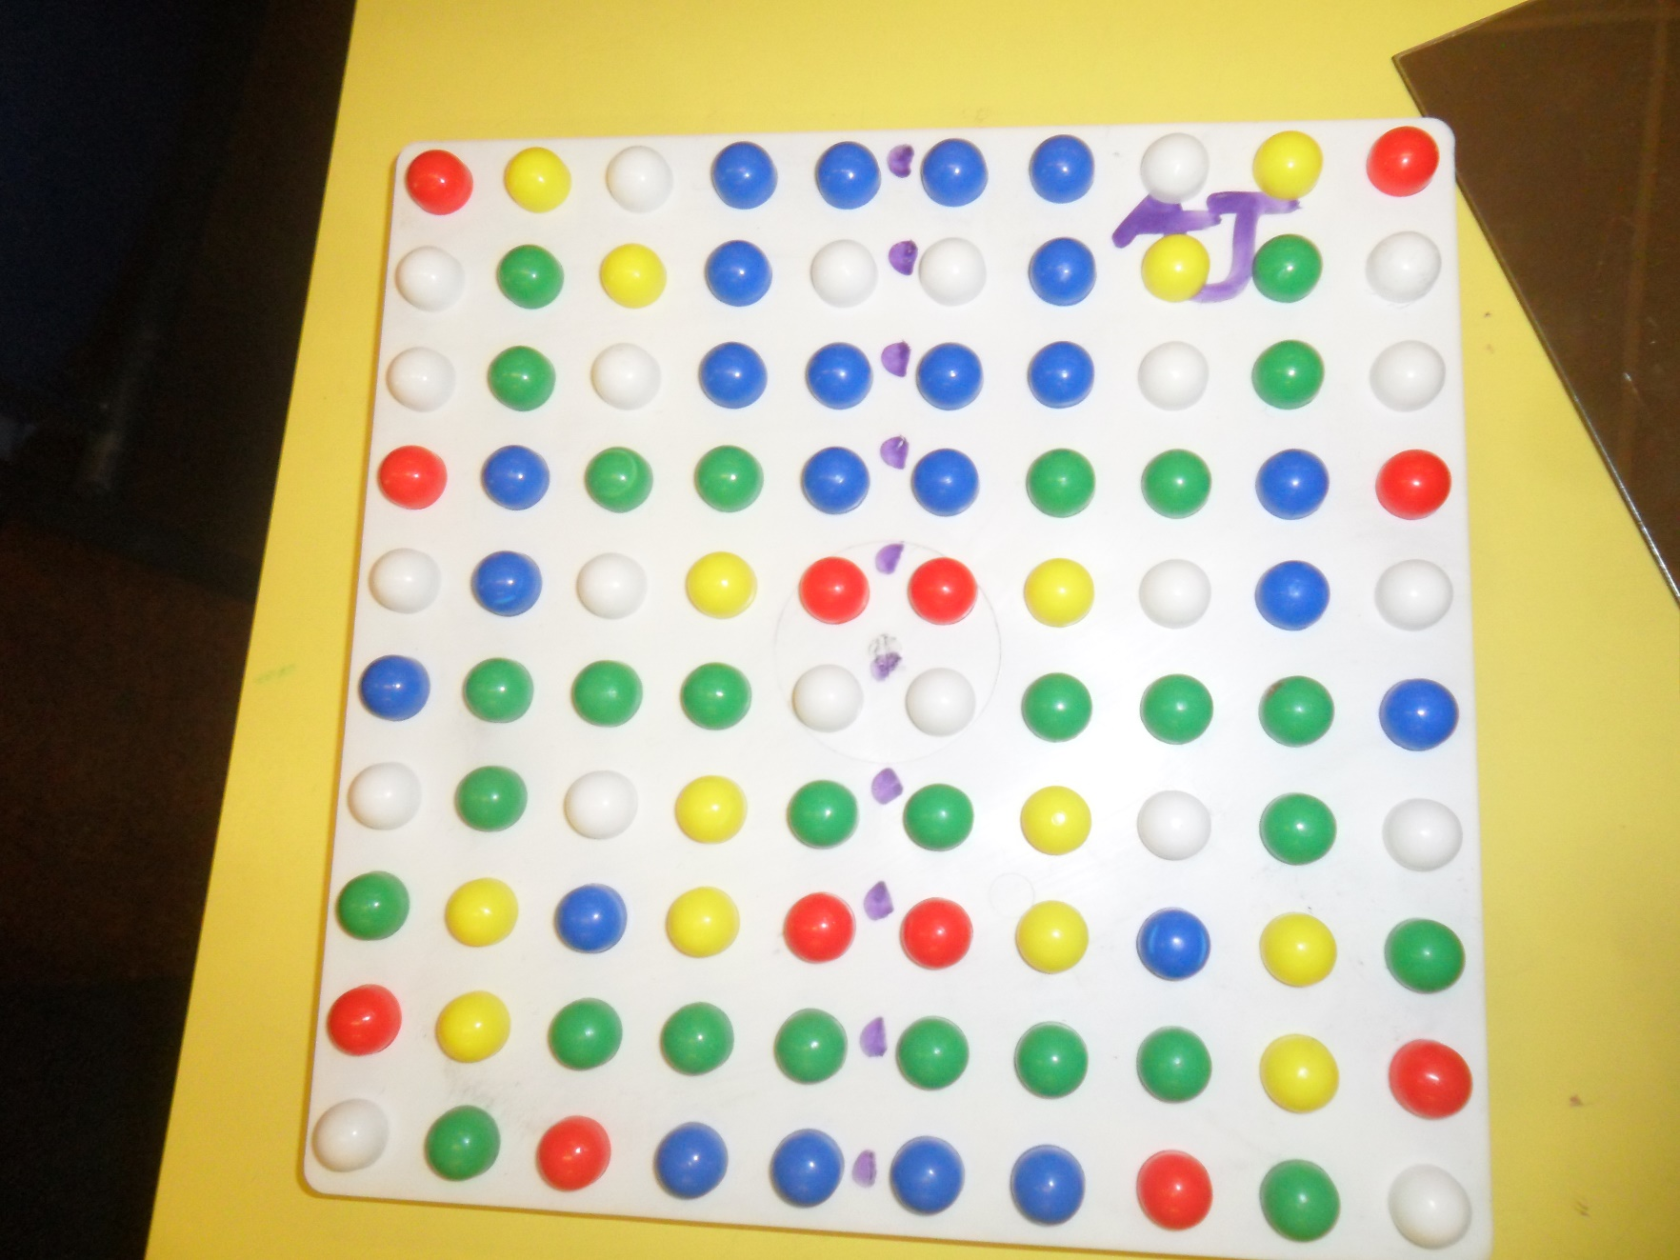

Slide 6


Slide 7
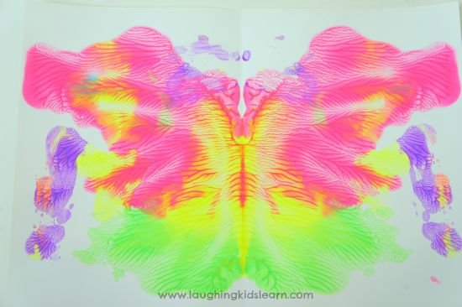

Slide 8


