Slide 1
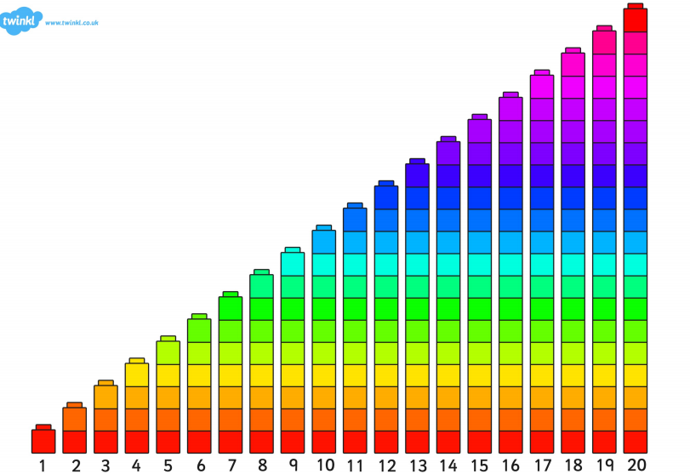

Slide 2
LI: to know simple 3D shapes by name and properties.. SC: I can say the names of 3D shapes . I can find shapes in the environment. I know some of the properties of 3D shapes.

Slide 3
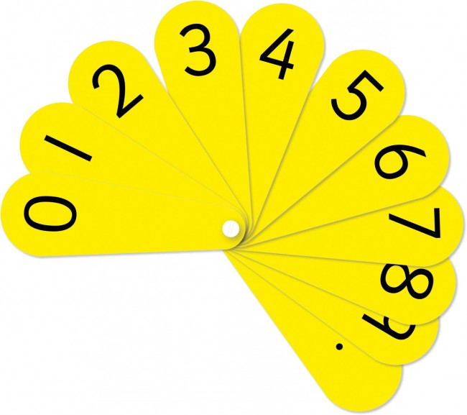

Slide 4
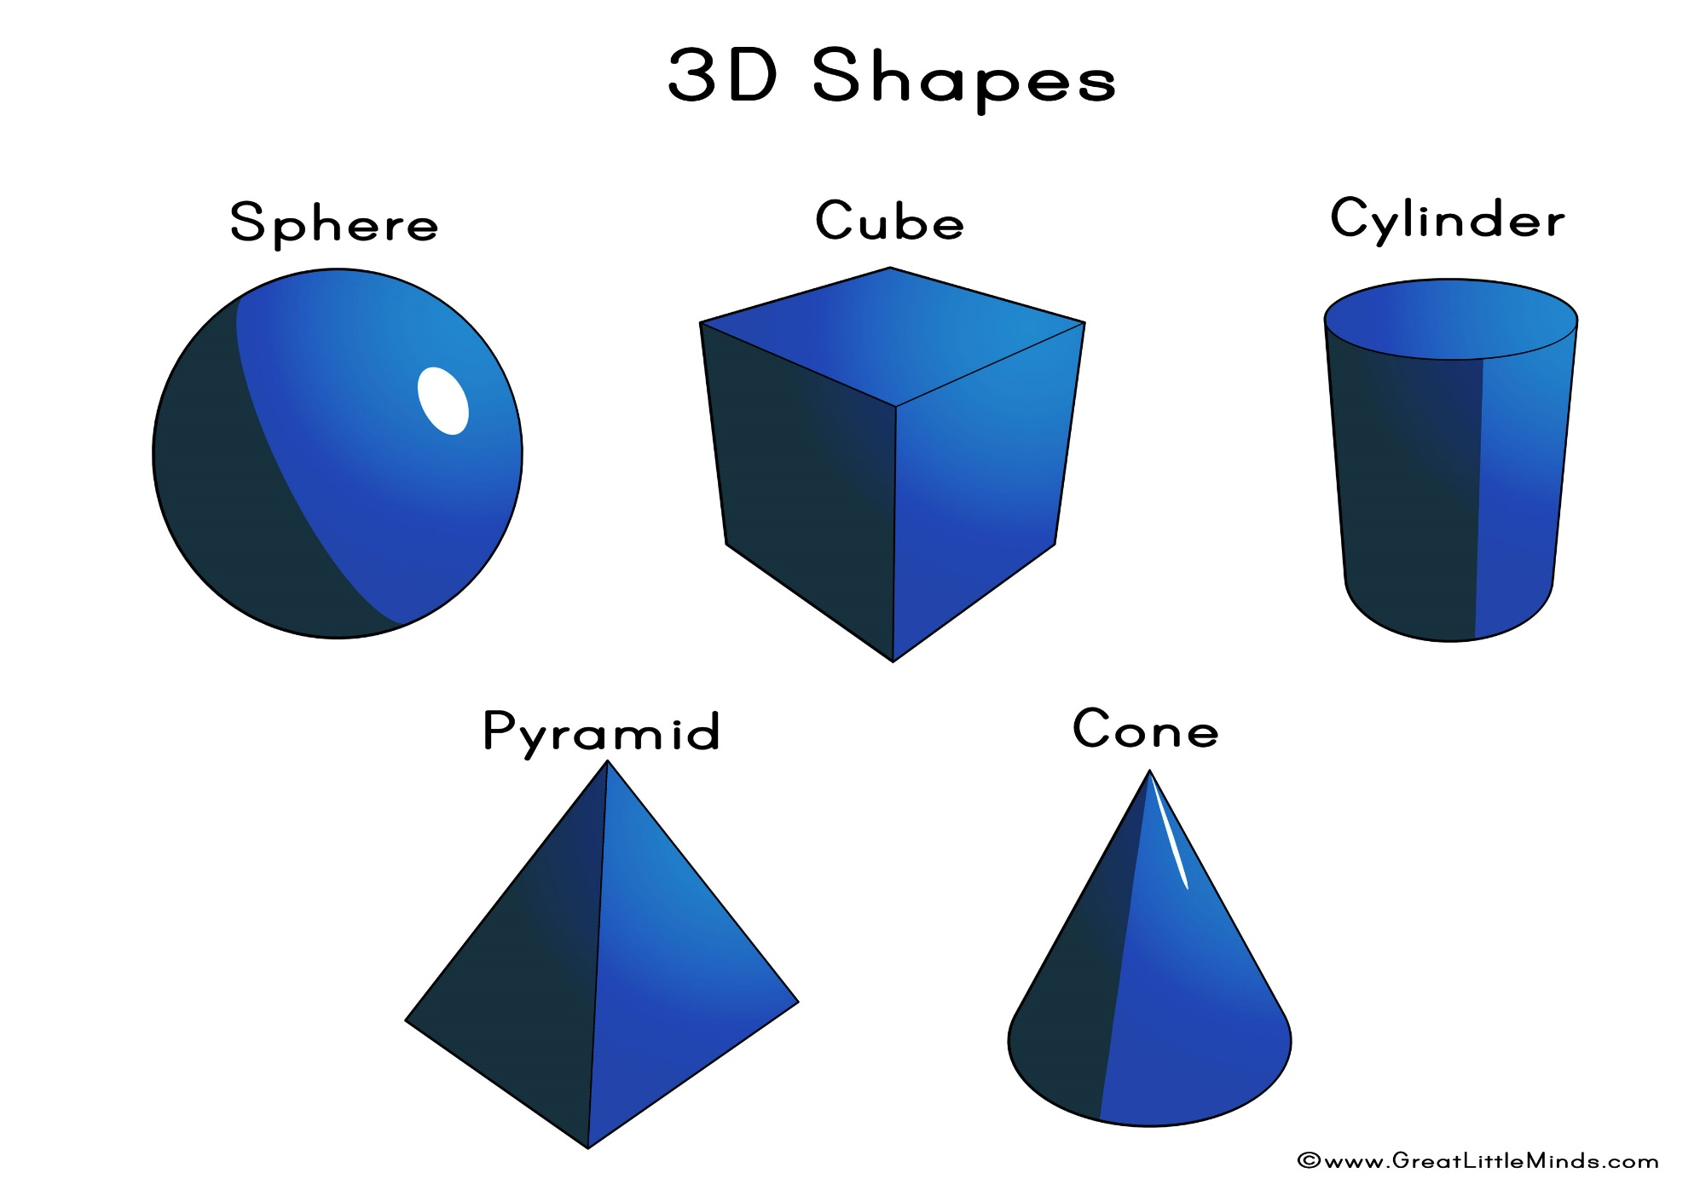

Slide 5
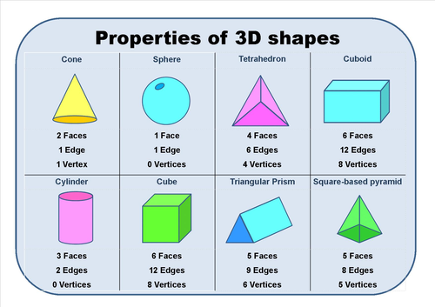

Slide 6


Slide 8
LI: To be able count to 10/20 and to order numbers correctly SC: I can count and order numbers from 1-10/20

Slide 10


