Slide 1
LI To be able to read sentences and write words containing ure SC: I can read and write using ure LO: To be able to match the letter to the sound heard SC: I can match the letter to the sound heard.

Slide 2

Sound Bingo
ure
picture

Slide 3
cure pure picture manure sure

Slide 4
I am sure the mixture is pure. What is the cure?

Slide 5


Slide 6
LI: To be able to read ccvc words SC: I can read ccvc words LI: To be able identify ch, sh, th, ng, qu, SC: I identify ch sh th ng qu

Slide 7

Blockbusters

Slide 9
LI: To be able to read cvc/ccvc words and identify which is pseudo SC: I can read cvc/ccvc words and know which is a pseudo word

Slide 10


Slide 12
Can you read the tricky words on the next two slides?

Slide 13
I no go to the into

Slide 14
he me be we she my you are her was all they my

Slide 16




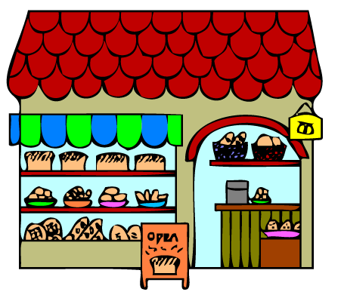
Look at the pictures, write down the words.

Slide 17
Can you read the sentences?
Is a ship wet?
Can a fish hop?
Can a shop sell a bag?

