Slide 1
LI: To be able to read ccvc words SC: I can read ccvc words LI: To be able identify ch, sh, th, ng, qu, SC: I identify ch sh th ng qu

Slide 2

Blockbusters

Slide 3


Slide 4
LI: Tobe able to read cvc/ccvc words and identify which is psuedo SC: I can read cvc/ccvc words and know which is a pseudo work

Slide 5


Slide 8
I no go to the into

Slide 12




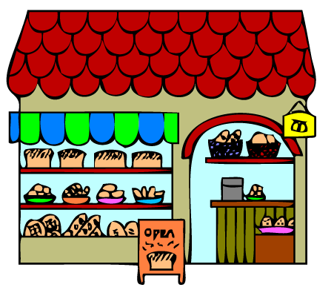

Slide 13
Is a ship wet?
Can a fish hop?
Can a shop sell a bag?

Slide 15
LI: To be able to identify the ‘qu’ sound SC: I can recognise the ‘qu’ sound.

Slide 16

i

Slide 18
LI: To recognise/ read phase 2/3 tricky words, and HF words taught SC: I can read the above phase 2 /3words. I know all of the phonemes learnt so far.

