Slide 1
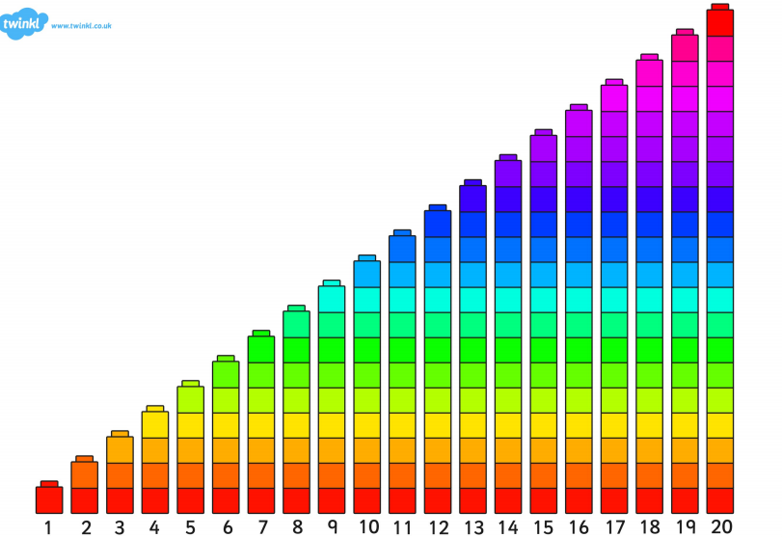

Slide 2
LI: To be able count to 10/20 and to order numbers correctly SC: I can count and order numbers from 1-10/20

Slide 3
1 2 __ 4 5 __ 7
5 __ 7

Slide 4


Slide 6
LI: To be able count to 10/20 and to order numbers correctly SC: I can count and order numbers from 1-10/20

Slide 7
5 __ 7 8 __ 10
9 10 __ 12 13 __
20 __ 18 __ 16 15 14 __

