Slide 1
LI: I can add two numbers together to make a given number SC: I can recall and add different numbers to make a given number

Slide 2
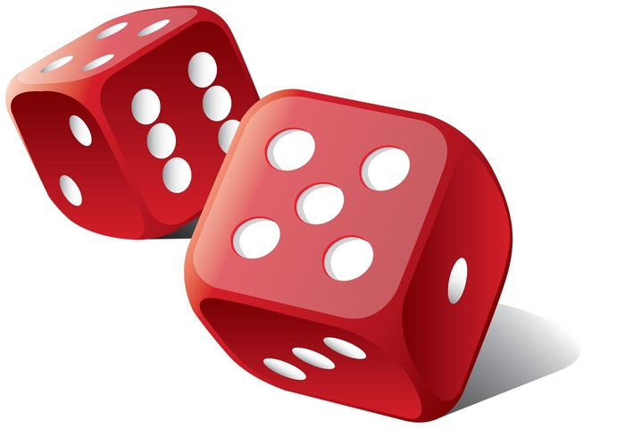

Slide 3
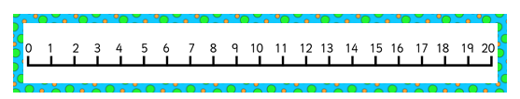
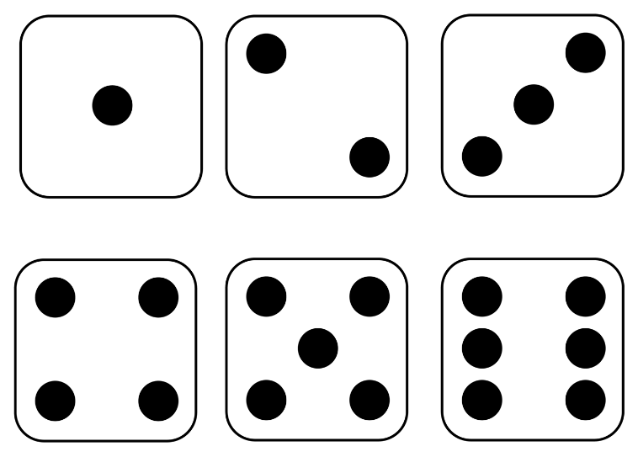

Slide 4
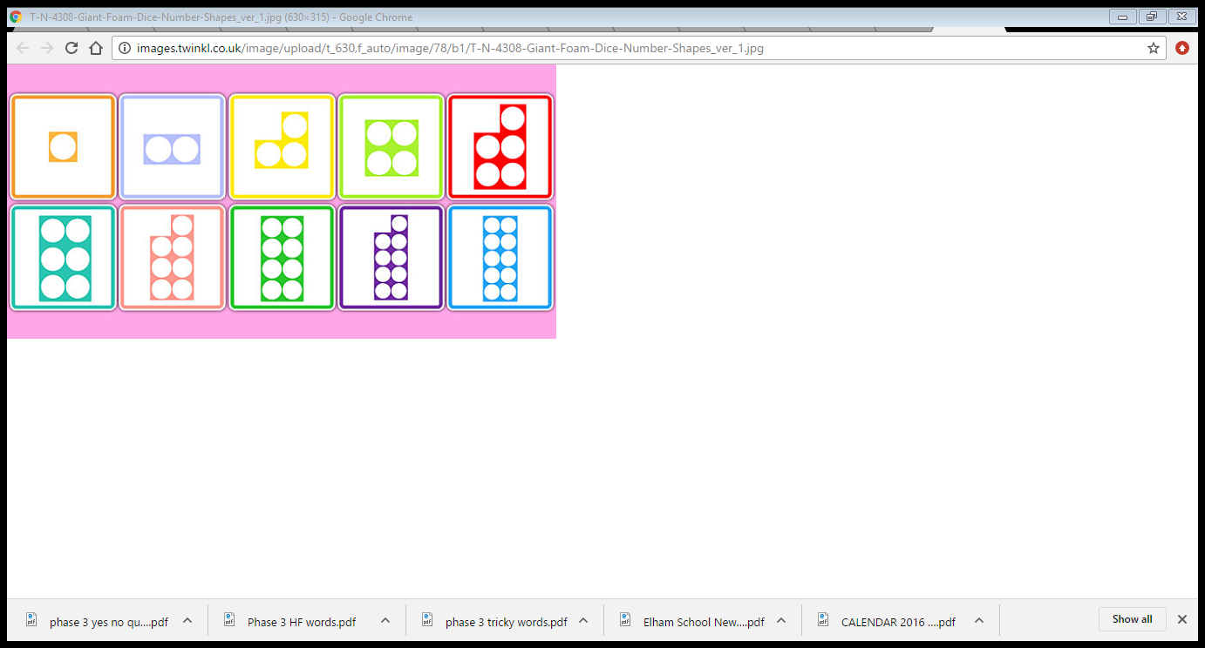

Slide 5


Slide 6
LI: I can add two numbers together to make a given number SC: I can recall and add different numbers to make a given number

Slide 10


